Slide 1


Introducing the
National Zoning Atlas
Housing Affordability: Permitting & Zoning Solutions Roundtable | December 2025

Slide 2
The NZA is digitizing critical information about zoning codes in 33,000+ jurisdictions in the US.

Slide 3
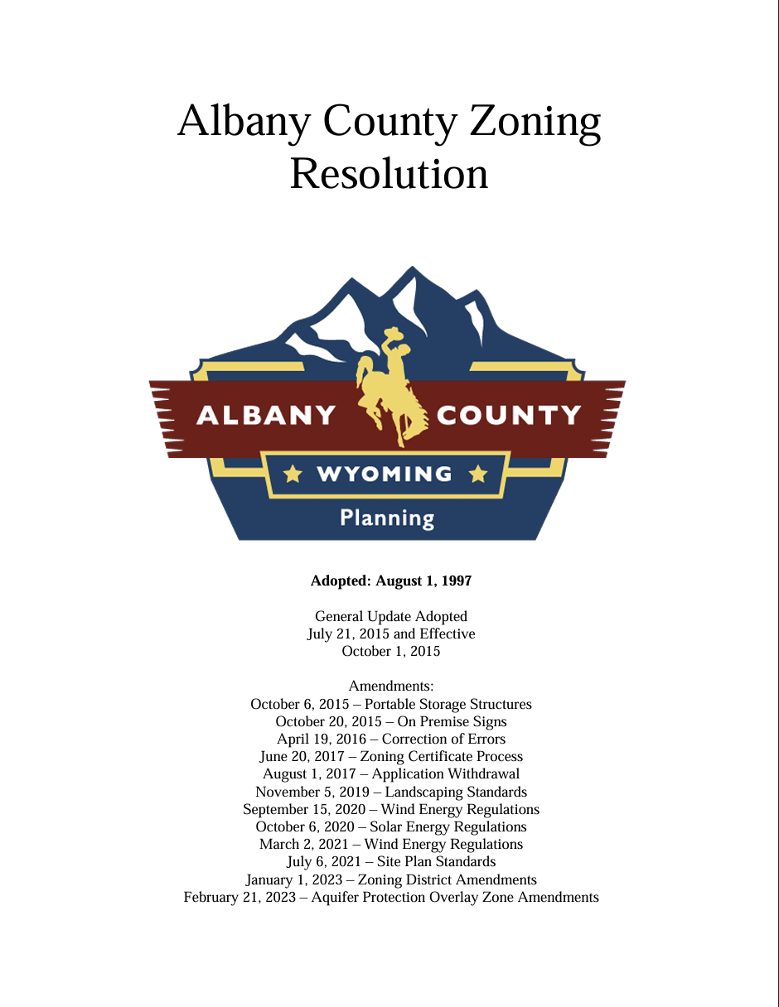
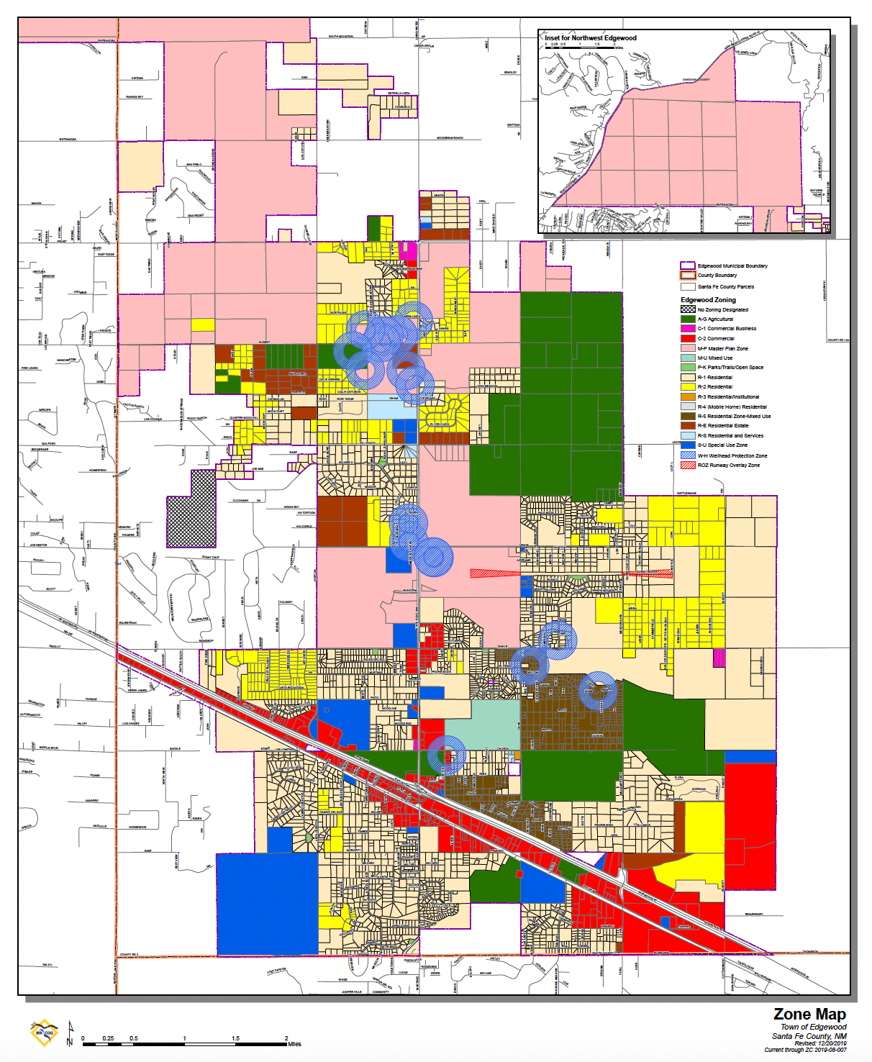

We Analyze Text + Maps
Zoning Text
Zoning Map
Notes:
Albany County WY, Edgewood NY

Slide 4
We create geometries for, and assign 200 data points to, zoning districts, using standard methods.

Slide 5
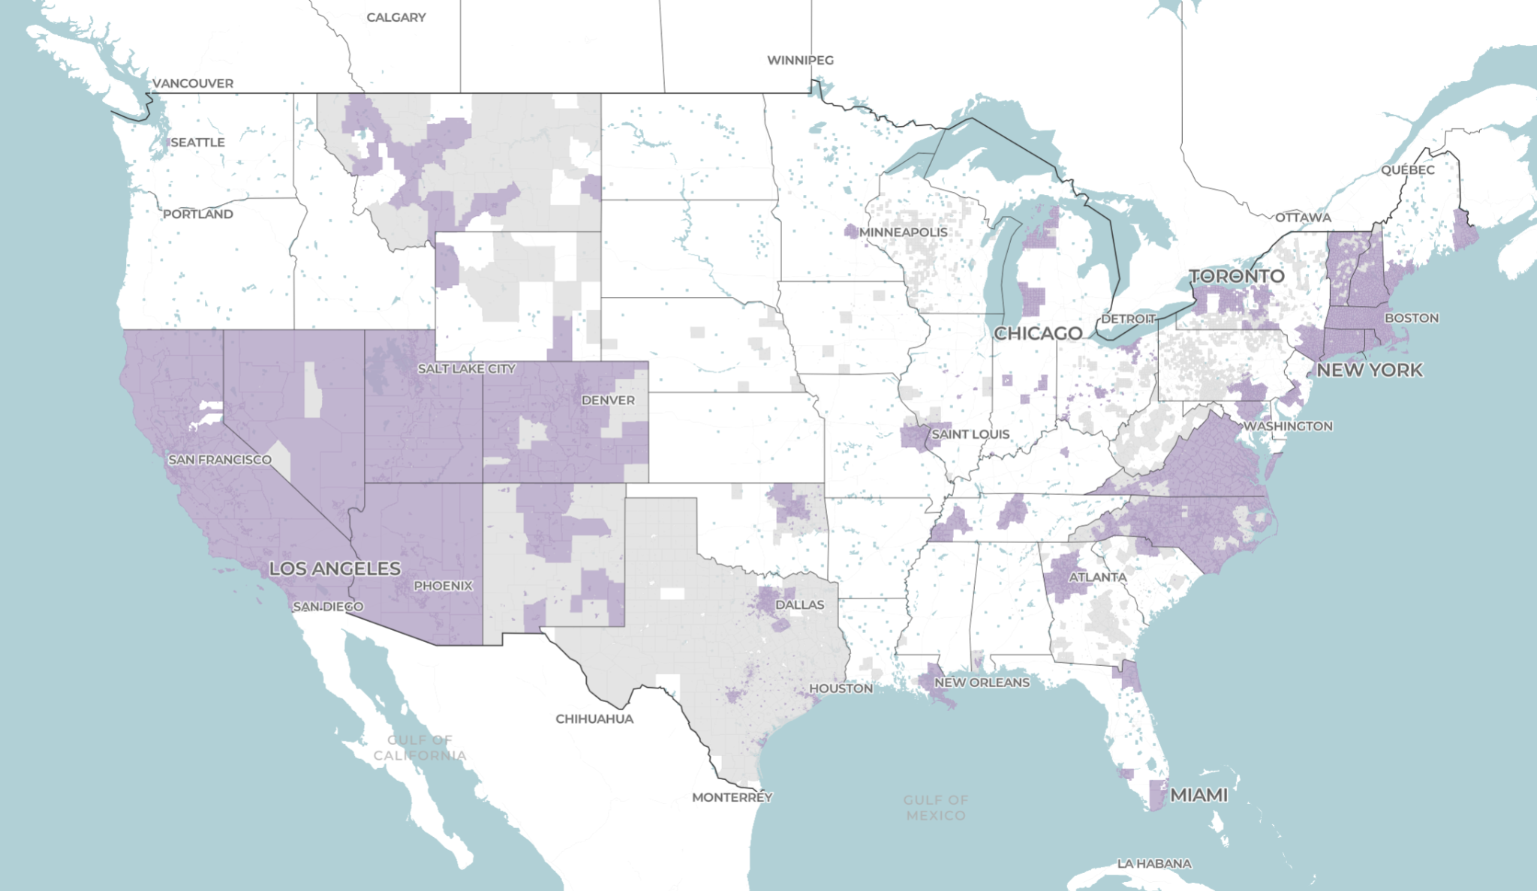
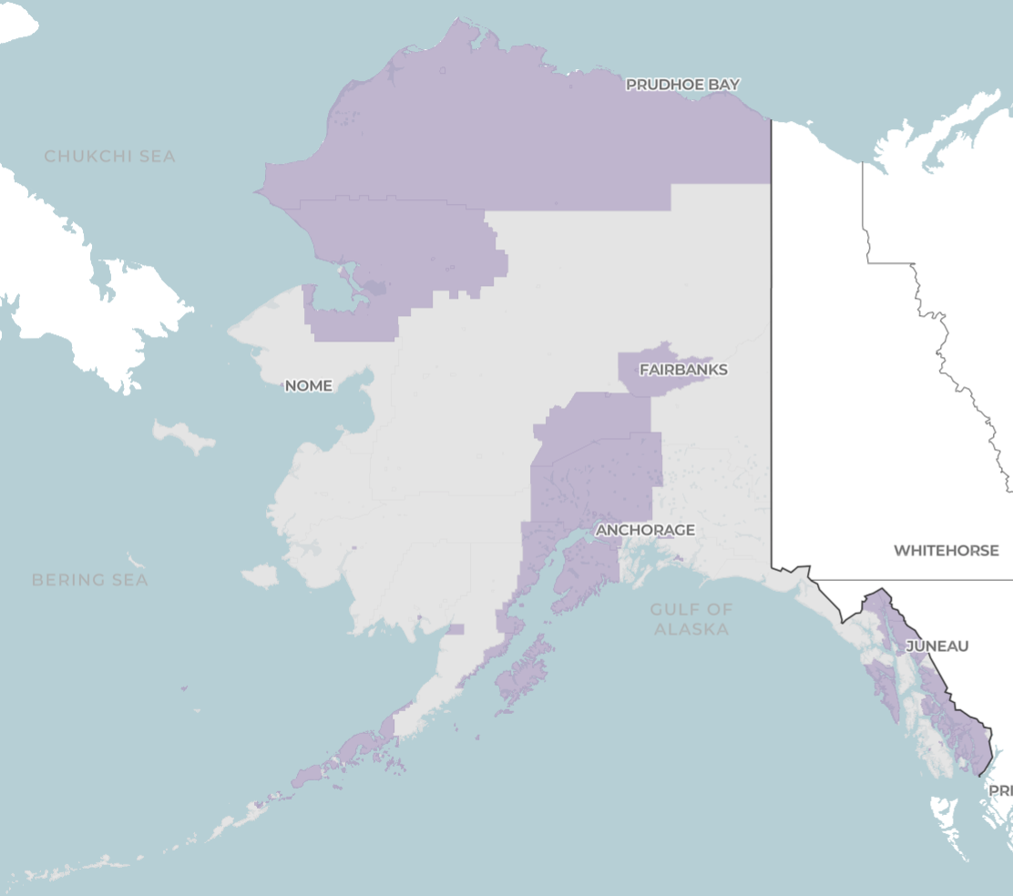
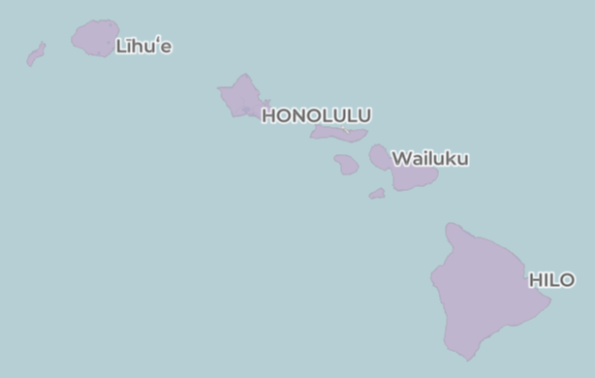
zoningatlas.org/atlas
VT
NH
MA
NV
UT
CT
RI
CO
VA
CA
DC
NC
AZ
NM
AK
HI

Slide 6
Progress to Date:
Published Jurisdictions:
8,900+
Population Covered
54%
With Zoning: 5,800+
Pages of Code:
1,033,000+
Without Zoning: 3,000+
as of 12/3/2025

Slide 7
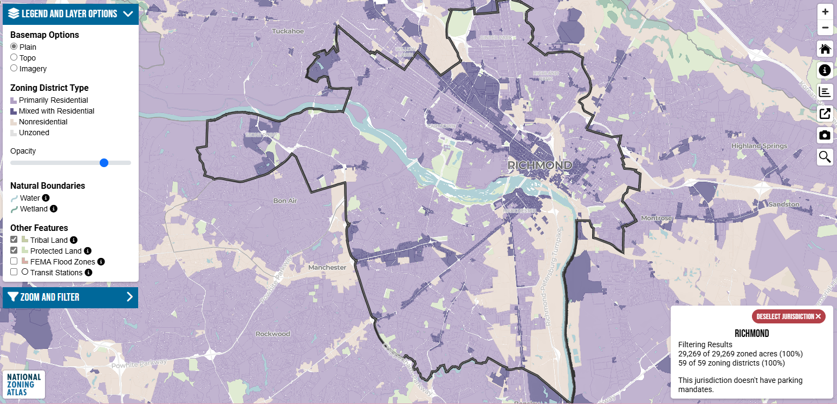

Slide 8
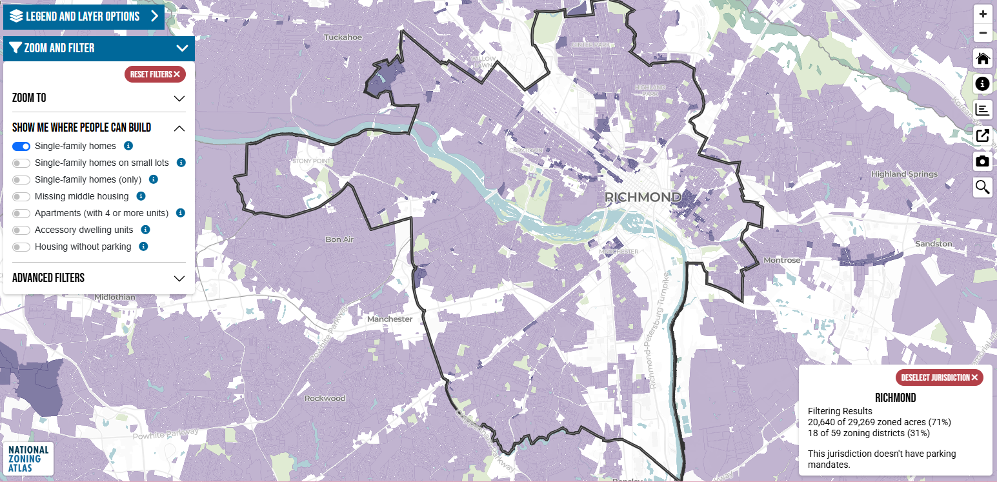

Slide 9
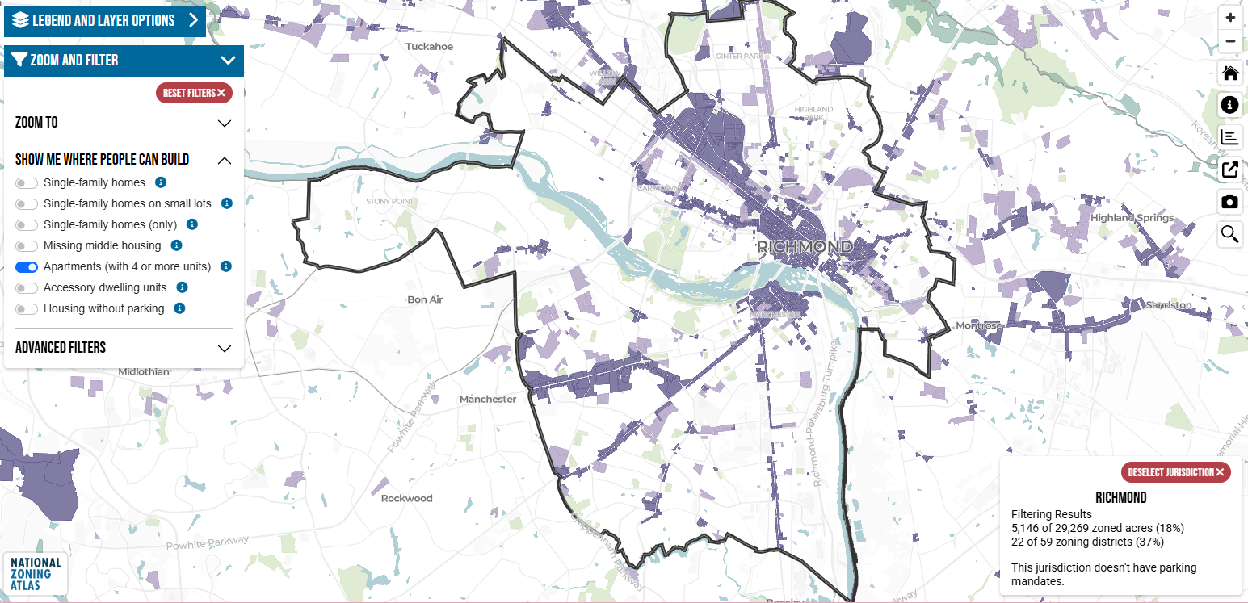

Slide 10
The map calculates the % of land in a jurisdiction that satisfies filters. It also generates stats…

Slide 11
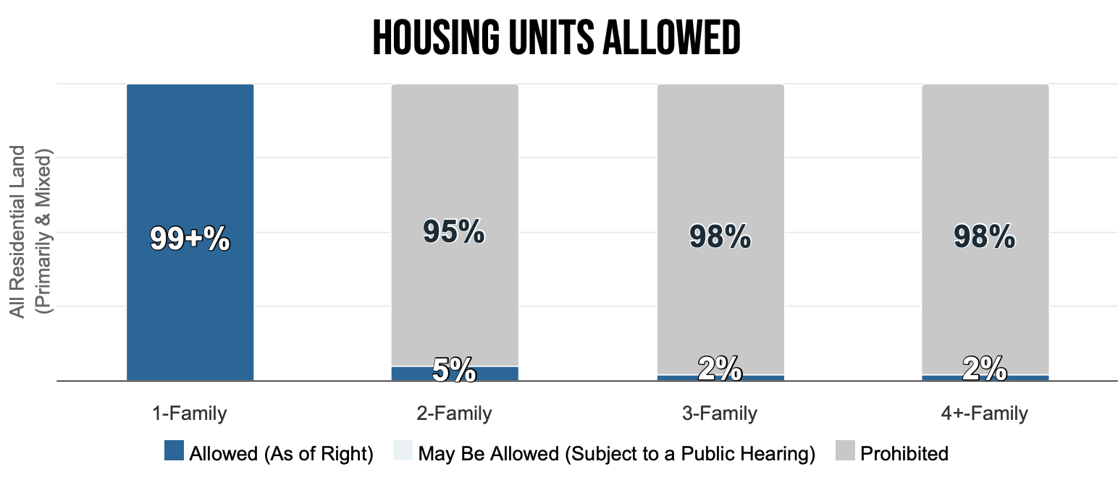
Town Stats (Greenwich CT)

Slide 12
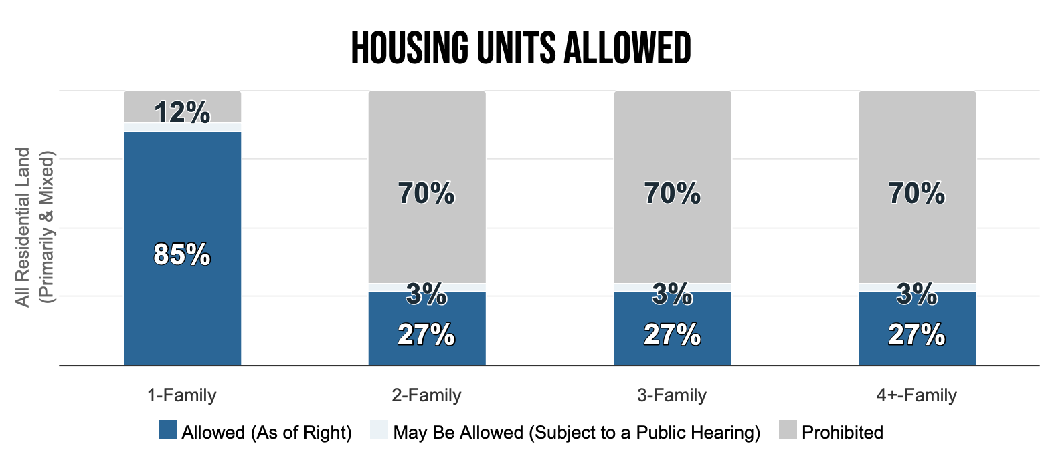
City Stats (Seattle)

Slide 13
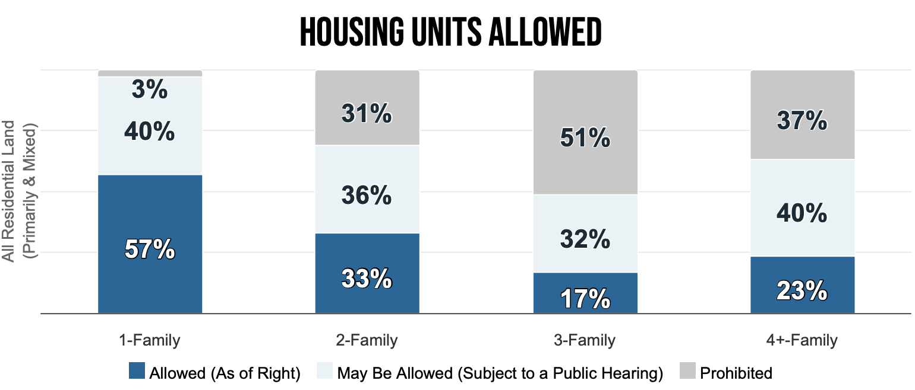
County Stats (Travis County, TX)

Slide 14
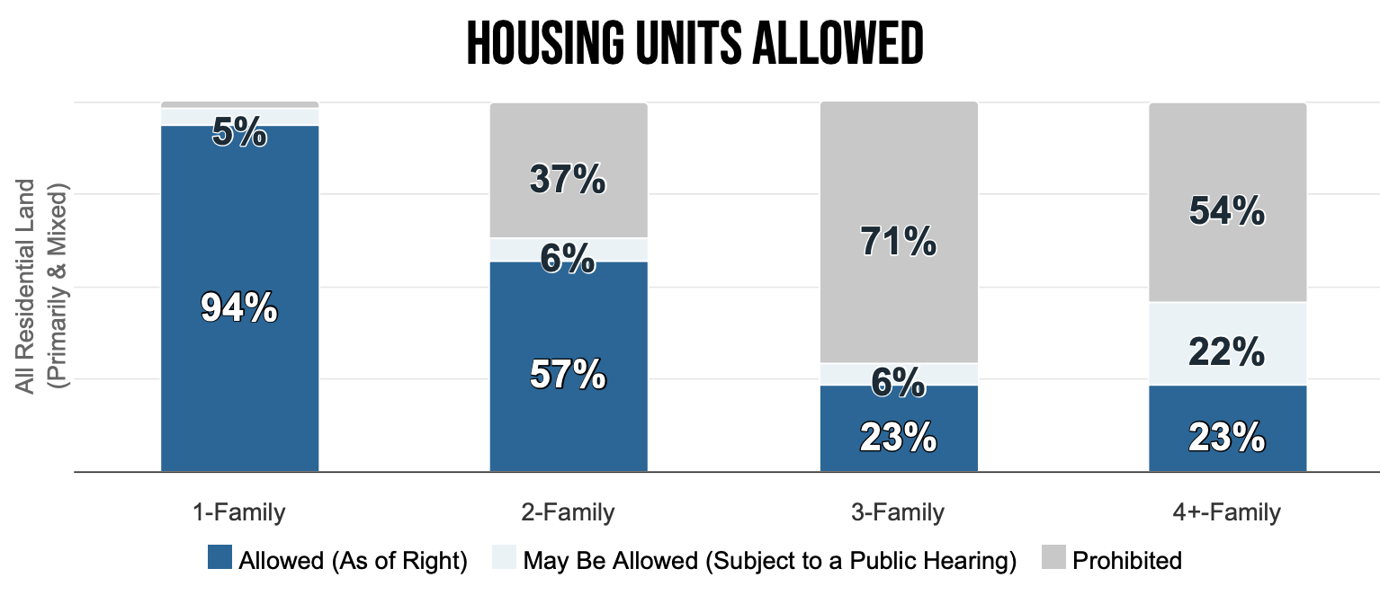
Metro Stats (Raleigh-Cary CBSA)

Slide 15
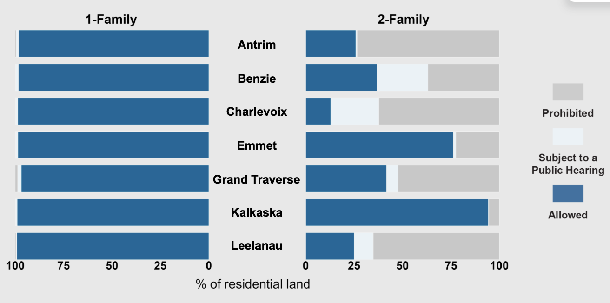
We Compare Counties (MI)

Slide 16
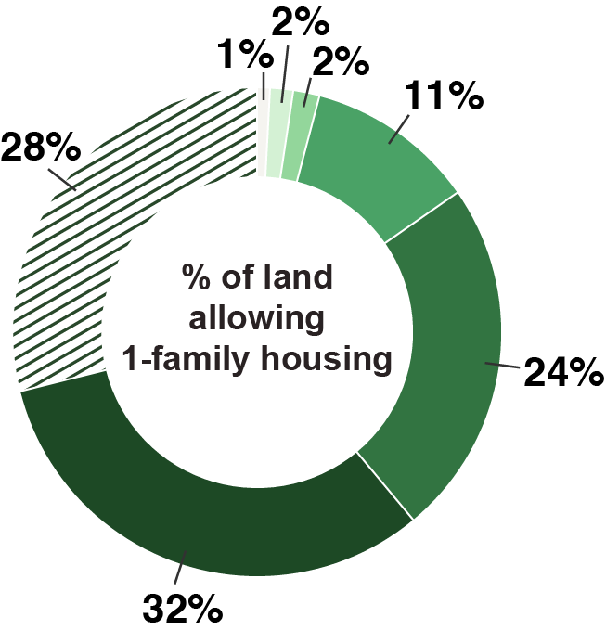
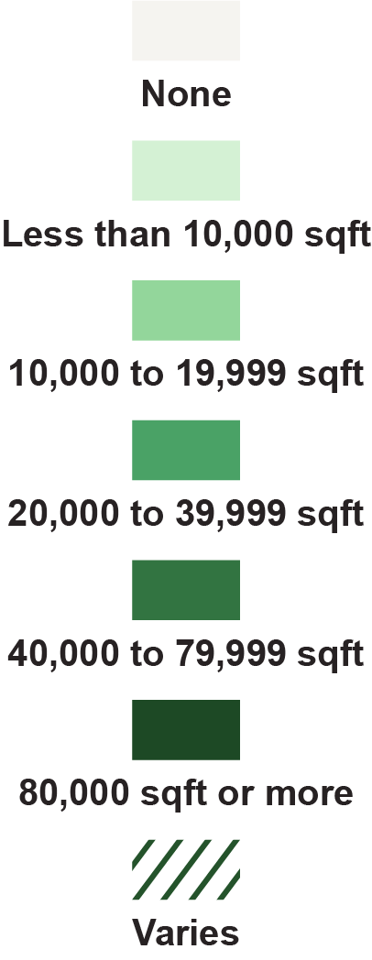
We Measure Lot Sizes (VA)

Slide 17
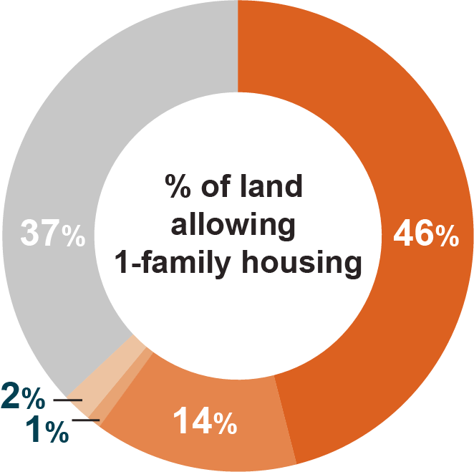
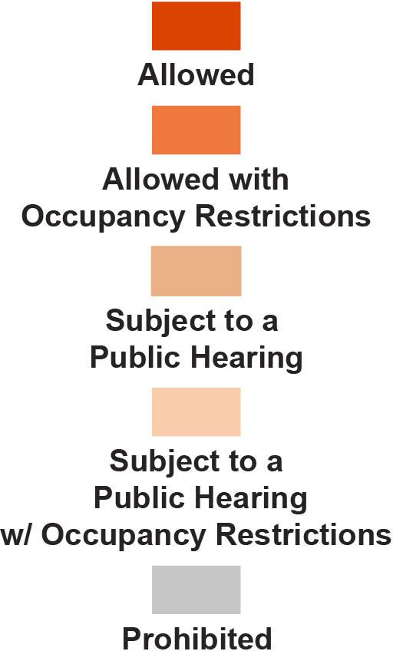
We Track ADUs (CO)

Slide 18
We gather info on setbacks, lot coverage, FAR, heights, parking, unit size minimums, occupancy requirements, required transit/sewer connections, mobile home permissions, planned residential development standards… and more.

Slide 19
We have a growing repository of information about zoning constraints on 55% of US land.

Slide 20
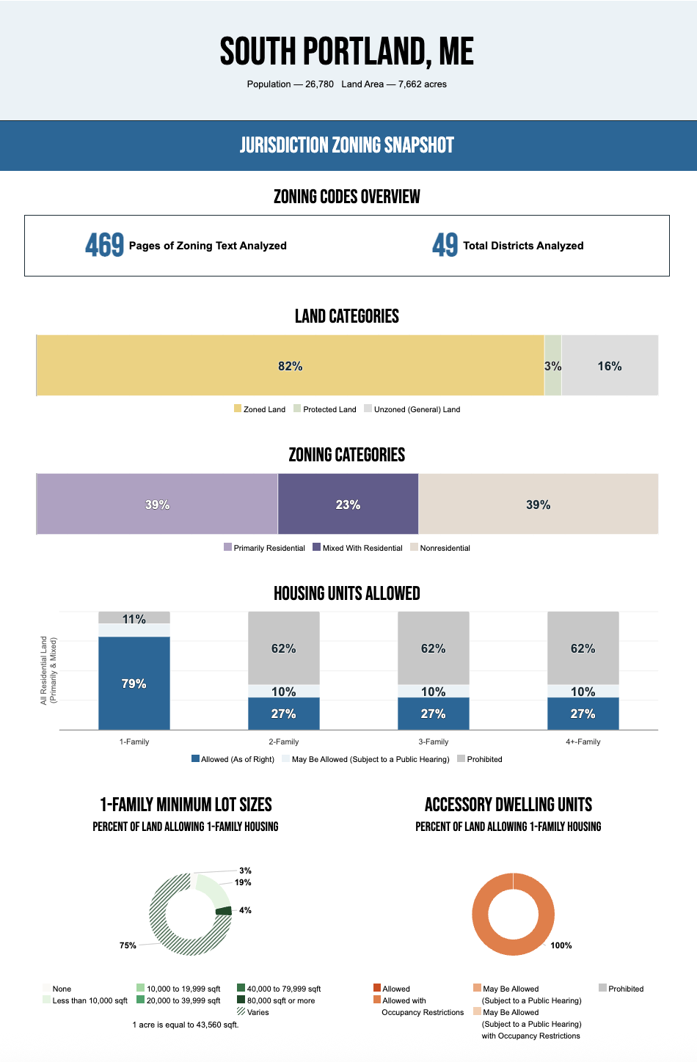
zoningatlas.org/snapshots
Data visualizations by jurisdiction, county, CBSA, and state

Slide 21
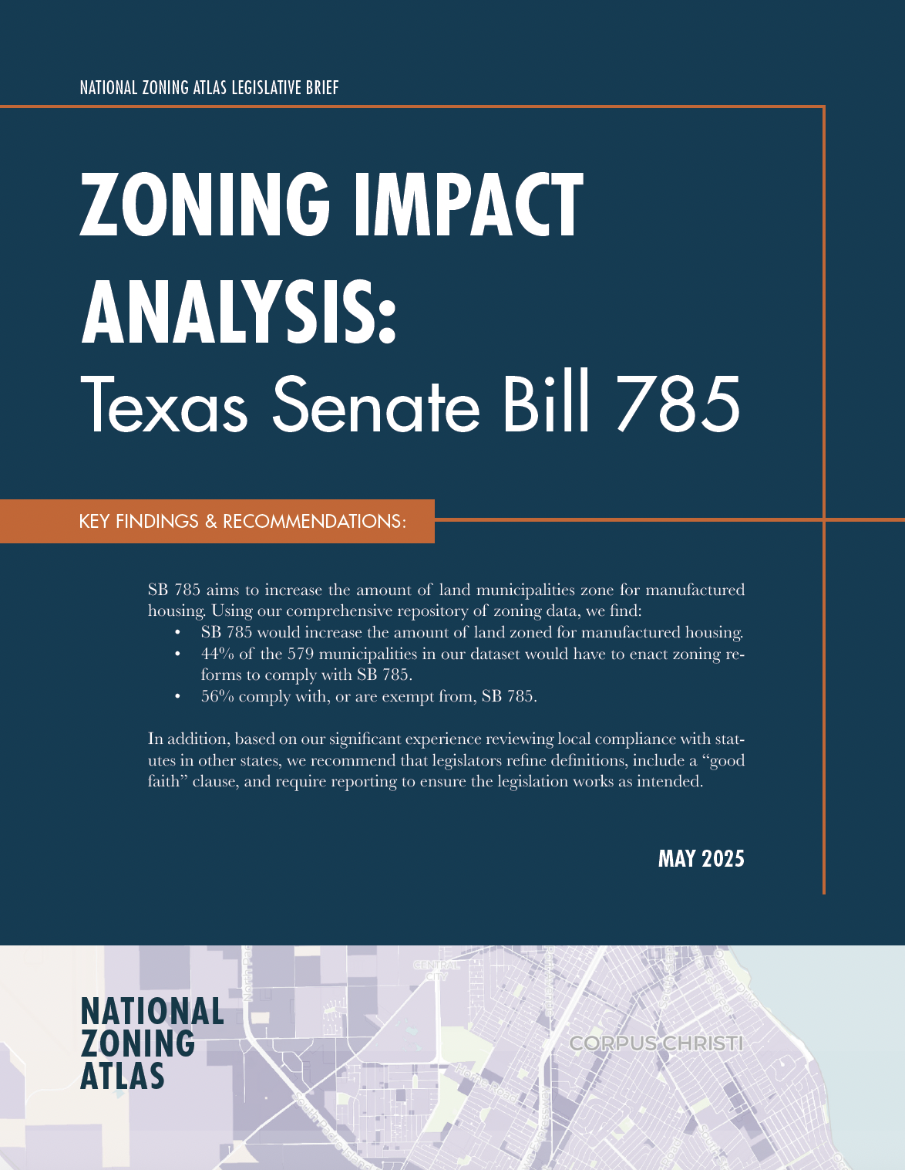
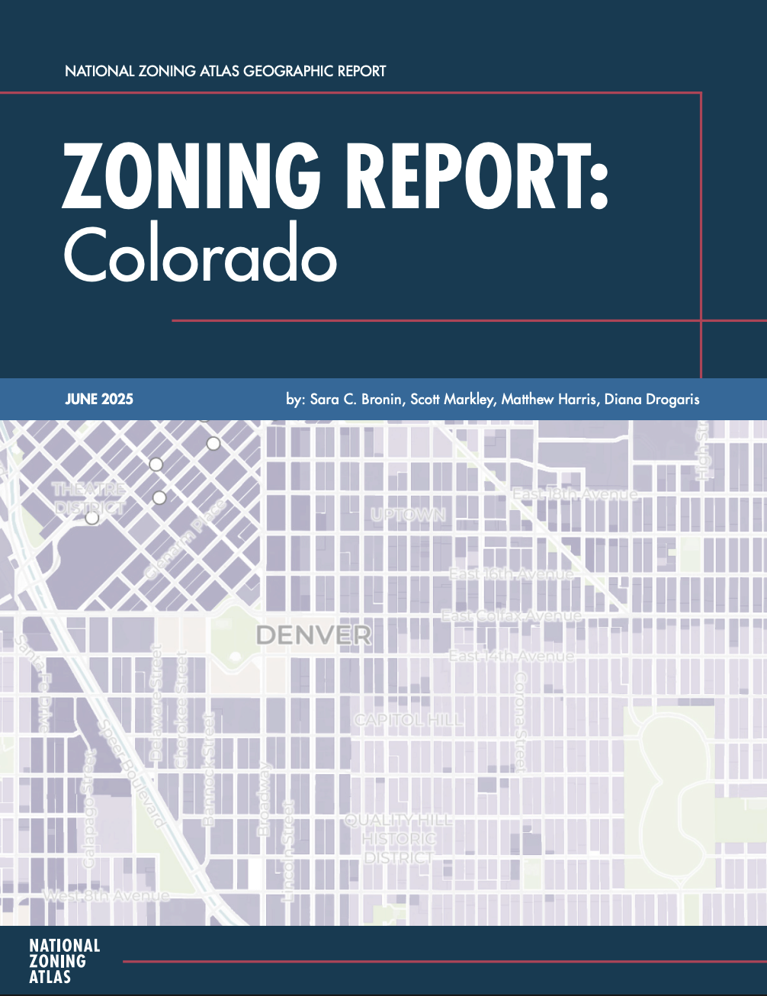
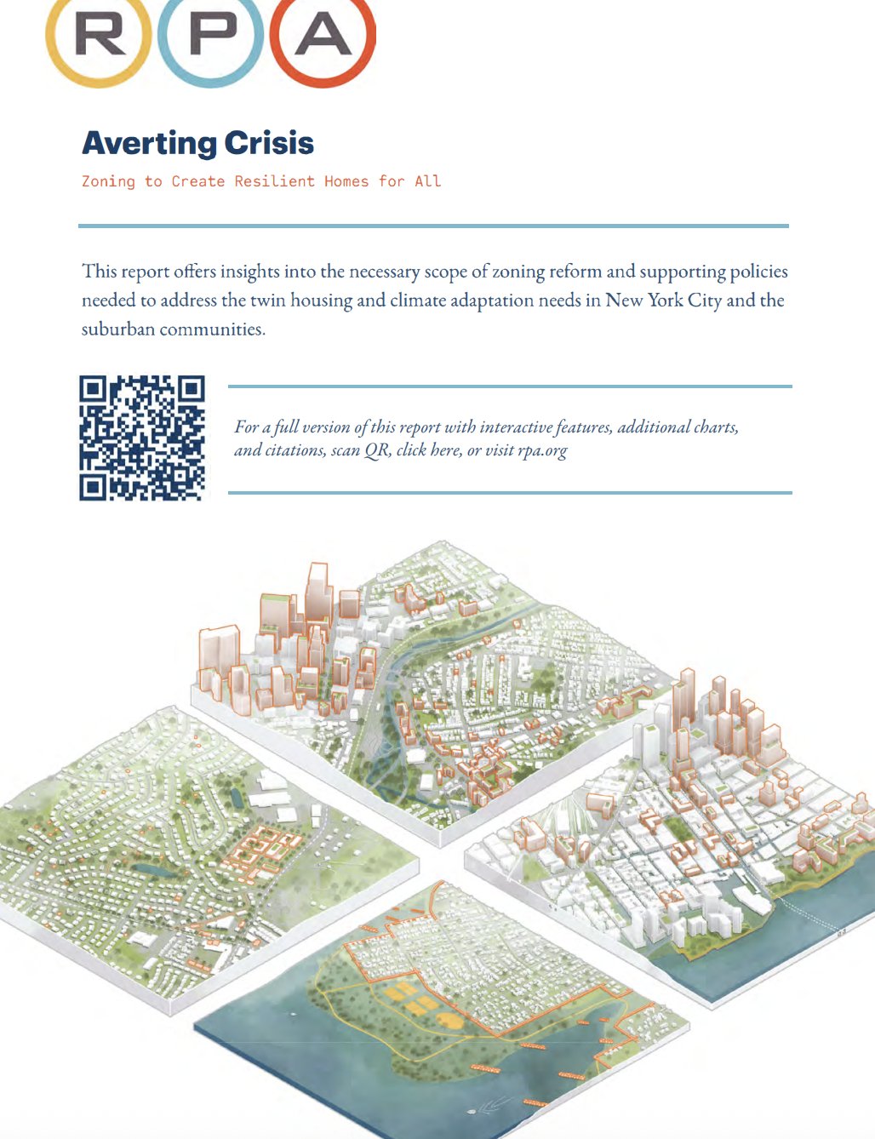

zoningatlas.org/resources
NZA publications
Collaborative publications
Webinars

Slide 22



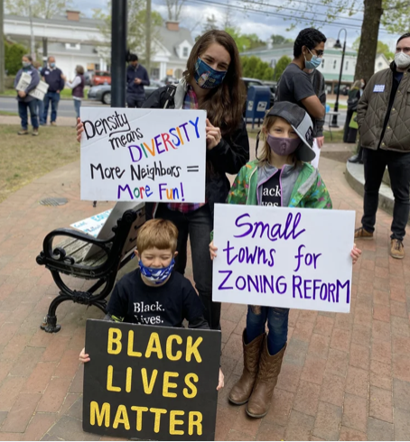
zoningatlas.org/impact
Analysis
Advocacy
Research

Slide 23
A full understanding of zoning’s constraints has long been hampered by lack of data.

Slide 24
NZA is creating data from scratch, but faces significant challenges in expansion and data maintenance.

Slide 25
ND
SD
OR
ID
DETROIT
CHICAGO
PHILADELPHIA
KS
AR
MS

Slide 26






Connect with us!
zoningatlas.org
info@zoningatlas.org
@zoningatlas

