Slide 1


Housing Affordability: Permitting & Zoning Solutions
Hosted by International Code Council, APA, National League of Cities, and Pew Charitable Trusts
City of Seattle: Updating our Comprehensive Plan, rezoning the city, and legislation developed and adopted to incentivize and remove barriers to diverse housing solutions
Rico Quirindongo
Director, City of Seattle Office of Planning and Community Development
December 4, 2025

Slide 2
Our Comprehensive Plan Major Update: The ‘One Seattle Plan’

Slide 3
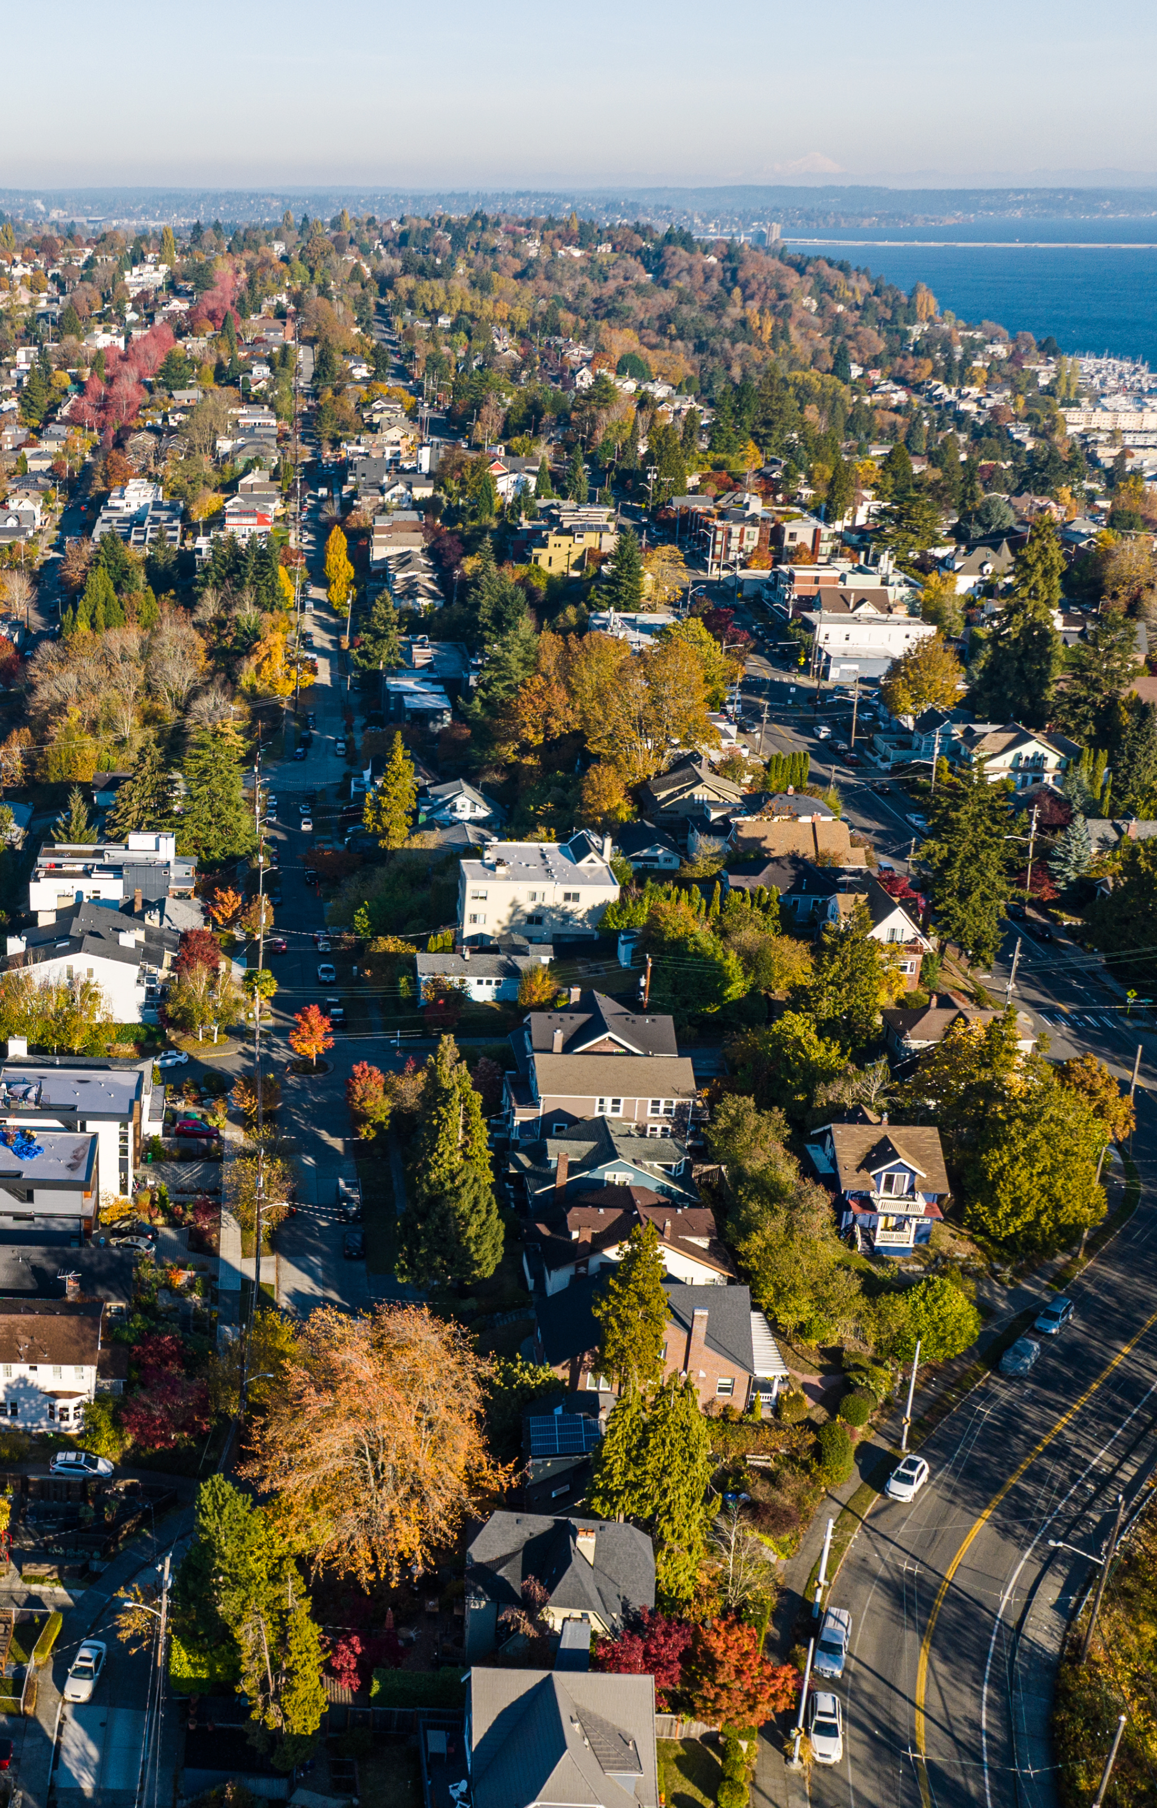
Confronting our Housing Challenges
Seattle was the fastest growing major U.S. city 2010-2020
Despite substantial construction, housing has not kept pace with job and population growth and is increasingly unaffordable
Recent growth has reinforced our history of housing exclusion and displacement
Seattle expects substantial growth over the next 20 years
One Seattle Plan identifies how we will plan for and accommodate future growth, with housing goals including:
Increase the supply and diversity of housing to reduce the market pressures driving up costs and accelerating displacement
Expand opportunities and incentives for affordable housing
Housing in complete, walkable neighborhoods near transit
Open pathways to homeownership and wealth-building

Slide 4
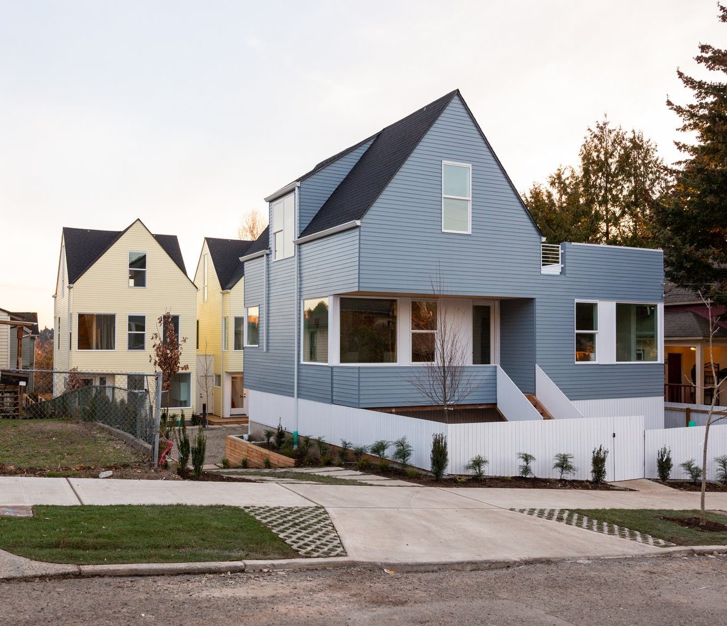
A new landscape of state requirements
In 2023, the Washington Legislation adopted House Bill 1110, requiring Seattle to allow middle housing and at least four units on all residential lots.
Today, roughly three-quarters of where Seattle allows housing is zoned for detached homes. The One Seattle Plan will expand housing choice by:
Allowing triplexes, fourplexes, courtyard apartments, and stacked flats
Allowing at least 4 units on every lot or 6 if within quarter-mile of major transit or if 2 are affordable
Allowing proportionally more density on larger lots
Removing development standards that are more restrictive for middle housing than detached homes
Incentivizing stacked flats and affordable housing
Allowing corner stores
Credit: Hybrid Architecture

Slide 5
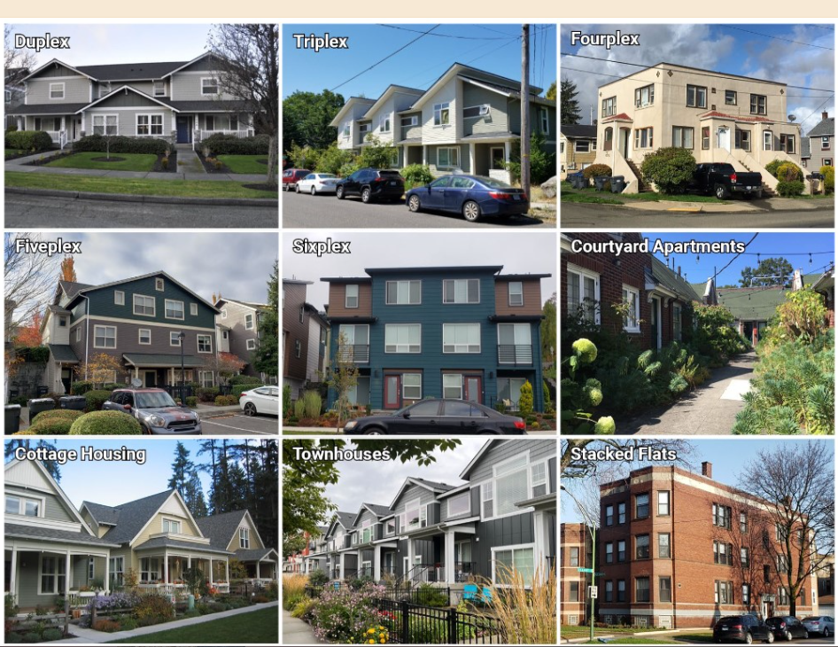

Slide 6
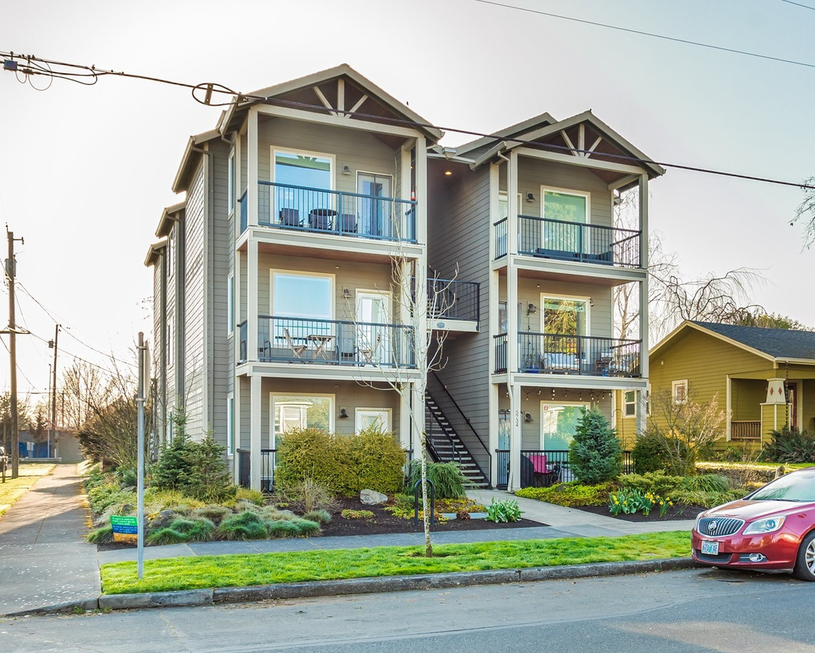
Bonus for stacked flats
Stacked flats can have:
Maximum 2.0 FAR
Maximum density of 1 unit per 600 sq ft of lot area
Maximum height of 4 stories
On a 6,000-square-foot lot, this results in 9 units rather than 6, with more units allowed as lot size increases.
Notes:
During public engagement on the draft plan last spring, we heard many comments that people would like to encourage the building of stacked flats, such as apartments of condos, where people can live on one floor. This type of housing is desired by many people because it can allow for the creation of accessible units where people can age in place.
In response to these comments, we are proposing to add a bonus for stacked flats. Under this bonus, Stacked flats that are located within ¼ mile of frequent transit and on lots 6,000 square feet or greater would be allowed to have additional floor area and a larger number of units. Specifically the FAR would be increased from 1.4 and the maximum density limit would be increased to 1 unit per 650 square feet. This density would allow 9 units on a 6,000 square foot lot.

Slide 7
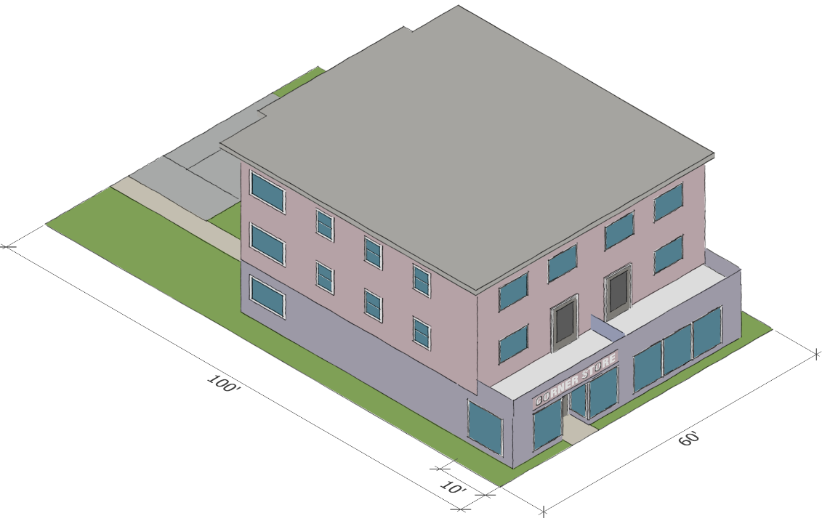
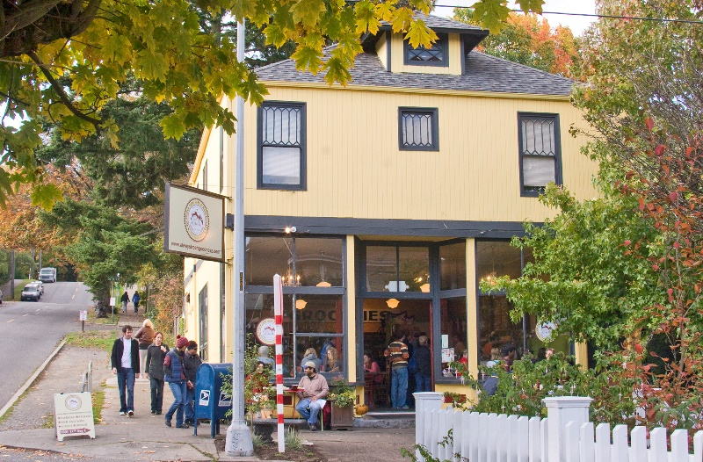
Corner Stores
Small-scale commercial uses, such as restaurants and retail stores, will be allowed on any lot in NR and multifamily zones provided they meet certain standards for:
maximum size
hours of operation
noise and odor
the location and screening of solid waste and other outdoor activities.
Photo credit: Joel W. Rogers
Notes:
The City is also proposing to allow small-scale commercial uses, such as restaurants and retail stores, on any corner lot in Neighborhood Residential and multifamily zones. These businesses would have to meet certain standards for:
maximum size, hours of operation, noise and odor, and the location and screening of solid waste and other outdoor activities.
Due to the high cost of construction, it is unlikely that property owners would develop new buildings expressly for corner stores. However, this change might allow property owners to use existing buildings, possibly with additions or modification, to accommodate these businesses.

Slide 8
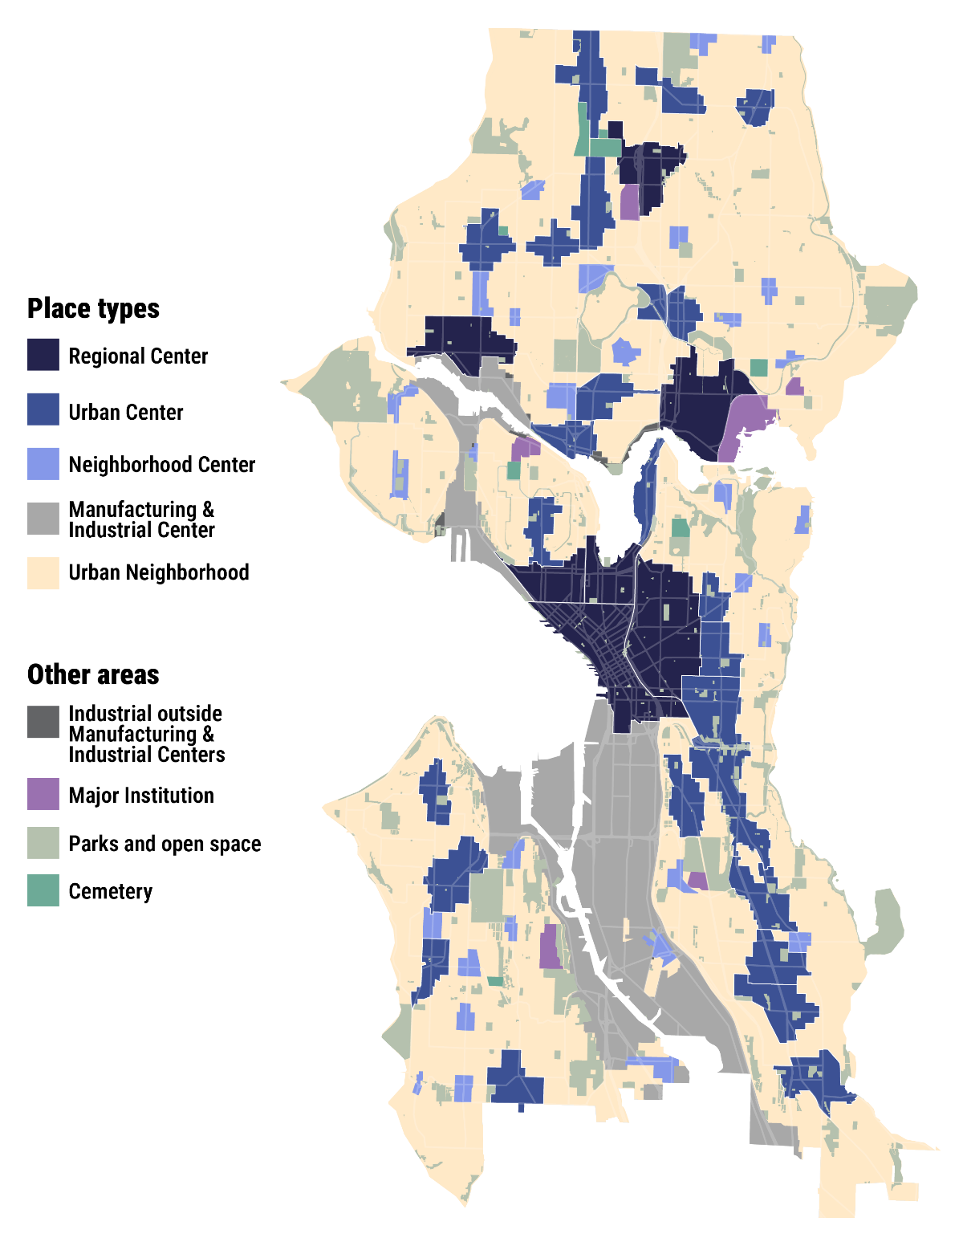
A new Growth Strategy at the center of the one seattle plan
Advances vision for more affordable, inclusive, and equitable city
Most significant changes in 30 years to meet pressing growth and housing challenges
Improves supply, diversity, and affordability of housing to meet present & future needs
Supports middle housing in all neighborhoods
Boosts capacity for apartments, condos, and middle housing near transit, including:
New and expanded Urban Centers
New Neighborhood Centers
Zoning for apartments along frequent transit routes
Roughly doubles current residential development capacity to 330,000 potential new homes
Notes:
As we developed a new growth strategy, these goals served as our north star.
These goals are specifically addressed by the changes proposed to the growth strategy that Brennon will describe in the next slides.

Slide 9
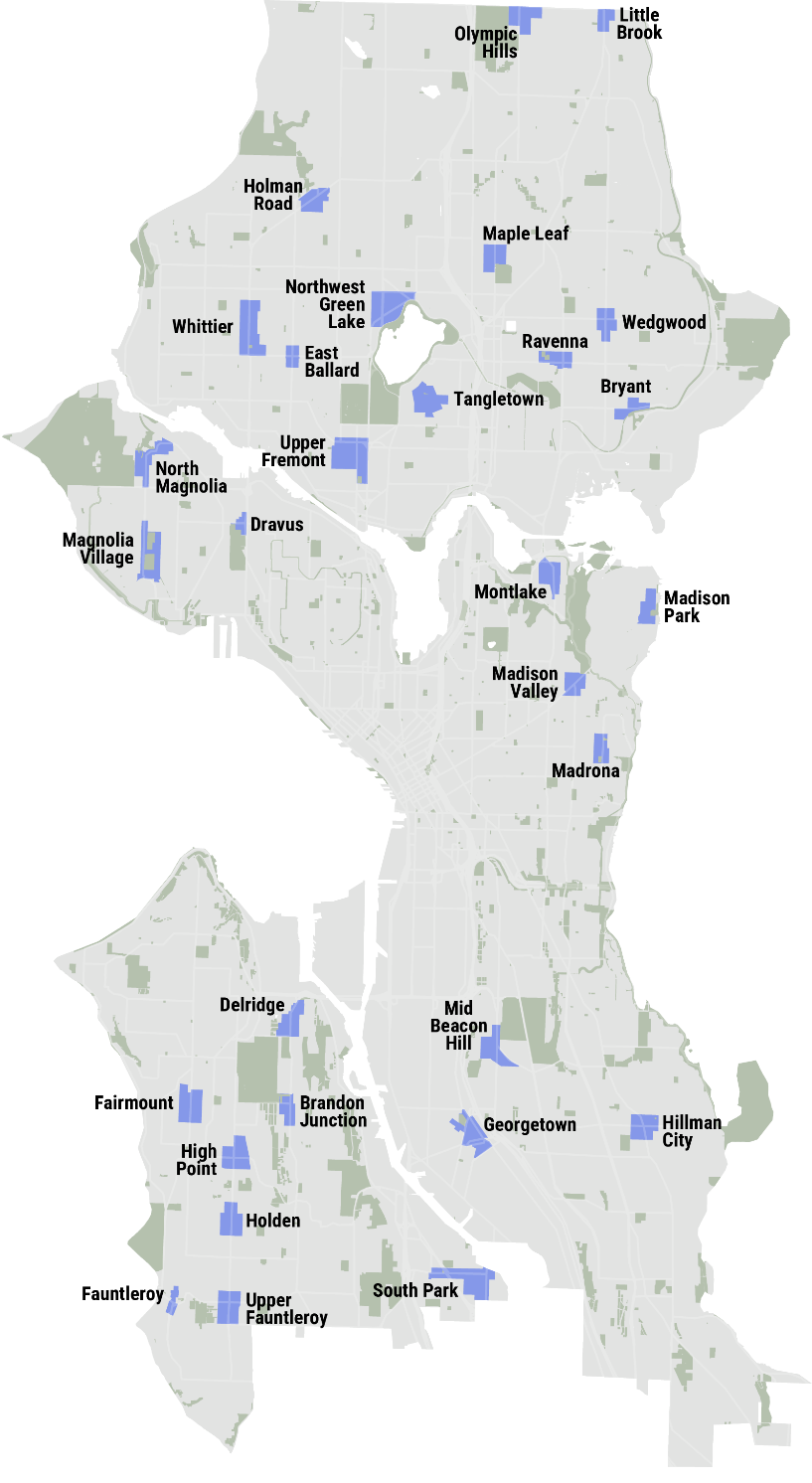
Neighborhood Centers
A new place type in Seattle’s growth strategy that expands room for apartments around beloved neighborhood business districts.
Number and locations
30 Neighborhood Centers
Add housing options within easy walk to frequent transit and/or neighborhood business districts
Increase housing diversity in more neighborhoods across the city
Size
Generally a 3- to 4-minute (800 feet) walk from the central intersection
Housing types allowed
Generally 4- to 6-story buildings
Especially 5- and 6-story apartments & condos
Neighborhood Center

Slide 10
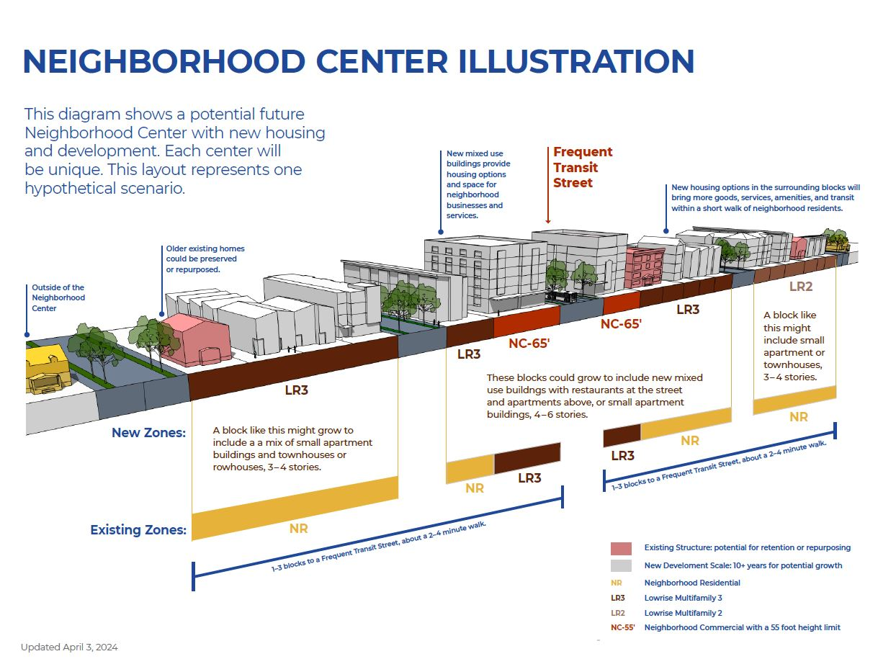

Slide 11
City of Seattle comprehensive plan legislation
Legislation | What it does | Council schedule
Interim HB 1110 Compliance Legislation | Amends Neighborhood Residential (NR) zoning to comply with HB 1110 and other new laws | Effective June 30, 2025
Permanent HB 1110 Compliance Legislation | Comprehensive update of NR zoning | Vote December 16, 2025
Comprehensive Plan adoption legislation | Adopts One Seattle Plan, including: Goals and policies Future Land Use Map with center boundaries | Vote December 16, 2025
Centers and Corridors legislation | Adopts changes to zoning maps — with upzones in new and expanded centers and along transit arterials — and other related changes to code | 2026

Slide 12
Other legislation adopted or in the works

Slide 13
Other State legislation
City of Seattle will implement the following over next several years
Bill | Topic | Deadline
HB 1576 | Historic landmark designations | 2025
HB 1353 | ADU self registration | 2025
SB 5148 | Dept of Commerce review of housing element | 2025
SB 5571 | Cladding materials | 2025
SB 5184 | Parking reform | 2027
HB 1096 | Lot splitting | 2027
HB 1491 | Transit-oriented development | 2029
HB 1183 | Code reform for sustainable/affordable housing | 2030

Slide 14
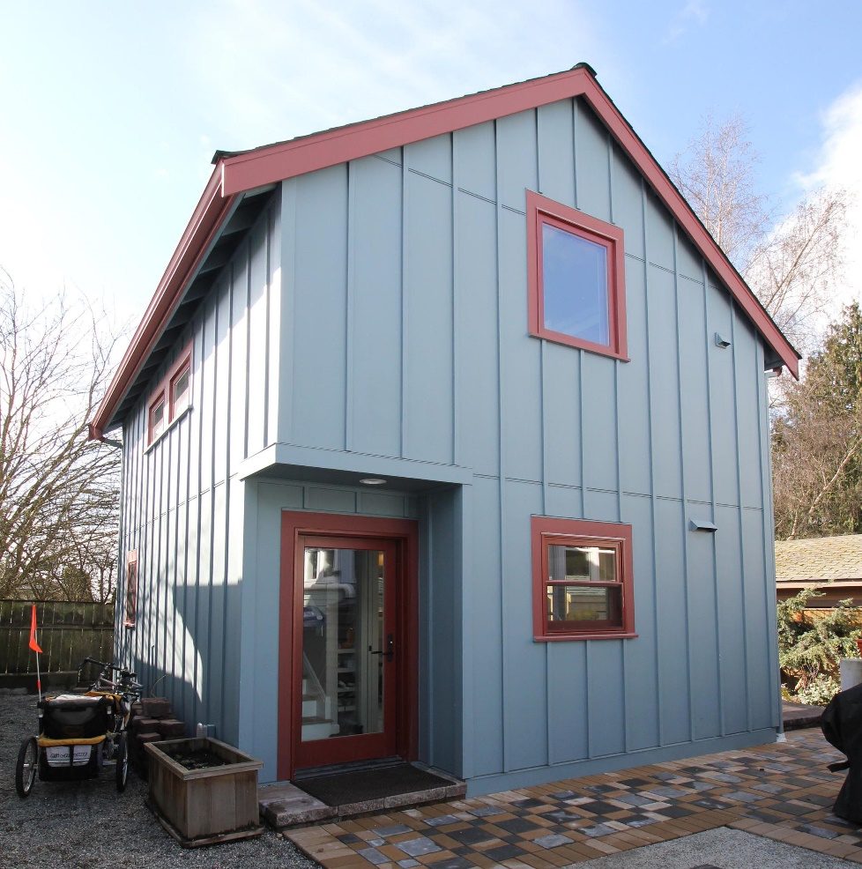
Accessory Dwelling Units (ADUs)
Implementing requirements of House Bill 1337
Already allowed under Seattle’s existing code:
Two ADUs per lot (excluding lots with environmentally critical areas)
Maximum size of 1,000 sq ft
No owner-occupancy requirement
No parking requirement
Newly adopted zoning change:
Allows 2 DADUs on each lot
Height limit increased equivalent to main house
ADUs count toward density limits in HB 1110 legislation

Slide 15
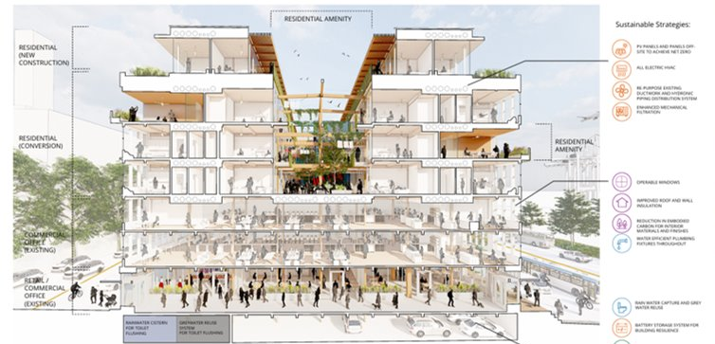
Office to residential conversions
Sponsored a "Call for Ideas" for proposals by building owners and designers. Spring 2023.
Passed code barrier removal legislation exempting conversions from all land use code regulations. 2024.
Enacted a sales tax deferral on conversion construction costs. Early 2025. (10.3% direct cost reduction.)
Example submittal during the Callf or Ideas.

Slide 16
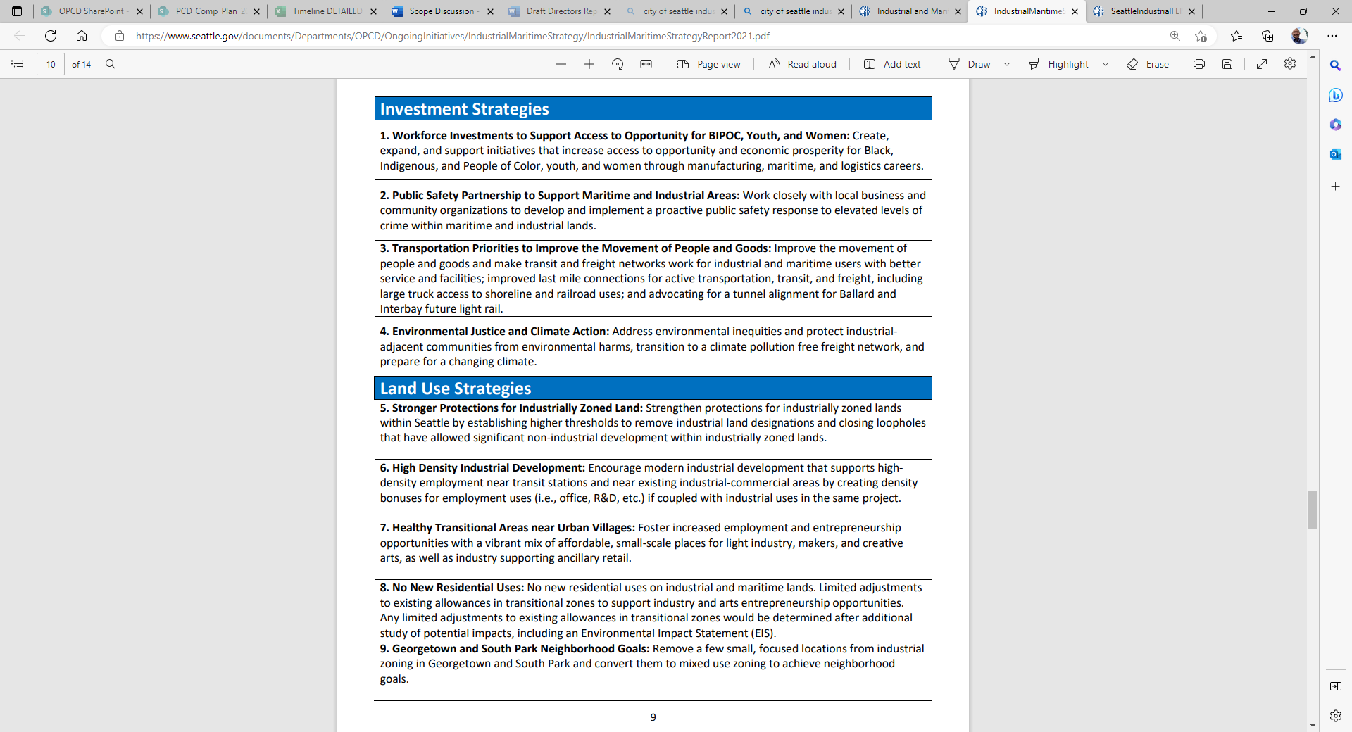
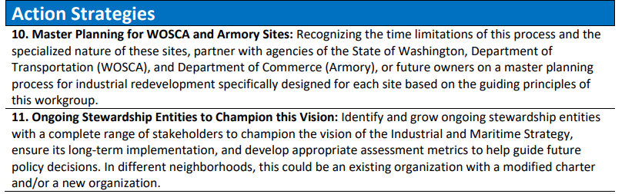
INDUSTRIAL And maritime strategy
A 60+ member Advisory Council approved 11 consensus recommendations with 85% support in June 2021.

Slide 17
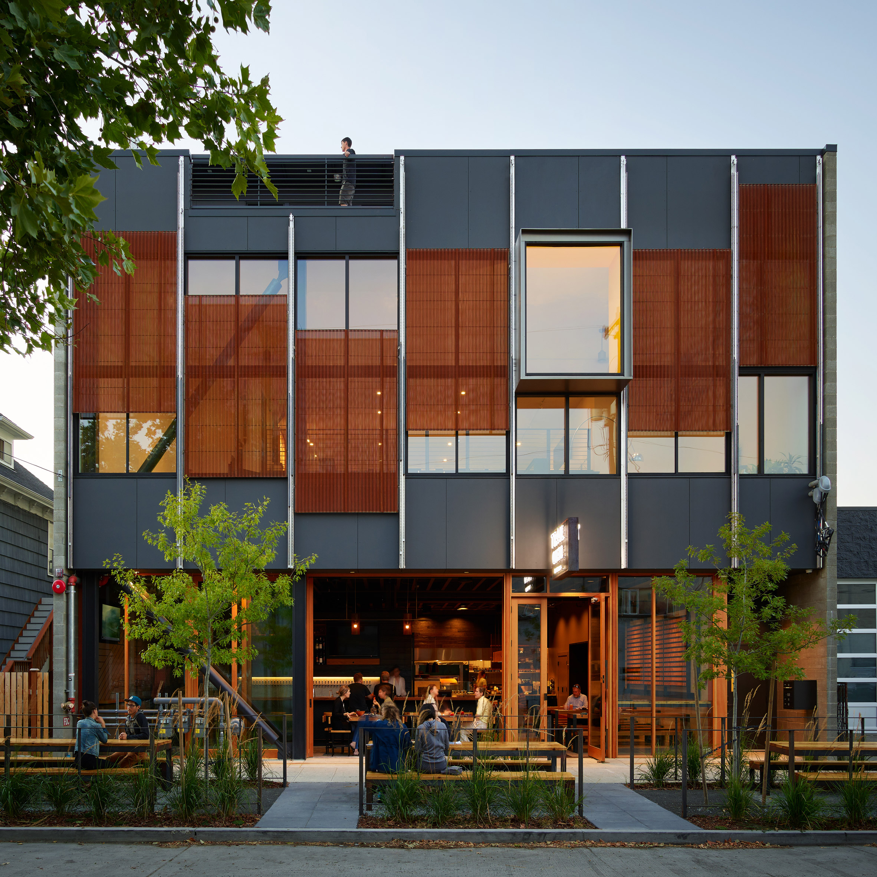
INDUSTRIAL And maritime strategy limited Workforce housing
Limited Workforce Housing. Small amounts of workforce housing are allowed in a new Urban Industrial Zone intended to support workers.
Conditions:
The residential uses must be either:
a.) Live-work or caretakers quarters for a business on the same site; or
b.) 50% of units as workforce housing affordable to incomes below 90 percent AMI.
50 dwelling units per acre maximum density
Not within 200 feet of a shoreline.
Not within 200 feet of a major truck street.
Sound-insulating windows
Located to reduce conflict with adjacent businesses.
The owner must sign an acknowledgement accepting the industrial character
New Areas for Housing. As part of the package the IM Strategy removed some land from the designated Manufacturing Industrial Centers, allowing for 3,000 new homes over 20 years.
Example of a building in the Urban Industrial zone with on-site caretakers housing, in a building with a tasting room for a local brewery.

Slide 18
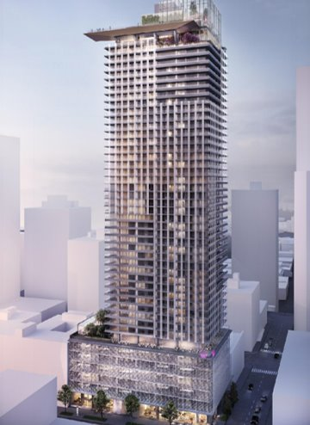
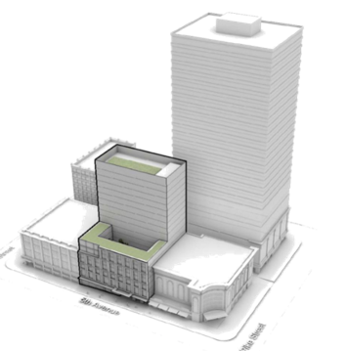
Downtown Activation rezoning
Rezoned parts of the Downton Retail Core along 3rd Ave. to encourage residential development and new investment as part of downtown activation efforts. (Summer 2023)
From
DRC 85-170 Zoning
170’ maximum
Limited scale of development to preserve a “retail core” district.
To
240/290-440 Zoning
440’ maximum
Typically tall, slender floorplate residential towers.
Significantly more economically feasible to build in this zone.
Expanded the area allowing high rise residential development.
Existing structures in the zone exceeded today’s zoning limits.
Example allowed structure

Slide 19
“Housing Opportunities” Legislation
A collection of 7 focused rezones and code changes to spur forward known housing development opportunities in the near-term. (Currently-proposed in 2025)
Rezones land in the Fremont / Stone Way corridor to allow housing.
Further expanded Downtown Retail Core (DRC) rezoning.
Rezone land to support multi-purpose redevelopment on sites with community-based uses. (i.e. YMCA’s, and non-profit owned land)
Removes code barriers to passive house, modular and mass timber construction. (i.e. upper level setback requirements.)
Increases height limits by 50’-100’ on key sites to encourage more housing in the Belltown neighborhood.
Creates a redevelopment incentivize for inclusion of a grocery store use in residential devlelopments with 200+ homes in the Lake City neighborhood.
Removes code barriers to conversion from commercial to housing in more zones.

Slide 20
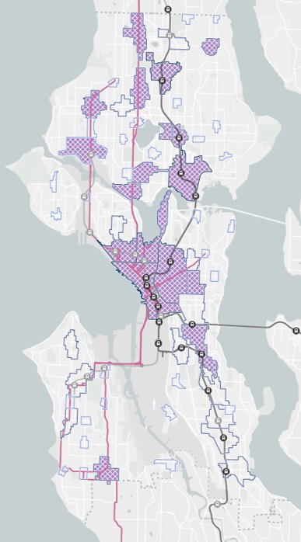
Regional and urban centers zoning implementation
STUDY AREA
Additional phase of Comprehensive Plan zoning implementation in 2026.
Increases housing capacity in Seattle’s existing Regional and Urban Centers.
Focuses on:
Strong market areas
Opportunity sites
Economical construction types
Requires Supplemental EIS review.
Regional Centers​ | Urban Centers​
Downtown^{1,2,3}​ | Aurora–Licton Springs³​
First Hill / Capitol Hill^{1,3}​ | Bitter Lake³​
Northgate¹​ | Central District​
South Lake Union^{2,3}​ | Crown Hill³​
Uptown^{2,3}​ | Eastlake³​
University District^{1,3}​ | Fremont ​
Ballard (proposed)^{2,3}​ | Green Lake​
​ | Lake City ​
​ | Mt Baker¹​
​ | Roosevelt¹​
​ | Wallingford³​
​ | Westwood–Highland Park³​

Slide 21
Design review - Exemption and reforms
Downtown & City Center: For three years (through 2027) Design Review is waived for proposals with residential or hotel uses within Downtown, South Lake Union and Uptown, as a downtown activation measure.
Design Review Exemptions for MHA Performance. In 2023 Seattle passed legislation to waive design review for projects that meet their Mandatory Housing Affordability (MHA) requirement by building affordable housing on-site instead of choosing the in-lieu payment option.
(Proposed) Temporary Suspension of Design Review. Seattle is working on a bill that would make all Design Review optional during a temporary period while the City responds to new guidance from the State of Washington requiring objective standards for design review. (House Bill 1293).

Slide 22
Partnership for ADU Development (PAD)

Slide 23
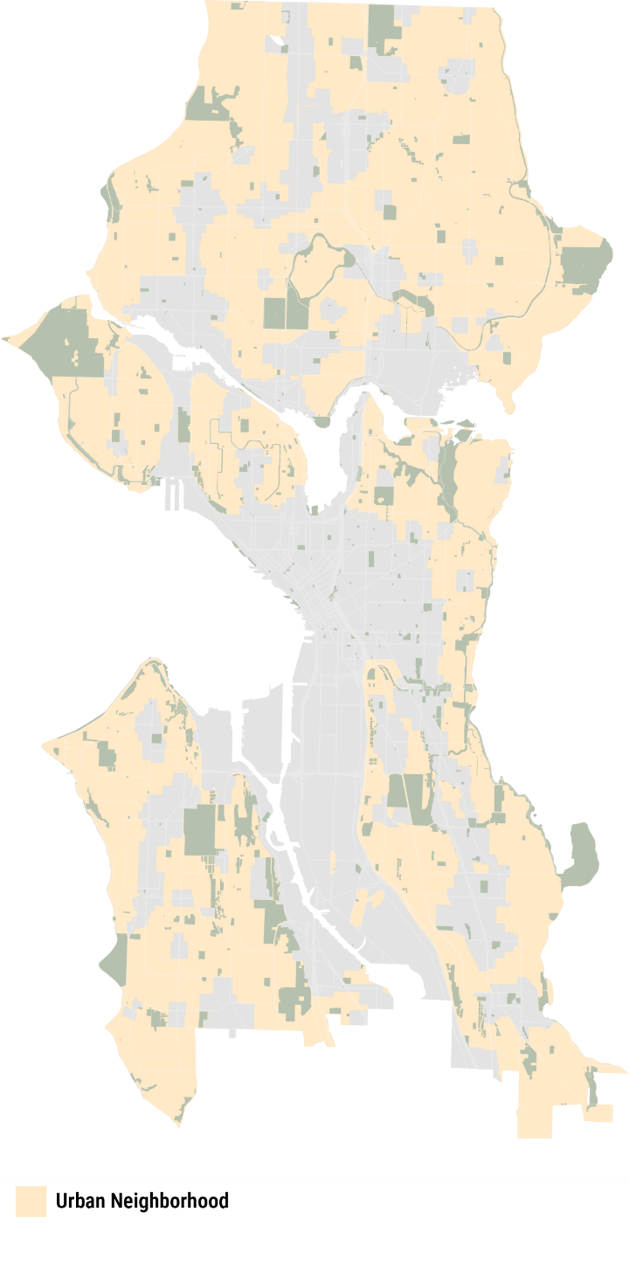
Seattle’s updated NEIGHBORHOOD RESIDENTIAL ZONING creates new ADU and middle housing options, fulfilling state law.
Properties can have double DADUs, triplexes, fourplexes, and stacked flats, with 4-6 units allowed on every lot.
These options give homeowners new ways to upgrade and leverage their property for stability, flexibility, and wealth creation.
Barriers that homeowners face:
A complex design and permitting process
Insufficient cash & equity and difficulty qualifying for financing to build
Lack of time & knowledge to oversee construction
Burden of managing a rental
More homeowners — especially lower- and moderate-income households and owners of color — could benefit from their development potential if supported to overcome these barriers.

Slide 24
Introducing PARTNERSHIP FOR ADU DEVELOPMENT (PAD): A MODEL FOR CO-DEVELOPMENT TO HELP THE CITY ADD HOUSING AND HOMEOWNERS CREATE WEALTH
What?
A City-facilitated partnership that helps homeowners overcome barriers to participating in development, adding housing, and creating wealth
Create creates a partnership, and the Partner works with the Homeowner to envision, design, permit, and deliver infill housing on the Homeowner’s property
Existing homeowners can maintain their mortgages, generate income to weather cost of living increases, and grow their property value
Why?
Updated NR zoning expands opportunities for homeowners to leverage their property.
But homeowners often face barriers to realizing this potential: lack of knowledge, design & permitting complexity, high costs, scarce financing, etc.
Through PAD, the City can boost housing production and support more equitable implementation of new zoning.

Slide 25
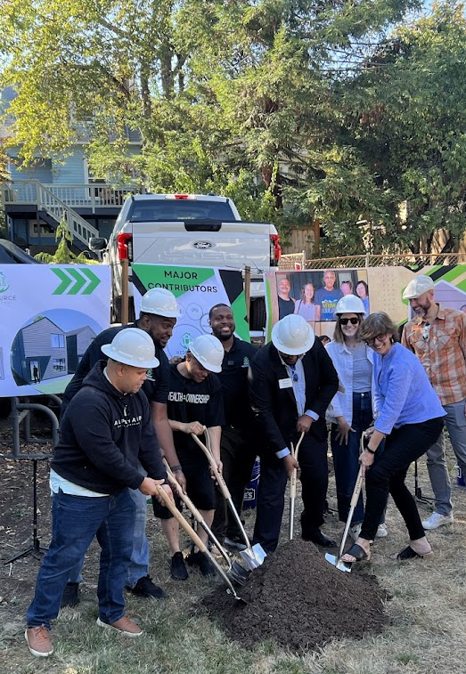
Introducing PARTNERSHIP FOR ADU DEVELOPMENT (PAD)
A City-facilitated partnership and co-development model pilot project whose mission is to help homeowners overcome barriers so they can participate in development, create housing, and build generational wealth.
Problem
Updated Neighborhood Residential (NR) zoning allows double DADUs, fourplexes, and flats — creating new opportunities for homeowners to leverage their property.
Many homeowners face barriers and cannot realize their development potential without comprehensive support.
This leaves many with just two options: watch their neighborhood change around them, or sell to a developer who capitalizes on their land’s value
What PAD does
Supports homeowners so they can realize their property’s potential to add housing and build wealth.
Through this pilot, the City catalyzes a partnership between Homeowners and a Partner who co-develops housing in their backyard.
By co-developing, Homeowners overcome financial barriers, get support through construction, and minimize risk.

Slide 26
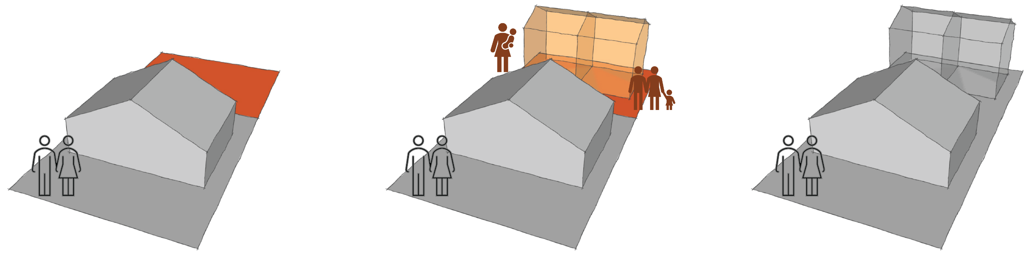
The pad CO-DEVELOPMENT MODEL
1. Lot split and ground lease
The Partner helps the Homeowner execute a lot split and enters into a ground lease for the backyard.
2. Design–build–operate–maintain
The Partner delivers infill housing, operates it as a rental, and shares rental income each month with the Homeowner.
3. Handoff to homeowner
Over time, the Homeowner invests lease income and buys out the Partner after 10 years, letting them own the units outright.

Slide 27
HOW IT WORKS: TWO MODELS TO SUPPORT HOMEOWNERS & BOOST HOUSING
GROUND LEASE
DESIGN / BUILD / OPERATE / MAINTAIN
Partner helps Homeowner split lot and enters into a ground lease for the backyard
Partner works with Homeowner to envision, design, and permit an infill housing project
Partner obtains financing and constructs the project
Partner operates unit(s) as a rental, returning a portion of rental income as lease payment to Homeowner
Homeowner saves portion of lease payment and can buy out the ground lease in year 10-12
This works well for homeowners who:
Need support executing a project from start to finish
Struggle to qualify for financing and/or want to minimize debt
FEE SIMPLE
DESIGN–BUILD OWNER’S REP MODEL
Partner works with Homeowner to envision, design, and permit a project
Partner helps Homeowner obtain financing
Partner carriers out construction
Homeowner gains ownership of new unit(s)
This works well for homeowners who:
Need support navigating design and permitting
Don’t want to oversee construction
Can qualify for financing and/or have savings or equity to bring to the project
Want to use the unit as a rental or for other uses, like housing family

Slide 28
A PILOT PROJECT TO TEST AND REFINE THIS NEW MODEL
Questions the pilot will answer
What types of homeowners and sites are suitable?
How can the Partner work most effectively with identified homeowners?
What legal considerations arise during the creation of a ground lease?
What designs are optimal?
What factors determine whether rents are sufficient to cover debt service and lease payments?
How does the Partner recoup their investment?
How many units could the Partner expect to deliver if the pilot were scaled?
What funding strategy should the Partner and City pursue?
City of Seattle
Forms and oversees partnership
Lender
Provides construction financing
HOUSE
Homeowner
Grants a ground lease to Partner and chooses from a set of design options
Partner
Obtains financing and constructs the ADUs.
Operates units as rental and shares a portion of income as lease payment to Homeowner.
ADUs

Slide 29
FOR More information
Office of Planning and Community Development One Seattle Plan website
https://www.seattle.gov/opcd/one-seattle-plan
Seattle City Council
Select Committee on the Comprehensive Plan
https://www.seattle.gov/council/issues/2025-comprehensive-plan
Learn more about Seattle’s ADU initiatives at ADUniverse
maps.seattle.gov/ADUs

Slide 30
Questions and conversation
Rico.Quirindongo@seattle.gov

