Slide 1

Zoning Reform in Raleigh: A Raleigh for All
Housing Affordability: Permitting and Zoning Solutions Roundtable Washington, DC December 4 2025
Patrick O. Young, AICP
Planning and Development Director
City of Raleigh, North Carolina
Notes:
Good evening – I’ve entitled this presentation “A Raleigh for All” because Missing Middle was adopted to promote a powerful, simple and beautiful idea – that Raleigh welcomes you, no matter who you are” – just like the sign says

Slide 2

Cities are “man’s greatest invention.” They make us “richer, smarter, greener, healthier, and happier.” Triumph of the City by Edward Glaeser, distinguished Harvard economist.
Notes:
(reference Glaeser quote) – I’ll take it one step further and agree with Ed Glaeser – its good for our society at large to have more people have access to Raleigh and other cities

Slide 3
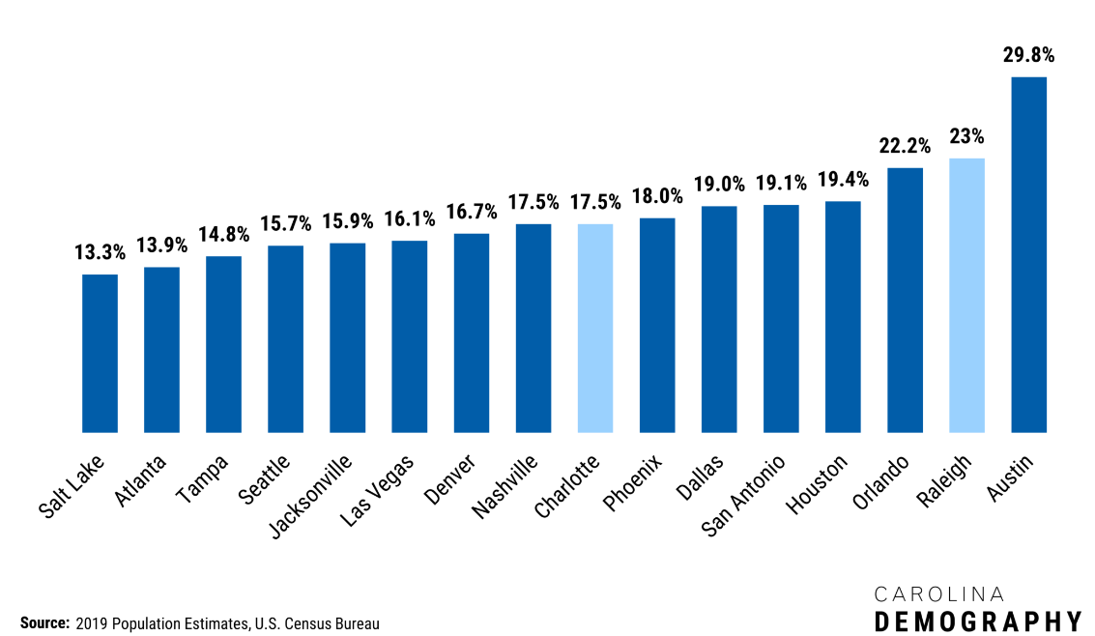
Raleigh is one of the fastest growing large metro areas in the country
% Increase in Population Since 2010
Notes:
https://www.ncdemography.org/2020/10/30/raleigh-is-the-second-fastest-growing-large-metro-in-the-united-states-behind-austin/
Net migration in accounts for almost 70% of the increase

Slide 4
Raleigh Population
by Race, 2021
Notes:
Data: 2020 ACS 5-year estimates

Slide 5
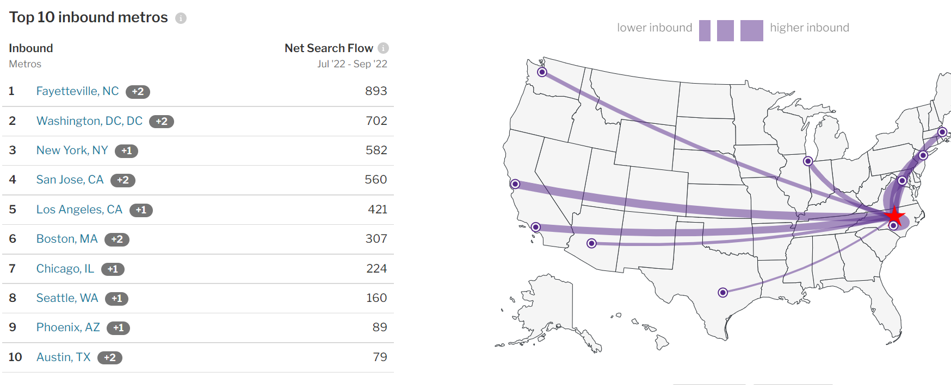
Large number of people moving from expensive metro areas…
Notes:
https://www.redfin.com/city/35711/NC/Raleigh/housing-market#demand

Slide 6



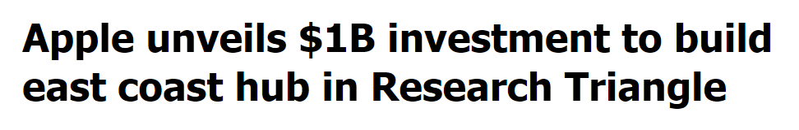


…Chasing high paying jobs
Notes:
11.7% of the population
makes > $100K per year
Cost of living 5.4% lower
than national average

Slide 7
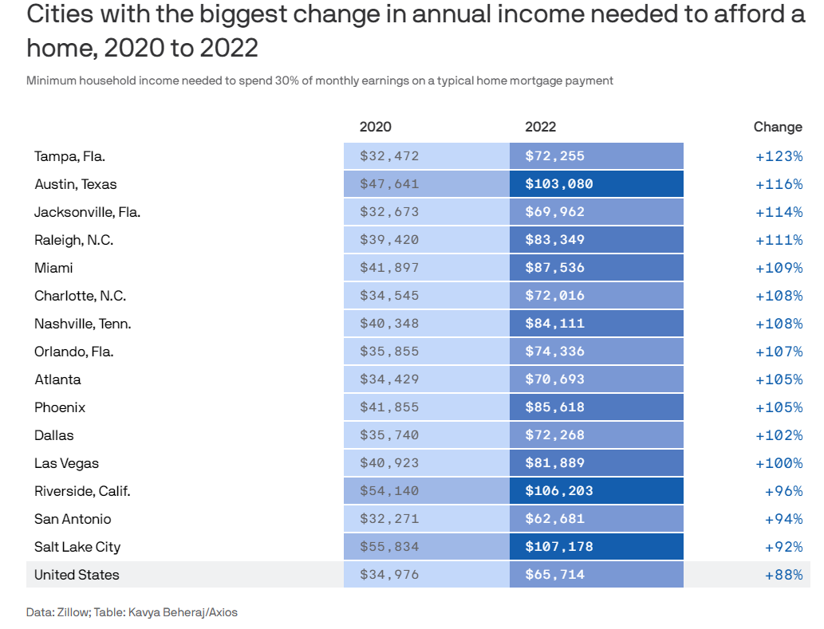
Notes:
https://www.axios.com/local/salt-lake-city/2022/10/13/income-needed-to-afford-house-salt-lake-city-doubled

Slide 8
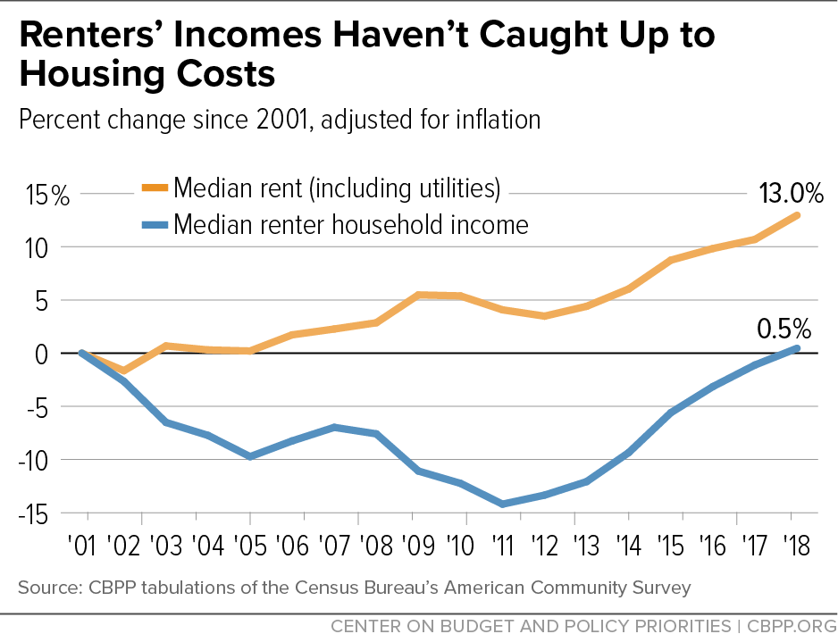
For most people, the cost of housing is out of reach

Slide 9
Construction costs have also accelerated
Source: RSMeans (January 1, 2020), Historical Cost Index; Bureau of Labor Statistics, Consumer Price Index, All Urban Consumers

Slide 10
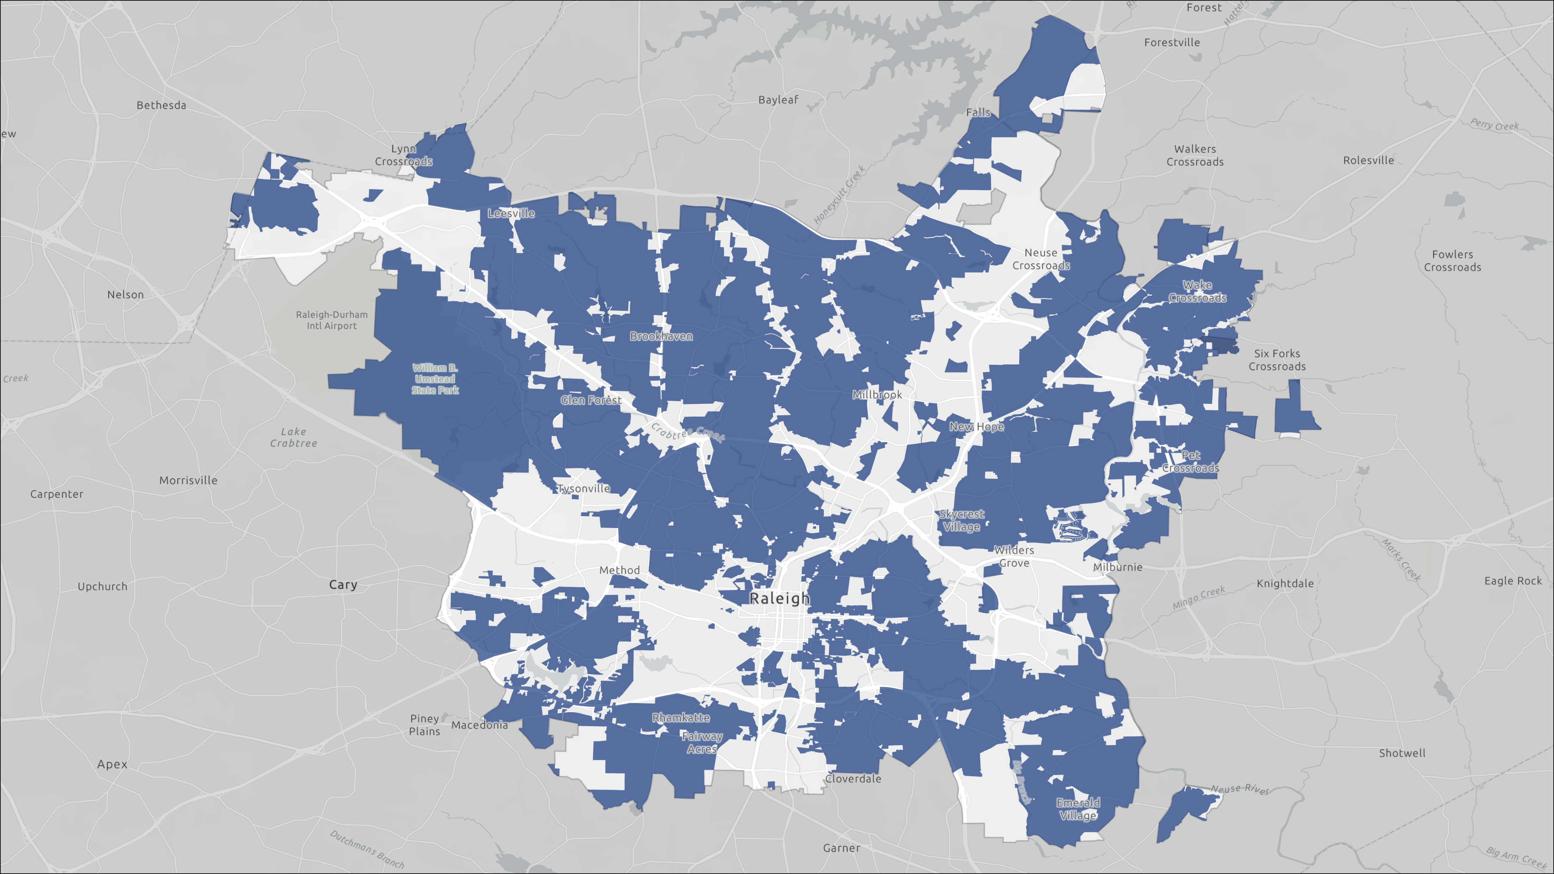
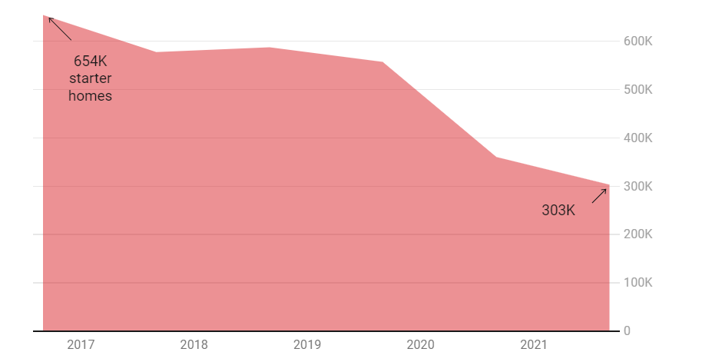
While the number of starter homes has declined
66%
Single-Family Only Zoning (Pre-2021)
Homes less than 1,850 square feet
Notes:
https://www.realtor.com/news/trends/death-of-the-starter-home-where-have-all-the-small-houses-gone/

Slide 11
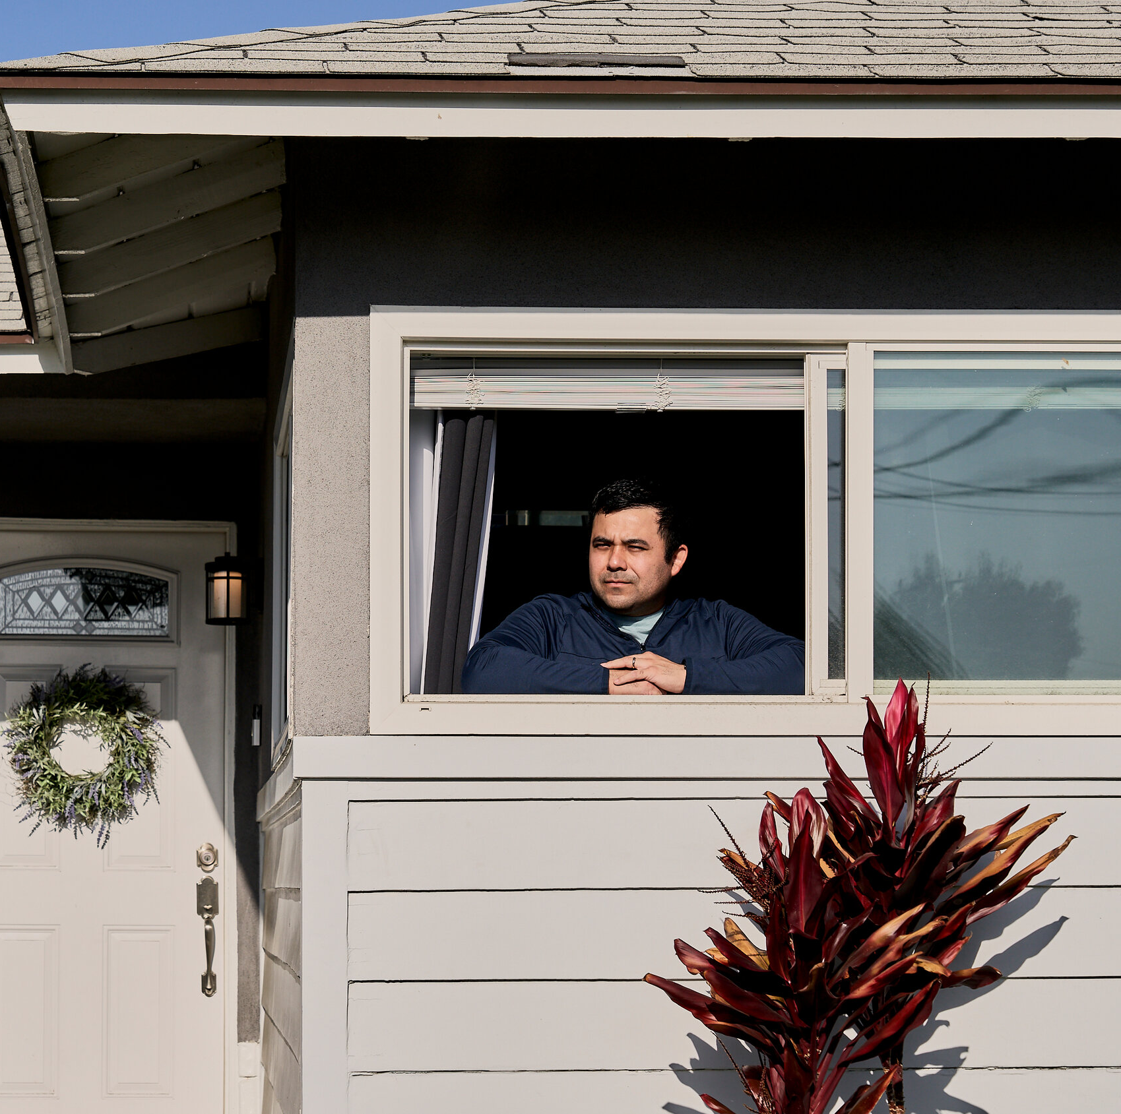
Average age of first-time home buyer reaches a new high at 36 years old Share of first-time home-buyers reaches a new low at just 26%
Notes:
White buyers accounted for 88 percent of home sales during the survey period, up from 82 percent during the same period a year earlier, reaching the highest level in 25 years, according to the association’s findings.
Together, Black and Asian/Pacific Islander buyers accounted for just 5 percent of all home sales, as their shares in the market dwindled in the survey year compared to the previous year. Latino and Hispanic buyers accounted for 8 percent during that period, according to the nationwide survey of 4,900 recent buyers of primary residences.

Slide 12

Population Growth
High-Income Earners
High Land Costs
High Construction Costs
Restrictive Zoning Regulations
High Housing Costs

Slide 13
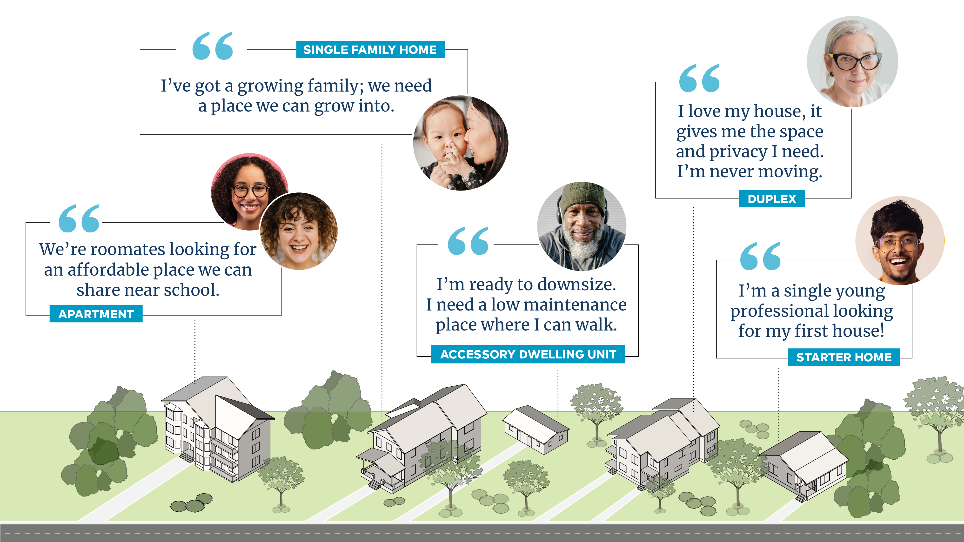

Slide 14
The Housing Crisis Requires Action on Three Fronts:
Improving Housing Affordability
across Raleigh’s entire housing supply
Increasing Affordable Housing
or the supply of income-restricted units
Addressing Homelessness
preventing and ending homelessness with evidence-based, data-driven practices
The City of Raleigh is committed to creating 5,700 affordable housing units by 2026.
Notes:
Abundant market-rate housing is key to ensuring affordability and managing the increase in housing costs.

Slide 15

Some tools are unavailable
Mandatory affordable
housing contributions
Mandatory inclusionary zoning
Rent control
Notes:
Conditional use zoning is authorized and voluntary conditions for AH can be accepted

Slide 16

Some tools are unavailable
Rent control
Mandatory affordable
housing contributions
Mandatory inclusionary zoning
Notes:
Conditional use zoning is authorized and voluntary conditions for AH can be accepted

Slide 17
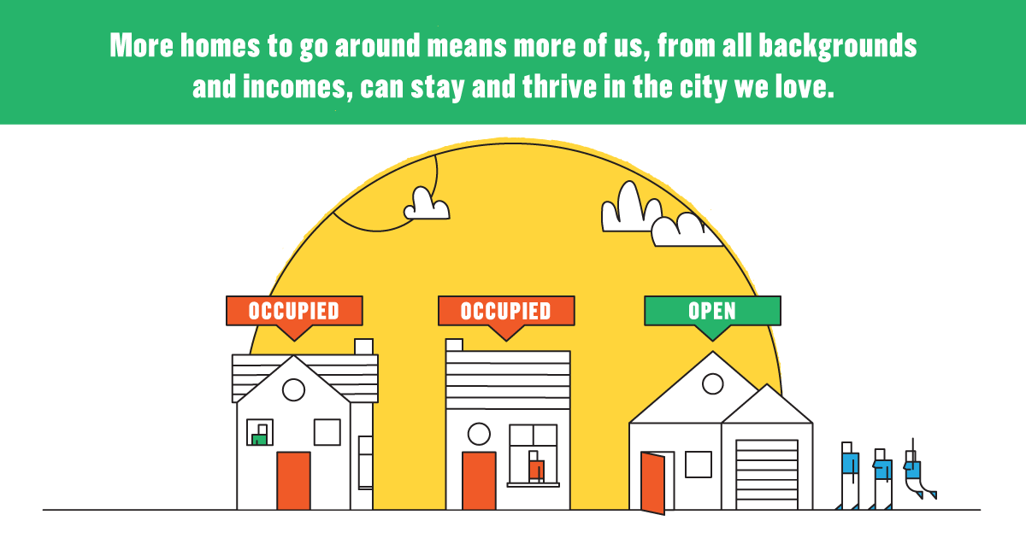
More Housing is Part of the Solution

Slide 18

For every 100 luxury units built in wealthier neighborhoods, as many as 48 households in moderate-income neighborhoods are able to move into housing that better suits their needs, vacating an existing unit in the process. Somewhere between 10 and 20 of these households are coming from among the city’s lowest-income neighborhoods, vacating units and reducing demand where housing is most likely to be affordable for working families.
Notes:
https://www.bloomberg.com/news/articles/2019-06-05/what-adding-luxury-housing-does-to-rents-elsewhere

Slide 19
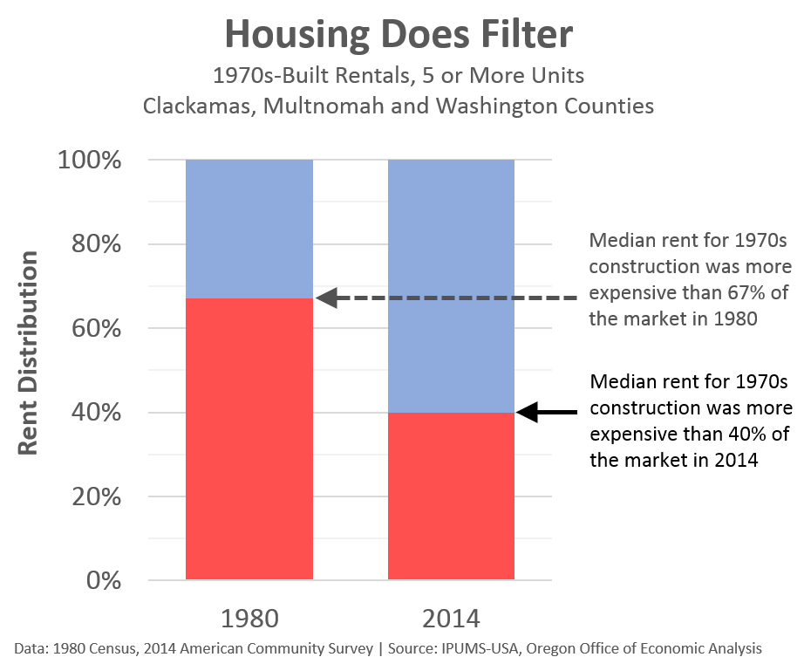
Notes:
https://oregoneconomicanalysis.com/2016/05/25/housing-does-filter/

Slide 20
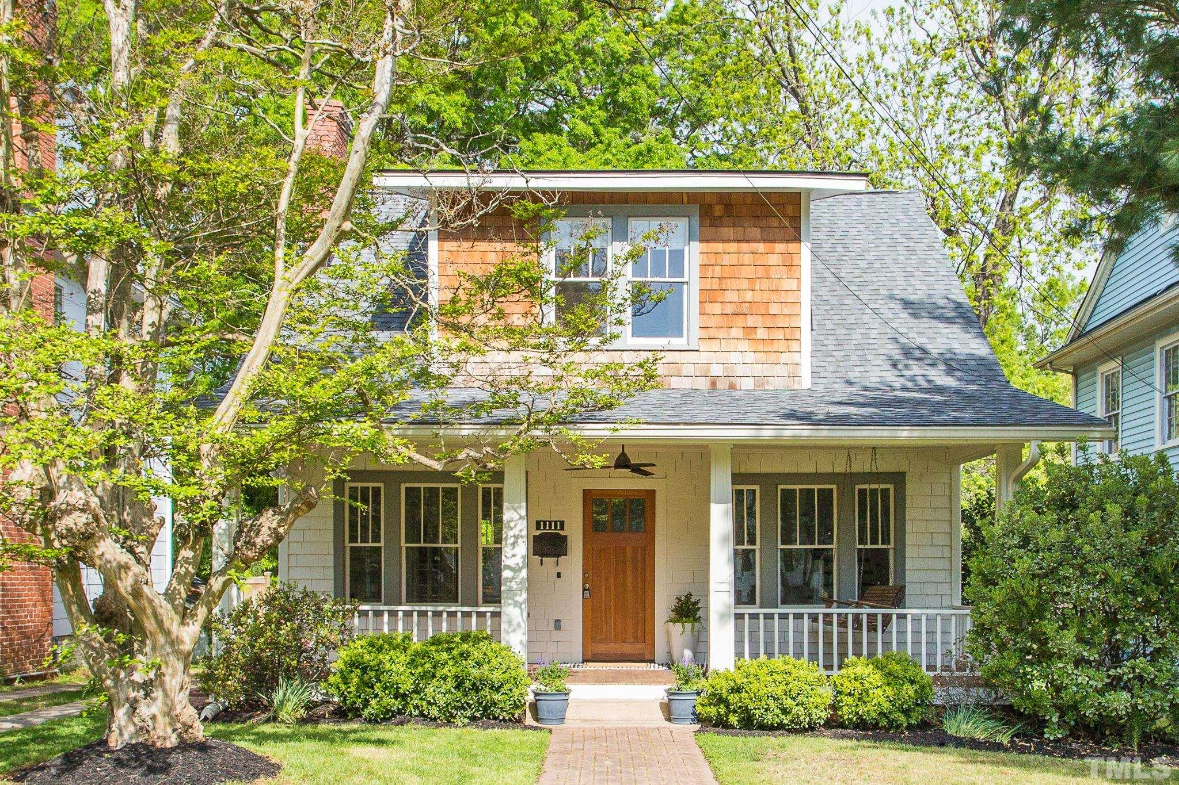
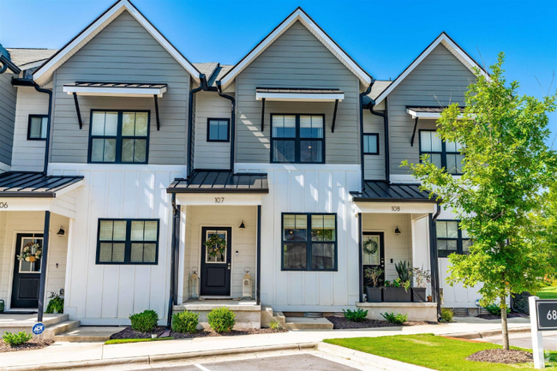
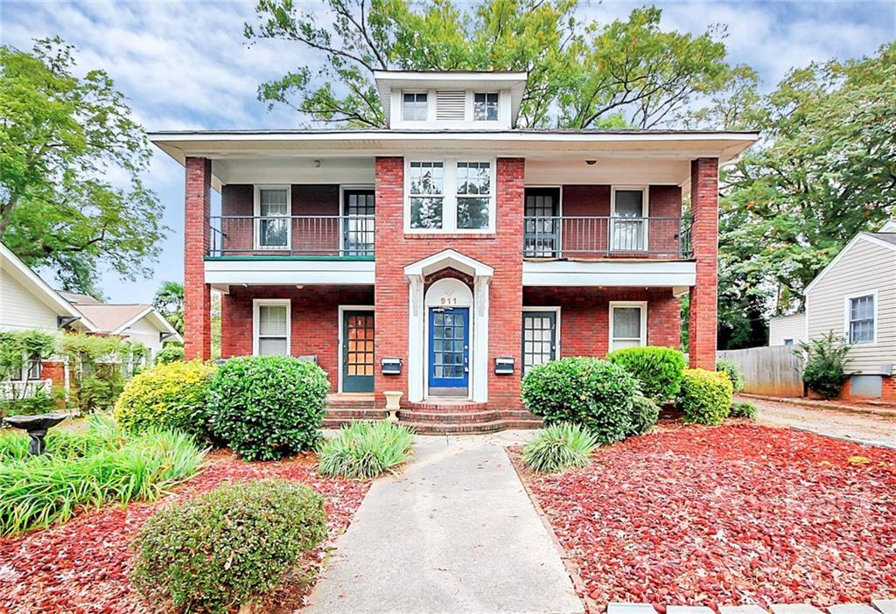
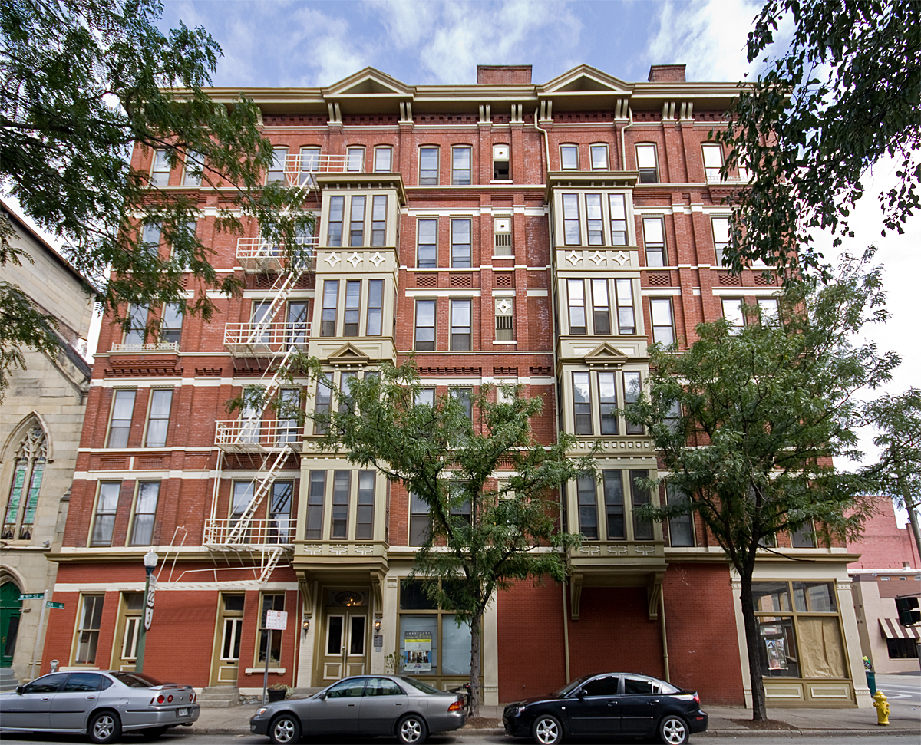

Average Annual Energy Usage by Housing Type and Carbon Emission Levels (BTUs)
These Housing Types Are More Sustainable
Detached House
Townhouse
Fourplex
Apartment
82.7 BTU
56.5 BTU
42.1 BTU
34.0 BTU
(BTU = British Thermal Units)
Notes:
The first key benefit of missing middle housing is sustainability and carbon reduction. Due to shared walls, roofs, utilities and other infrastructure, a fourplex uses, for example about half the energy per year as a detached house – since over ½ of all carbon emissions in Raleigh come from buildings, it will be very difficult to meet our Climate Action Plan goals for emissions reductions without an increased share of our housing being in these types (as noted, about 15% of our current housing stock is missing middle)

Slide 21
Solution:
More housing throughout more of the city for people of different ages, incomes, and lifestyle preferences
Notes:
https://wraltechwire.com/2022/10/14/report-raleigh-no-1-in-share-of-workers-earning-100000-durham-also-scores-well/

Slide 22
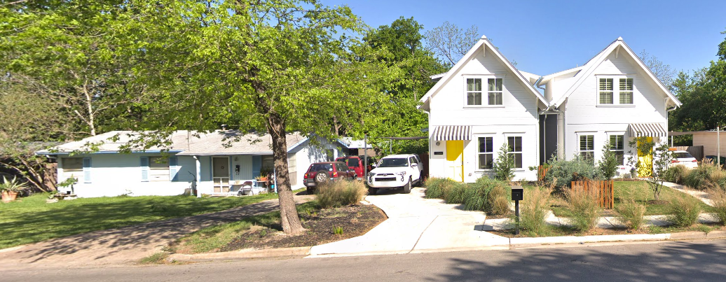
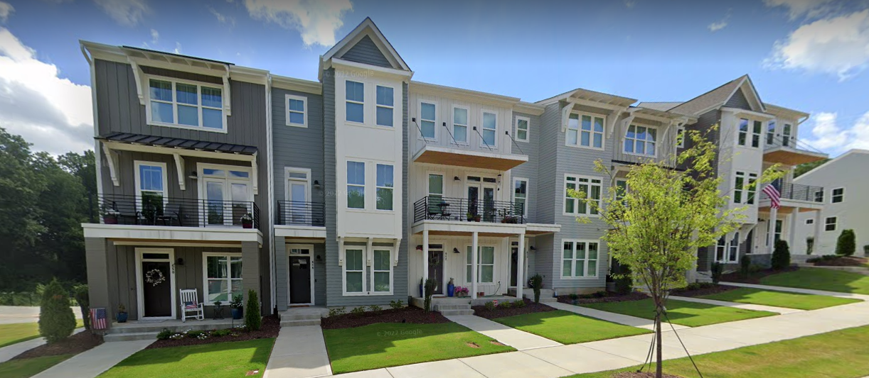
What has Raleigh done?
Legalized duplexes
Legalized ADUs
Expanded townhouse permissions
Promoted developments with common open space
Incentivized construction of smaller homes
Notes:
https://wraltechwire.com/2022/10/14/report-raleigh-no-1-in-share-of-workers-earning-100000-durham-also-scores-well/

Slide 23
Raleigh’s Steps Toward Change
1. Min. Site and Lot Width Standards
2. Accessory Dwelling Units
3. Attached Houses (Duplexes)
4. Two Unit Townhouses
5. Flag Lots
6. Density Changes
7. Townhouses in R-6
8. Small Apts in R-10
9. Tiny Houses
10. Compact & Conservation Dev.
11. Freq. Transit Dev.
Notes:
Lane 30 units per acre, Franklin – 40, Bloodworth - 90

Slide 24
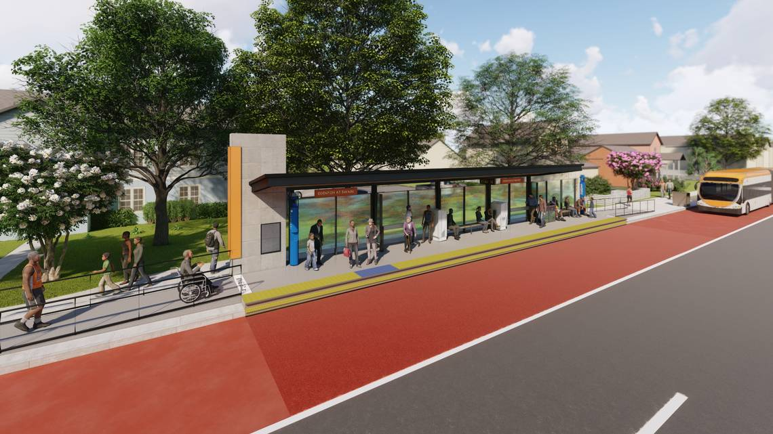
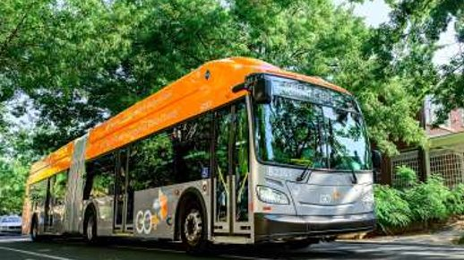
Bus Rapid Transit (BRT)
Community Benefits:
Enhances existing public transportation network
Allows the system to better meet transit demands
Takes more cars off the road, lowering environmental impact
Gets riders where they need to at a faster rate
Updated stations, bus lanes and traffic safety signs

Slide 25
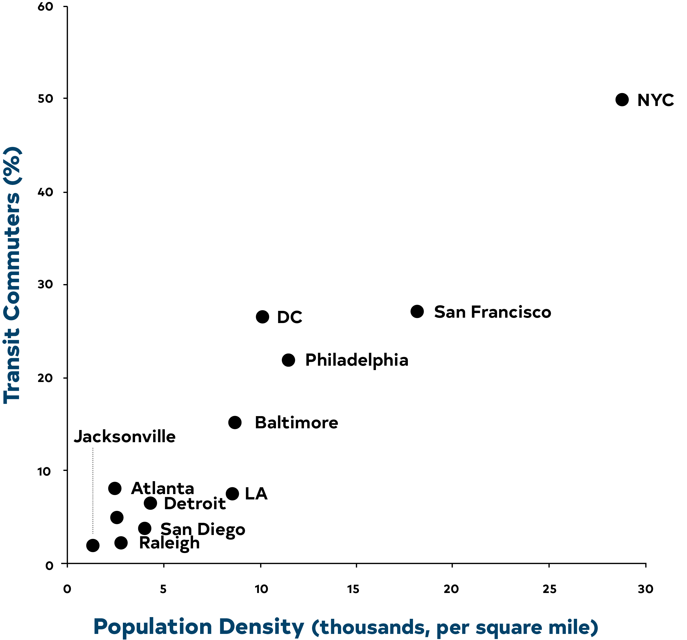

Transit Usage and Housing Proximity
Notes:
A closely related benefit is transit supportiveness. As you can see from the graph, there is a close connection between the compactness of development and the success of transit systems in cities across the nation. AS you know, we are investing millions of dollars in our BRT and high-frequency transit network and MM housing is a good way to help promote and encourage ridership.
https://ggwash.org/view/787/scatterplot-of-density-vs-transit-ridership

Slide 26
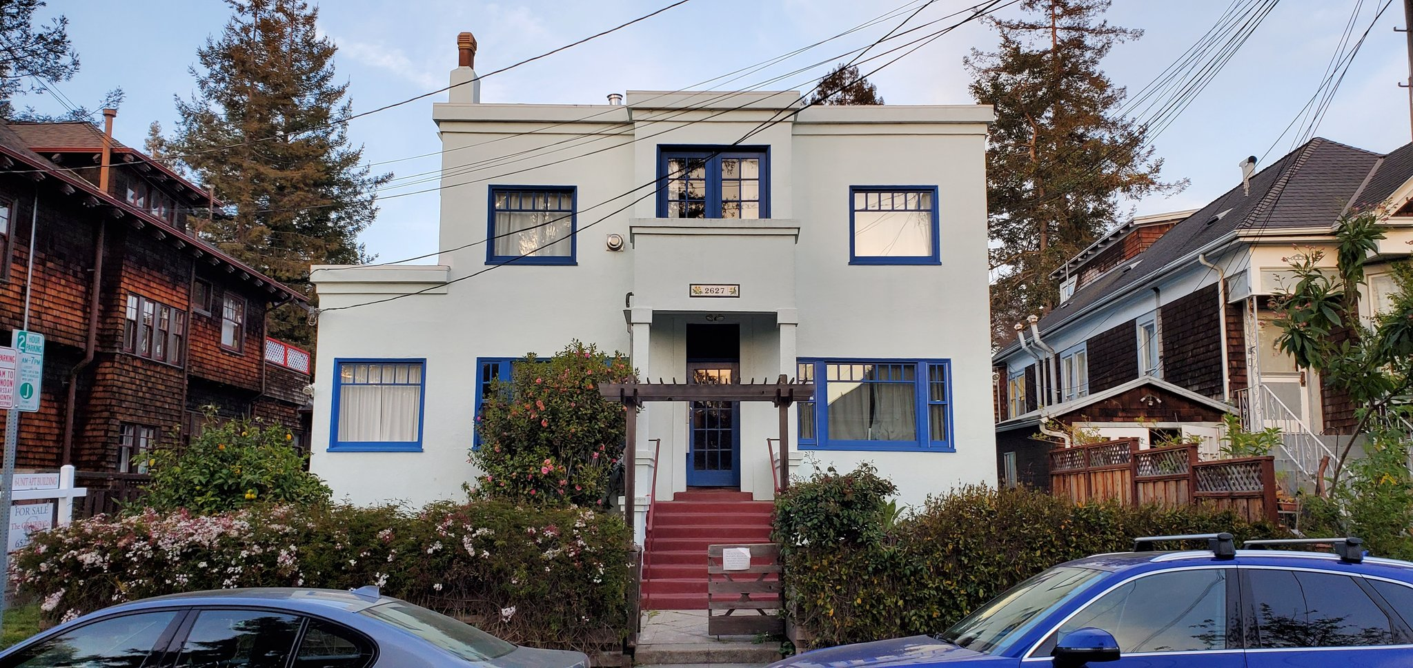
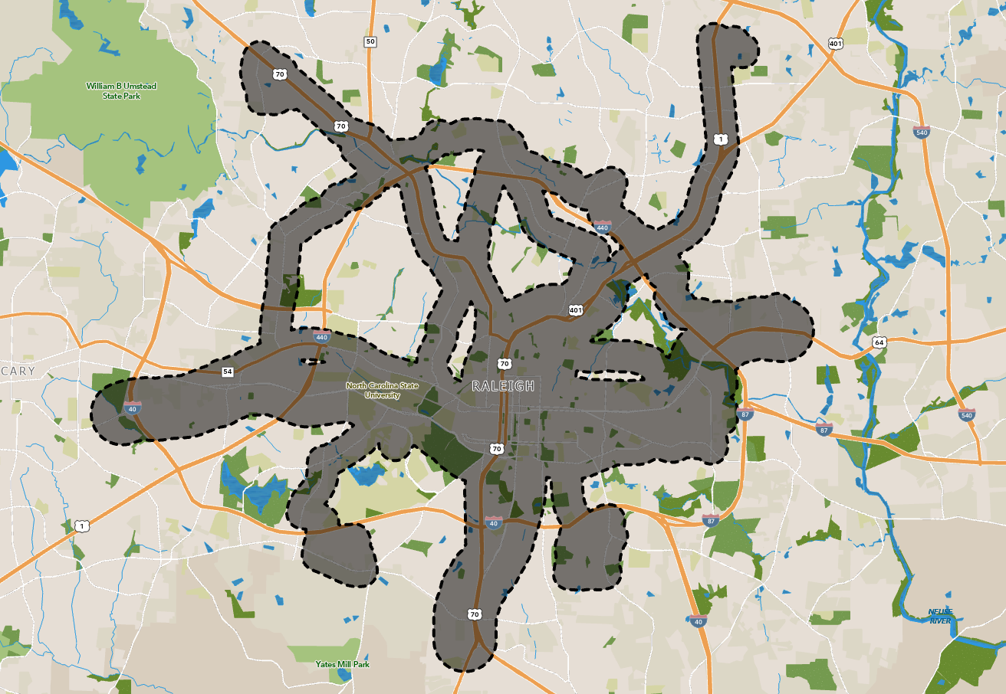
Focus on planned high-frequency transit
Incentivized multi-unit development
Instituted affordability requirements for larger-scale projects
Duplex (Existing)
5 Unit Apartment (Proposed)
Notes:
https://wraltechwire.com/2022/10/14/report-raleigh-no-1-in-share-of-workers-earning-100000-durham-also-scores-well/

Slide 27
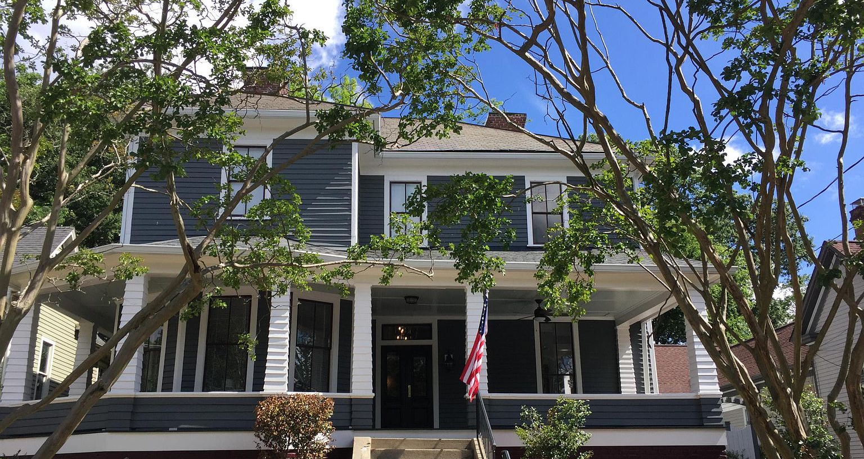
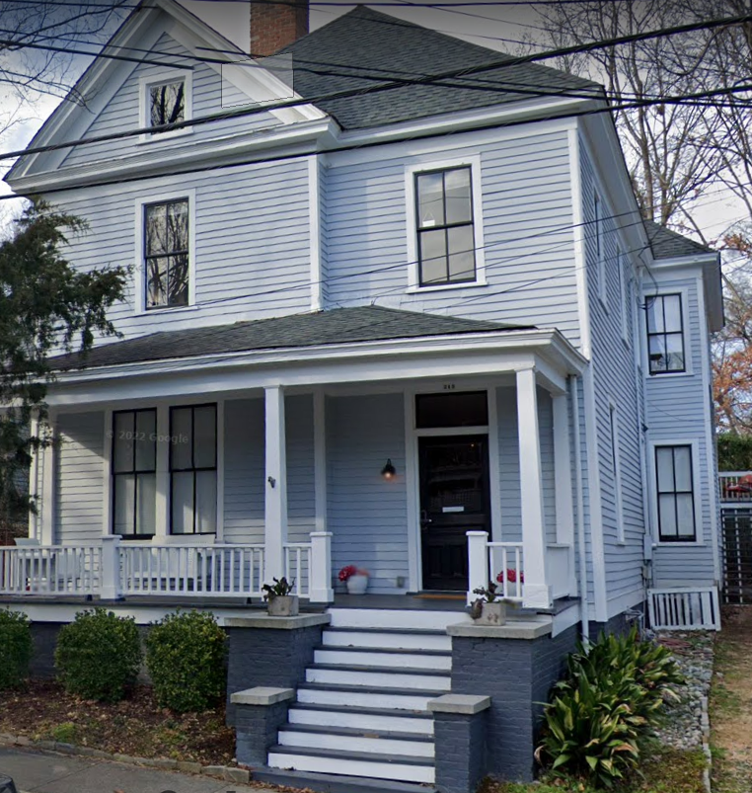
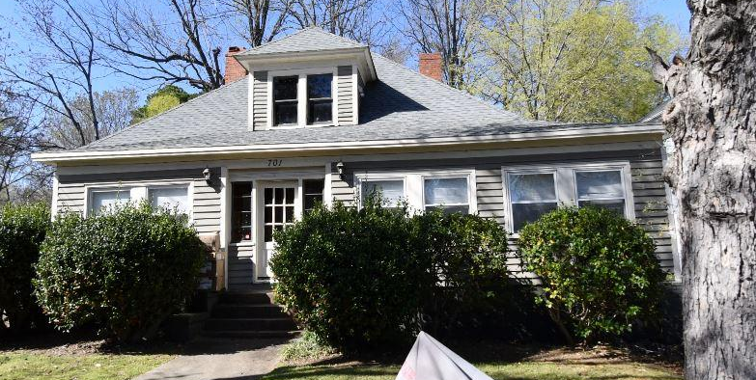
30 units/acre
86 units/acre
40 units/acre
Notes:
Lane 30 units per acre, Franklin – 40, Bloodworth - 90

Slide 28
Total Missing Middle Dwelling Unit Count by Review Status
254
866
3,643 Total
2,523

Slide 29
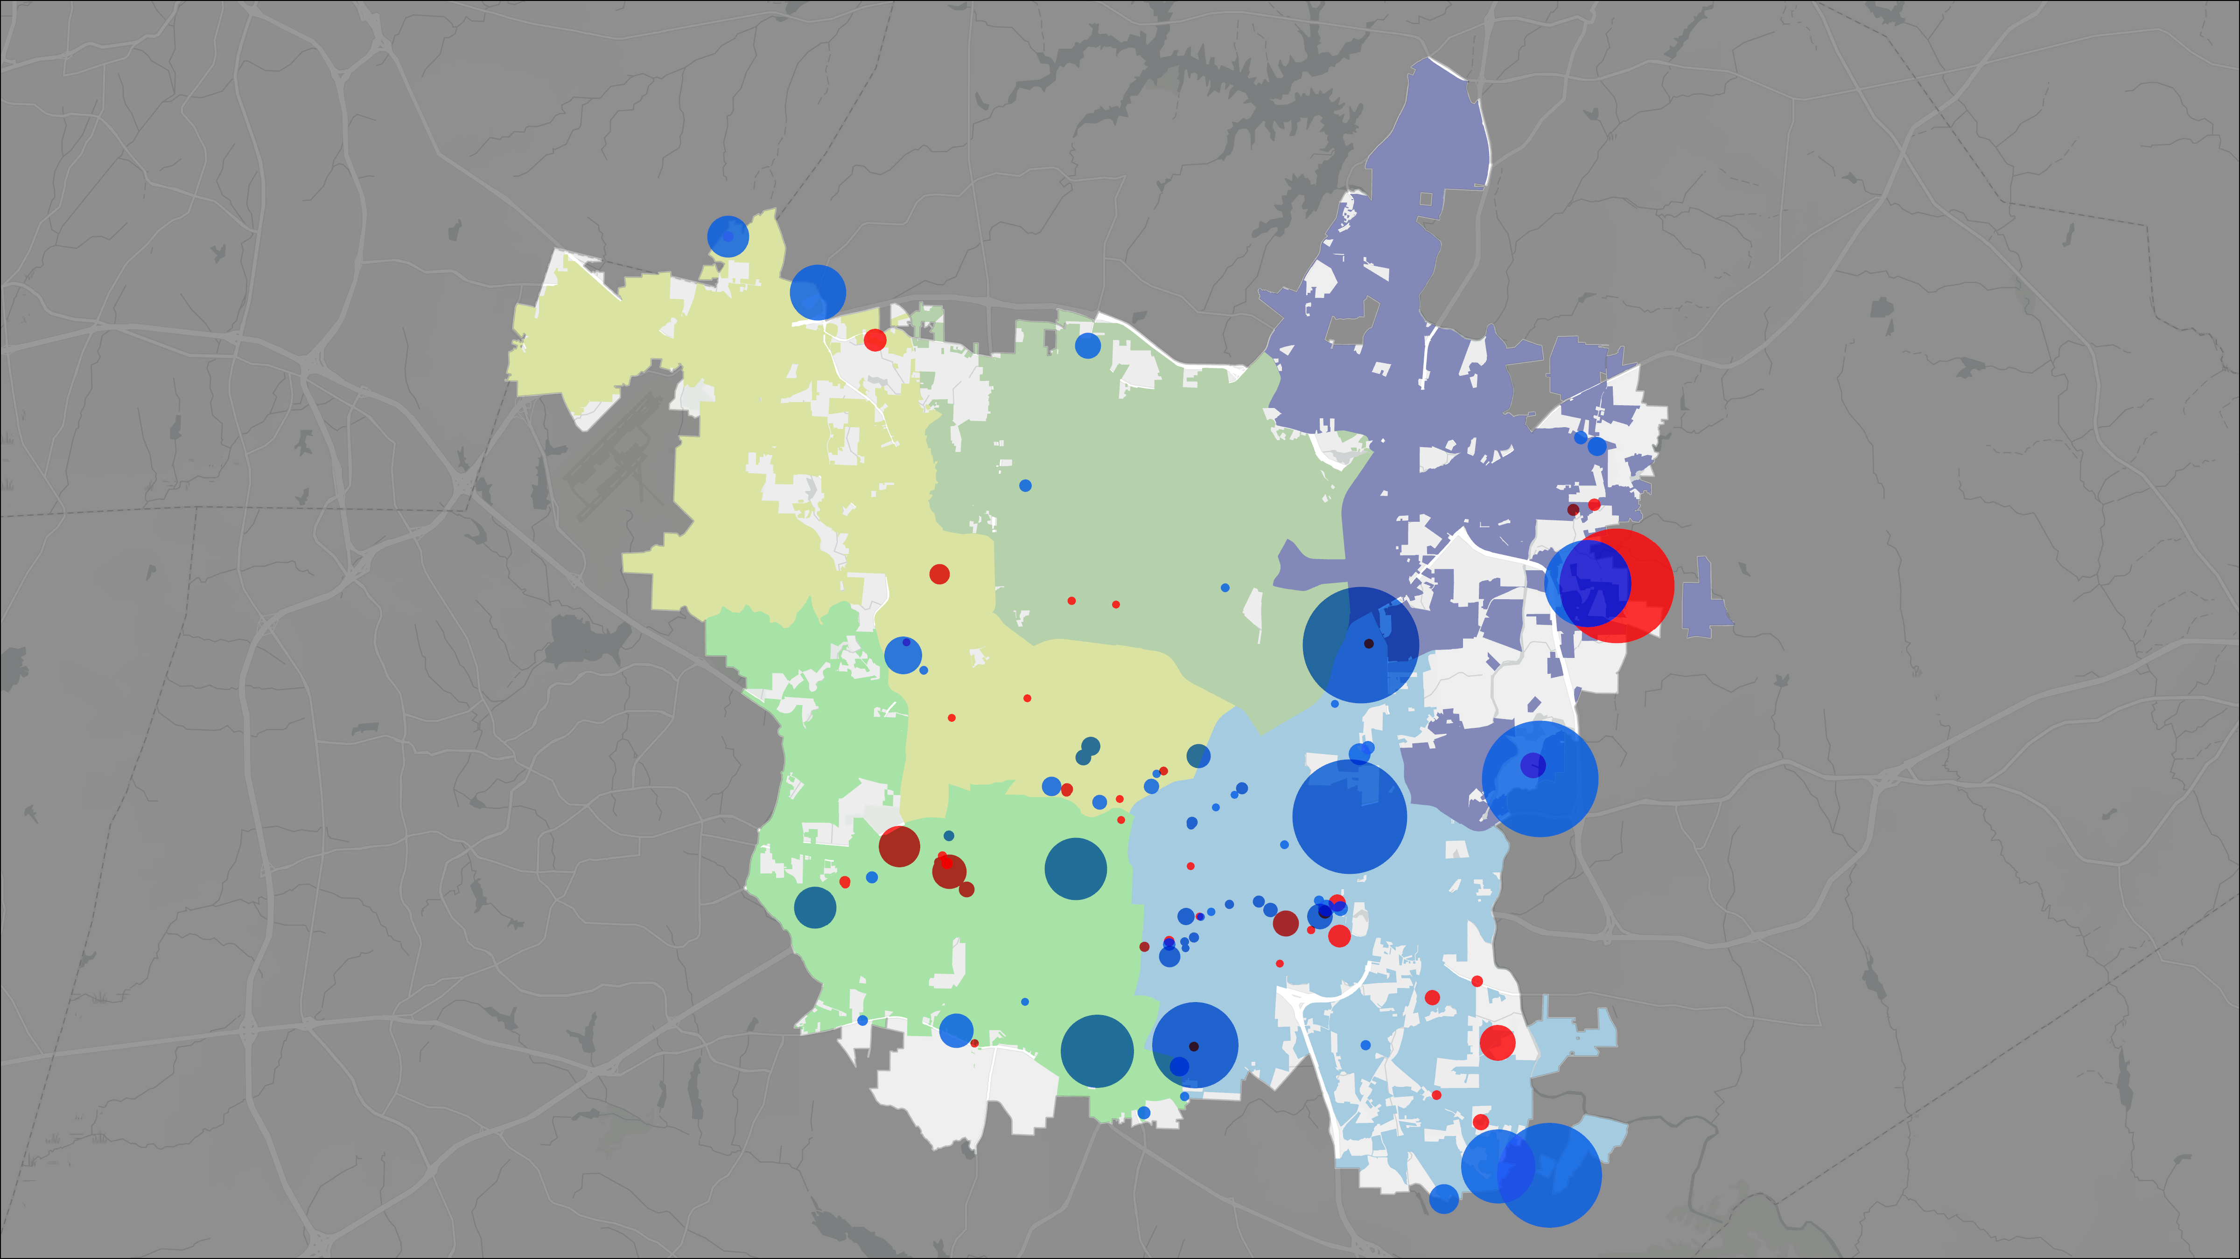



Missing Middle Projects (SUBs & ASRs)
B
Approved or In Review
(through January 9, 2025)
E
A
D
Approved: 2,513 DUs
A: 55 DUs
B: 427 DUs
C: 1,238 DUs
D: 383 DUs
E: 410 DUs
C
In Review: 808 DUs
A: 5 DUs
B: 282 DUs
C: 252 DUs
D: 176 DUs
E: 93 DUs

Slide 30
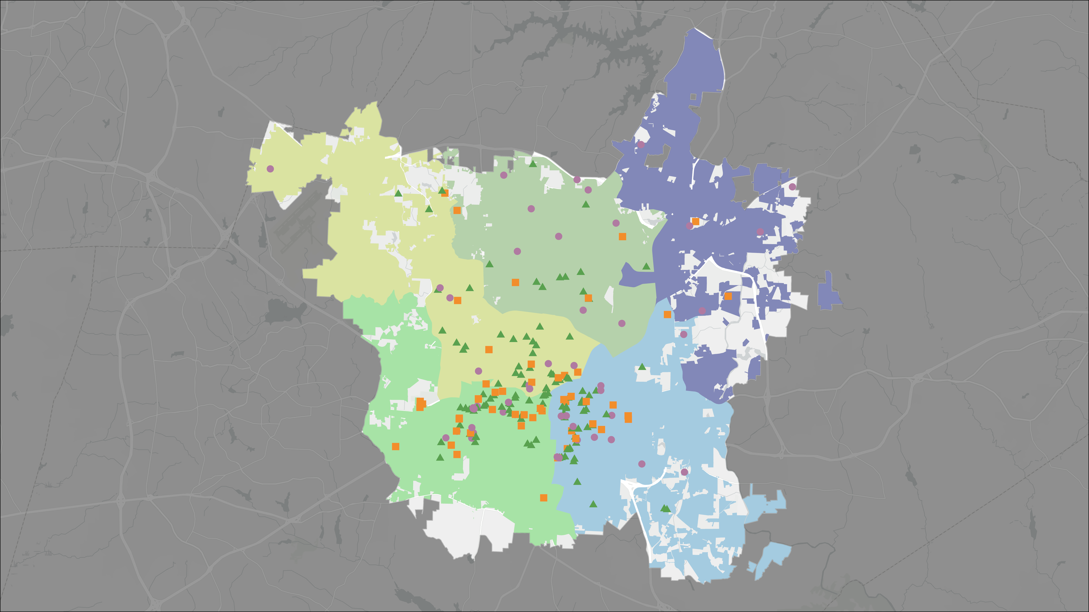


ADU Distribution
B
E
A
236
Applications
as of 1/9/2025
D
ADU Permits
Issued: 173
In Review: 63
Complete: 120
C

Slide 31
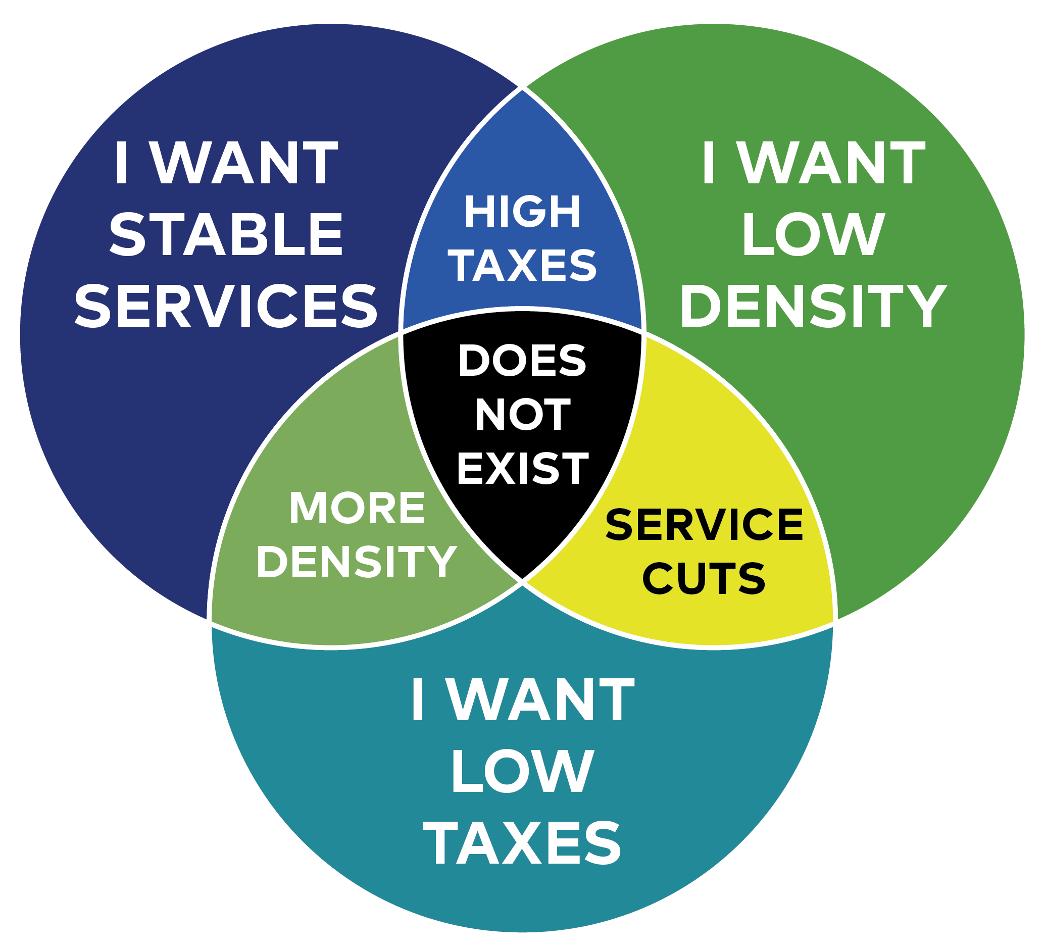
How should we continue to grow?

Slide 32
Questions?
Notes:
https://wraltechwire.com/2022/10/14/report-raleigh-no-1-in-share-of-workers-earning-100000-durham-also-scores-well/

