Slide 1
Housing Affordability: Permitting & Zoning Solutions
Removing Barriers
ICC Roundtable
December 4, 2025
December 4th, 2025
Housing Affordability Roundtable

Slide 2
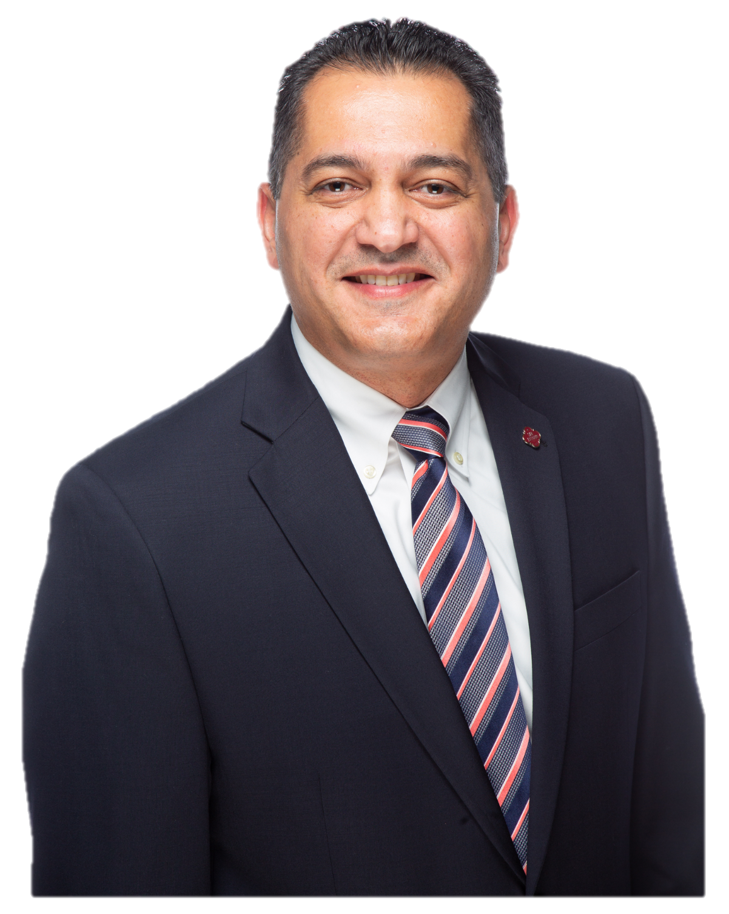
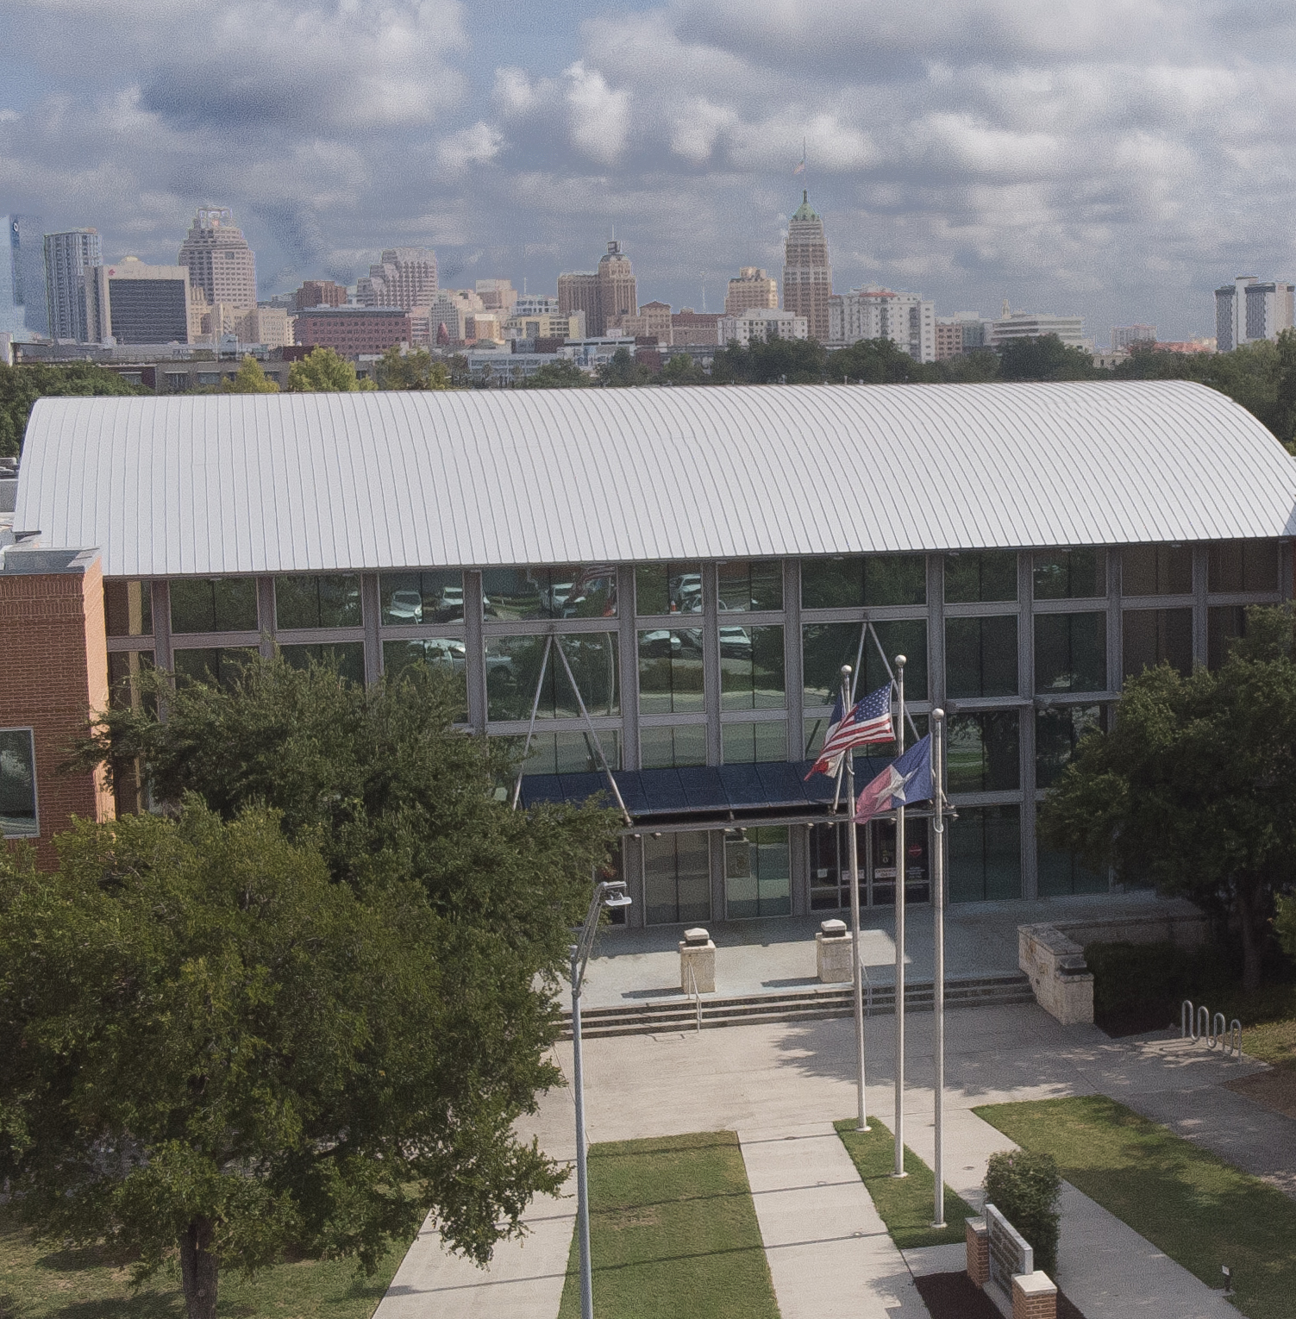
Introduction
Engineering & Management
20⁺ years of experience
City of San Antonio
13 years of service
DSD Engineer – Plan Review
Assistant Director – Field Services
Deputy Director – Field Services
Director – Building & Code Official
Amin Tohmaz, PE, CBO - Director
Development Services
City of San Antonio, Texas

Slide 3
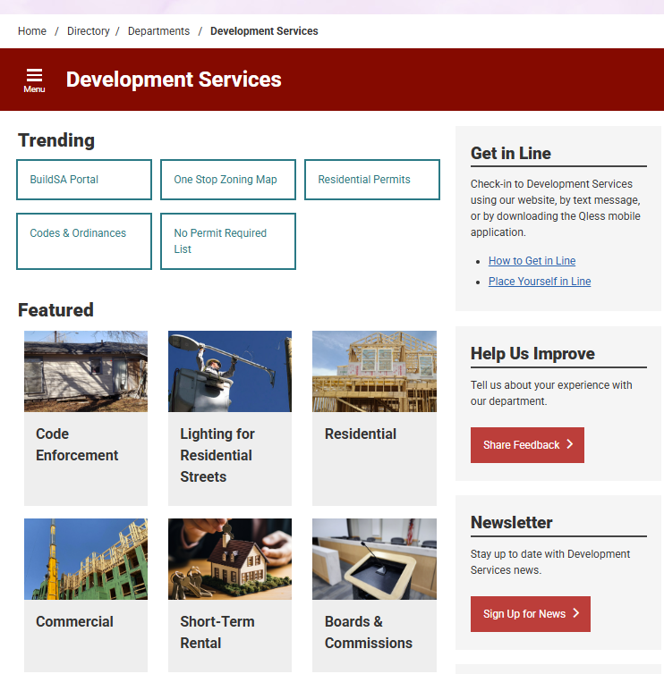
Enabling Tech
Applications & Plan Review
COSA Online portal allows:
Over the counter permits
Applications & plan reviews
Paying fees
Uploading drawings and letters
Live updates and email notifications
Garage sale permits
All application submittals

Slide 4
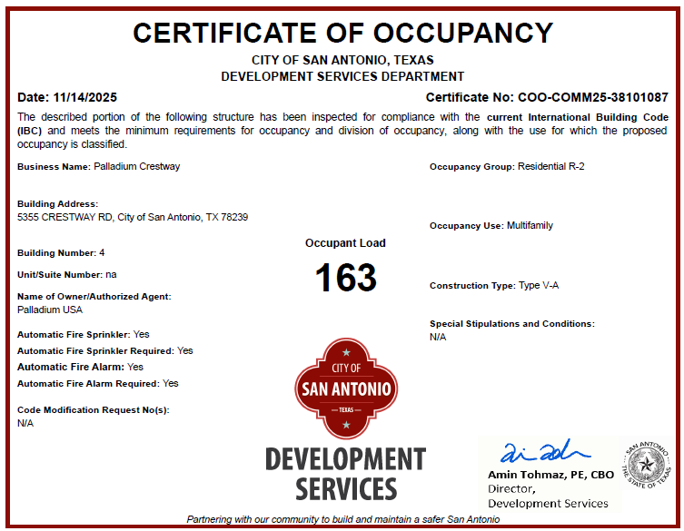
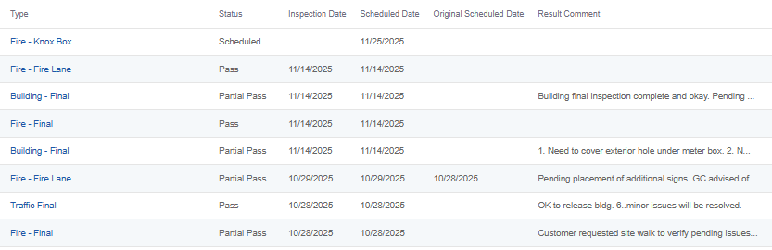
Enabling Tech
Inspections, TCO’s, & COO’s
COSA Online portal allows:
Scheduling inspections
Tracking inspections and results
RVI (Remote Video Inspections)
Uploading drawings and letters
Live updates and email notifications
Instant TCO & COO issuance

Slide 5

Enabling Tech
Results:
Efficient review times
Reduced timeframe for issuing permits
Customer has instant access to all information for their project
More efficient and timely inspections
Instant TCO & COO issuance

Slide 6
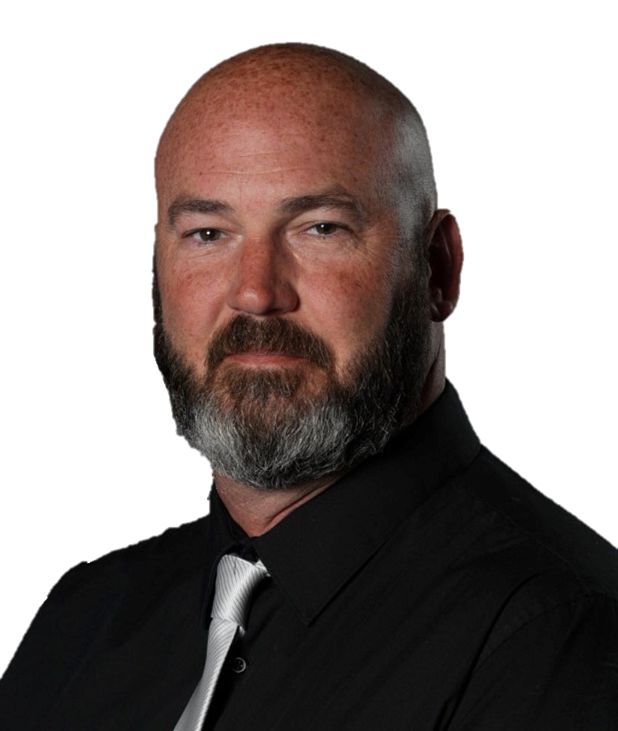
Introduction
Associates of Applied Science in Civil Engineering (Architectural)
Drafter, Estimator, Purchaser, CAD Manager
16 years
City of San Antonio DSD
13 years of service
Residential Combination Inspector
Building Inspector
Sr Building Inspector
Chief Building Inspector
Project Manager
Jason Gray, Project Manager
Affordable Housing Team - Development Services
City of San Antonio, Texas

Slide 7

Am I a barrier? Put yourself in their shoes.
Potential barriers:
Need of a network:
Unfamiliar with permitting process
Zoning / Platting / Addressing
Who do I contact at the Building Department
Plan Review process / submittals
Inspection process
Application and permit fees
Other divisions within the Department
Utility contacts
Political connections
Developers / Architects / Engineers / Contractors
Attend Meetings
Provide trainings

Slide 8


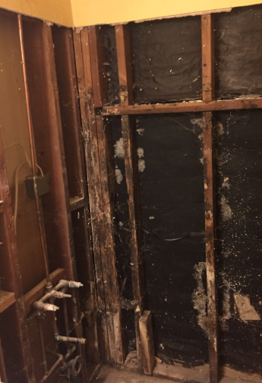

Should we help before they have an application or permit?
Pre-inspect property
What codes apply?
Scope of work?
Termite, water, or structural damage?
Previous open permits
Work done without permits
Zoning issues
Service utilities
Value Engineering
Required permits
Preliminary plan review service
Meet with developers and designers prior to application submittal
Include all needed teams
Give direction

Slide 9
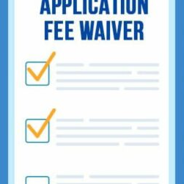

We can’t afford this!
Funding + gap funding
Funding sources – Local, County, State, Federal, HUD, VA, Charities…
Work with Neighborhood Housing Services Department
Fee waivers – permit fees, impact fees, utility connection fees…
Land Trusts

Slide 10


Deadlines
Shorter review times
Track all reviews
Track plan review/lender milestones
Creative solutions to get permit ready letters, partial permits, code modification requests…
Issue permits
Timely and consistent inspections
Track turnover milestones and closings

Slide 11

Affordable Housing Team
Accomplishments
Gained understanding of our role as Building Officials
Developed a network
Identified barriers and learned how to navigate them
Assist developers and funding sources
Streamline plan review and inspection processes
Navigated deadlines and milestones
Consistently shorter overall permitting and inspection processes

Slide 12
THANK YOU!
Jason Gray, Project Manager Jason.Gray2@sanantonio.gov

