Slide 1
Classroom Presentation
Grade level: 4-6
Run time: 30-45 minutes (additional information in slide notes)
Suggested materials: Building Safety Month home checklist and Kids' proclamation + supplies for extension activities (see last slide)
Available for purchase: Building Safety Month vest, hats and pencils
Extension activities available at the end of the presentation.
Notes:
This slide includes overview information for teachers – not to be included in the presentation.

Slide 2
Video Coming Soon!
Hi!
I’m CODiE
the Cheetah.
Happy Building Safety Month!
Notes:
The entire month of May is Building Safety Month!
Does anyone have a guess what Building Safety Month means? This year’s theme for Building Safety Month is “Game On!”, and we need your help to get in the game and take part in learning about and practicing building safety.
Play the video. https://youtu.be/d2uQIkLnapU
Let's learn more about building safety with CODiE the Cheetah! (mention his hat, vest, clipboard – what is he looking at?)

Slide 3
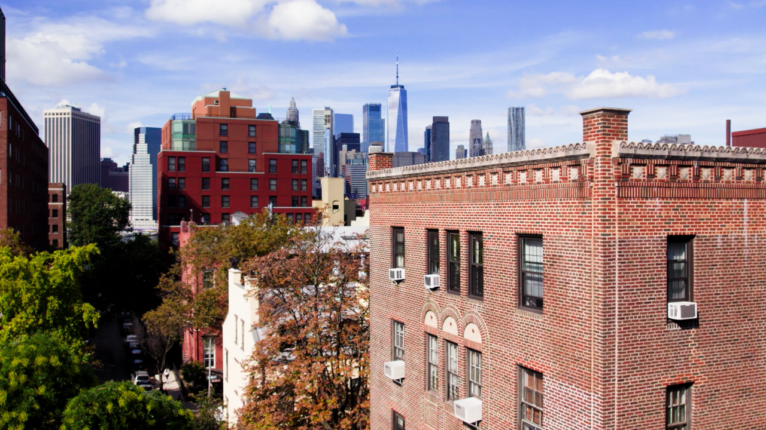

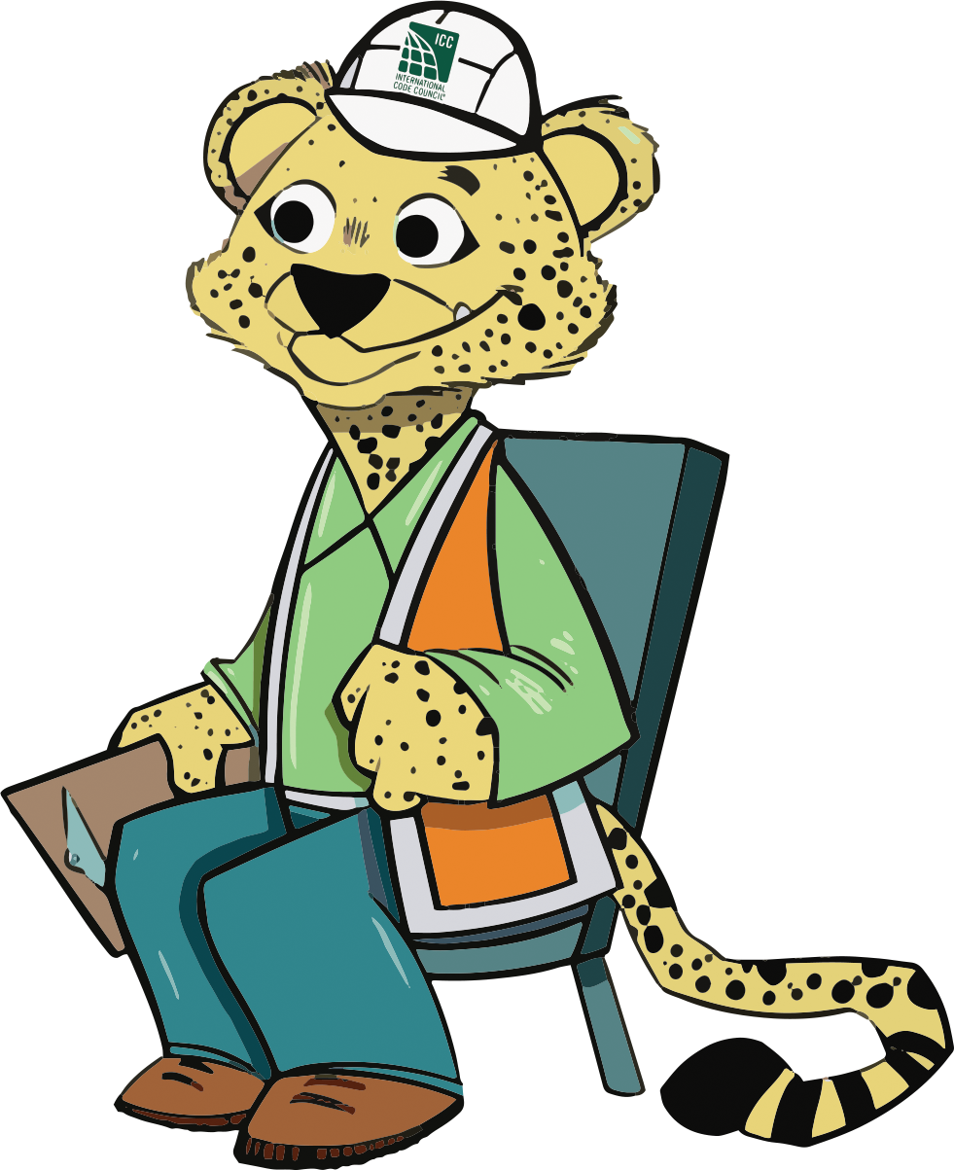
What is your favorite building?
Notes:
Raise your hand and tell me your favorite building. Why is it your favorite? My favorite building is _____. (or give examples of notable buildings at school or in the community) In that building, what do you think are some ways it's keeping you safe?
Building safety is all about making sure you know how to keep yourself safe in case of emergency, and that buildings are built safe, strong and secure for everyone.

Slide 4
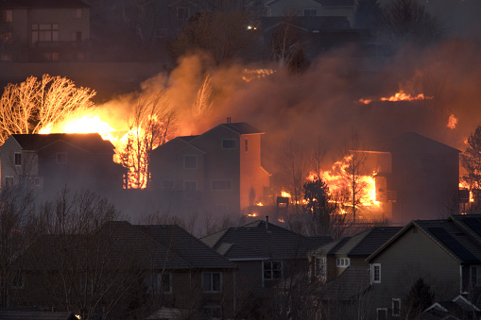
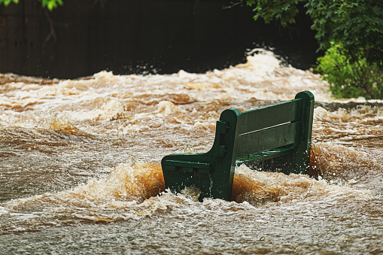
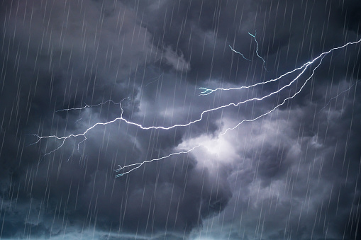
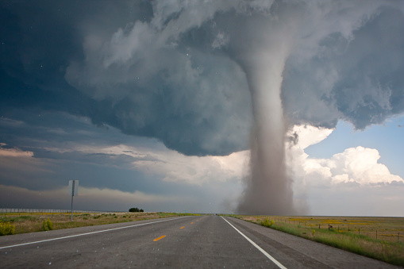
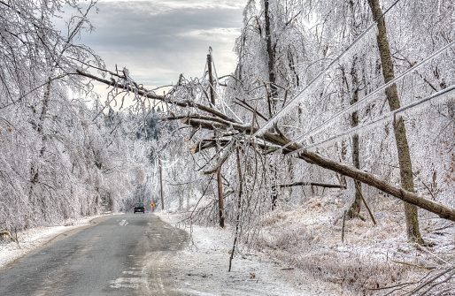
What are some potential safety dangers for a building?
Notes:
Buildings, like our classroom, are usually safe, but there are a few things that can be dangerous that we should be mindful of.
Does anyone have any guesses what might be dangerous?
What weather events do we have in our area that we should be mindful of?
To help protect yourself, it's important to be prepared in case of an emergency, including bad weather events.

Slide 5
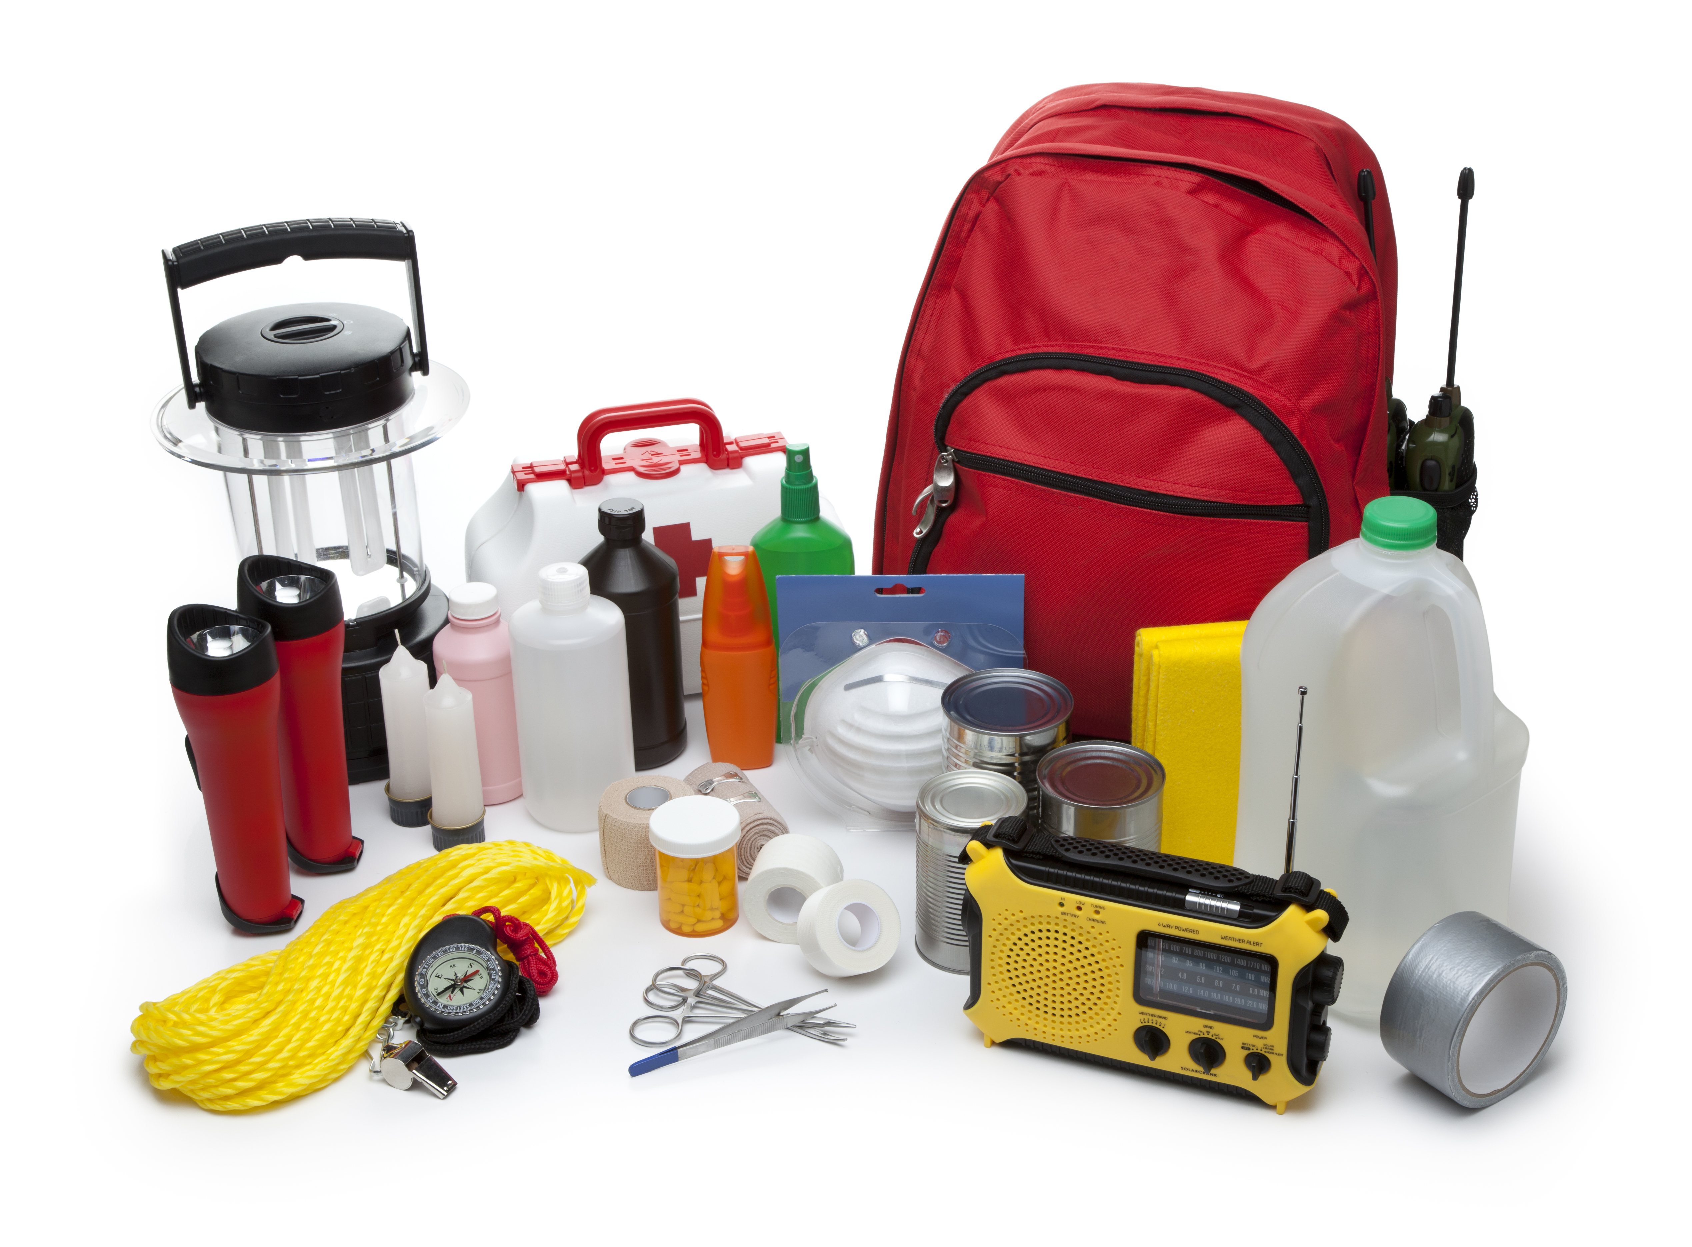
Let's build a safety kit!
Notes:
It's always important to have a safety kit around the house in case of bad weather or emergencies. What items should you include in the kit, and why?
ANSWERS: Radio, Money, Medicine & First Aid Kit, Batteries, Dog Food, Important Documents, Water, Canned Food, Flashlight, Band-Aids (can be customized with what's appropriate for your community)
It's also important to have a safe meeting area at home and at school in case of an emergency. Our safe zone is ______. We also shelter under our desks during an earthquake, and safe areas are set up in case of tornados.
Does anyone have a safety plan with their families at home?

Slide 6


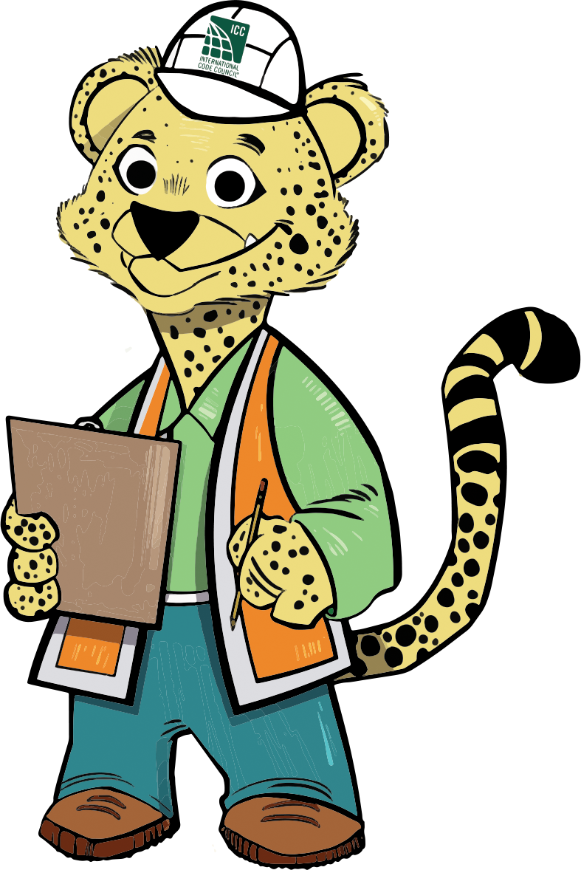
Who makes sure buildings are built safely?
Notes:
There are a lot of people who help ensure the places where we live, work and play are safe and stay safe.
Everyone from architects and engineers to plumbers and electricians all work together to make sure buildings are designed and built safely.
CODiE here is a code inspector, which means he makes sure that all buildings are up to the latest safety rules and regulations.

Slide 7
Building codes are like rules for builders.
Notes:
Think of building codes like a set of rules. When buildings are built, rules are followed to make sure they're strong, safe and last a long time.
Rules cover everything from how tall buildings can be, what kind of pipes they use and more! Every rule has a reason.

Slide 8
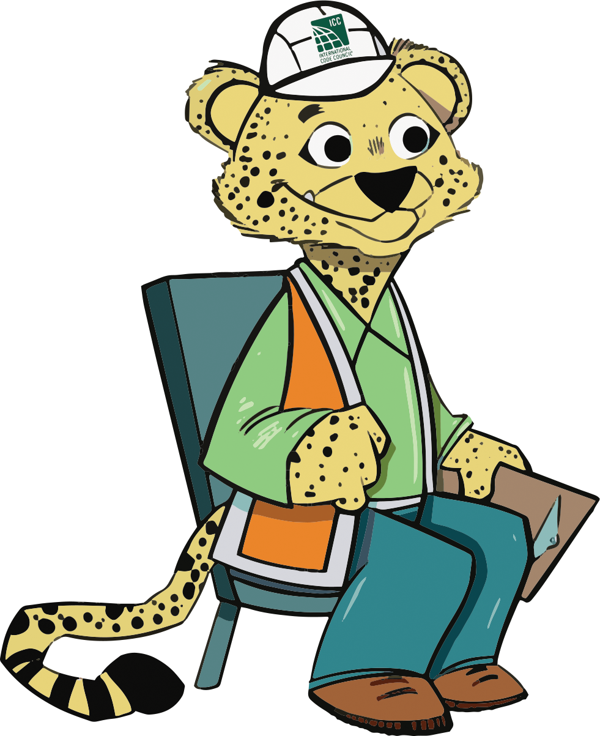
Buildings are designed to be safe for everyone!
Notes:
Codes are made with all types of people in mind so that everyone can enjoy the building safely.
Everyone is different and needs different things to stay safe. For example, buildings have ramps and automatic doors to make it easier for people in wheelchairs.
Clear fire exits and fire alarms are also important to protect people from indoor fire risks. Fire alarms even flash and ring so that people who are deaf or visually impaired can be alerted!
With your help, building fires can often be prevented.

Slide 9
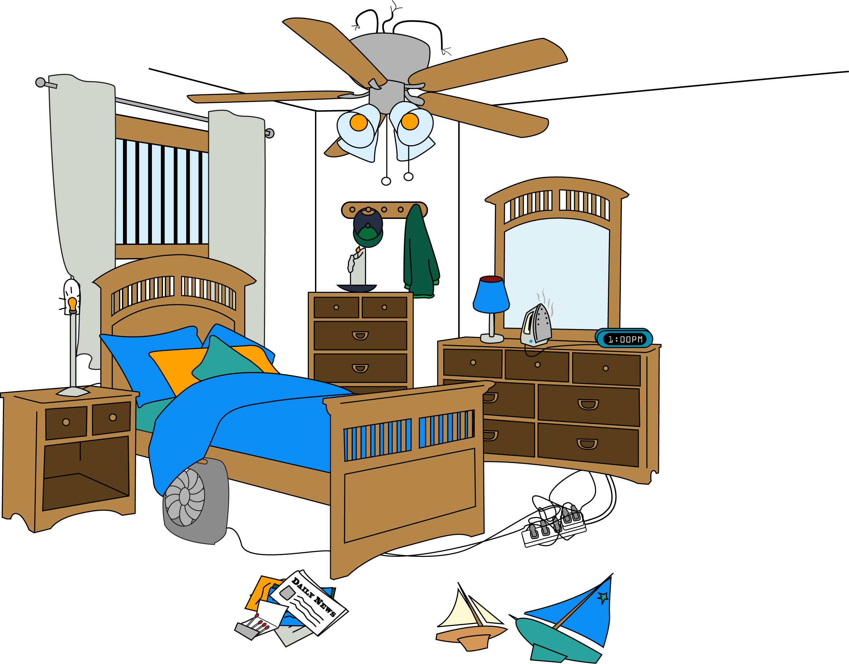
Help CODiE find fire dangers!
Notes:
Fire safety is a very important part of building safety. There are lots of things you can do to make sure you and your family stay safe. Can you spot any fire dangers in this picture? For example, I see _____.
ANSWERS (discuss why these are dangerous)
1. Matches on the floor on top of the newspaper.
2. Lamp without lampshade in contact with curtains.
3. A candle burning unattended directly under clothing.
4. Cords coming out of the light fixtures.
5. Iron left on.
6. Too many electronics tangled together in outlet.
7. Space heater is covered with a blanket.
8. Security bars across window

Slide 10
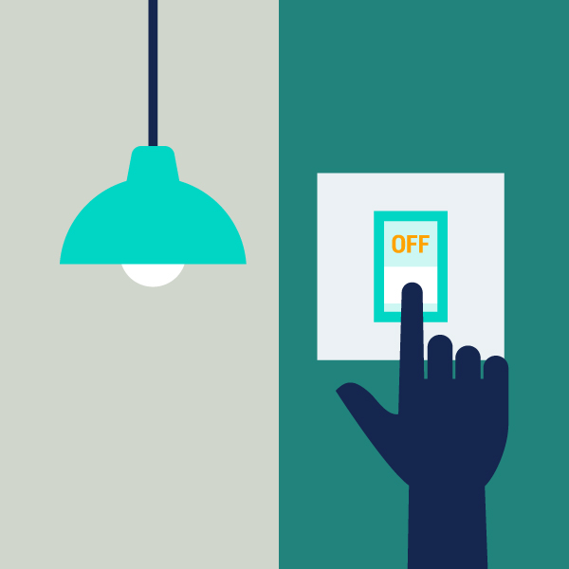


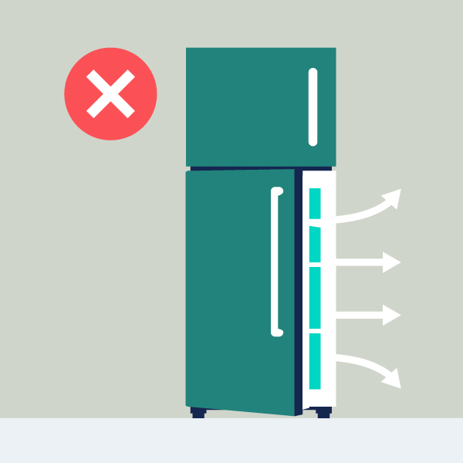
Let’s Save Energy and Water!
Notes:
Did you know a big part of building codes are about how to save energy and water? It's called being more efficient, and it's good for the planet and saves money.
What are some ways you can save energy or water at home or at school?
-Turn lights off
-Use LED bulbs
-Use fans instead of the air conditioner
-Unplug devices when you're done
-Leave the fridge door closed
-Take shorter showers and turn off the water when brushing your teeth
-Water the grass less often
Etc.

Slide 11
Let's make it official!
Notes:
Print copies in advance. Hand out the Kids' Proclamation flyer and have the students sign their first name and last initial and write the date. Instructors can then scan and upload the signed proclamations to the Kids' Corner website, where they'll be compiled for the year.
Proclamation form: https://www.iccsafe.org/wp-content/uploads/BSM_Kids_Proclamation_2025_pdf.pdf
Upload the proclamation form here: https://www.iccsafe.org/advocacy/building-safety-month/kids-corner/
Now that they understand the basics, encourage students to spread the word about building safety and talk with their friends and families about ways they can stay safe at home. Follow up the presentation with an email to parents, covering some of these topics and where to find more information.

Slide 12
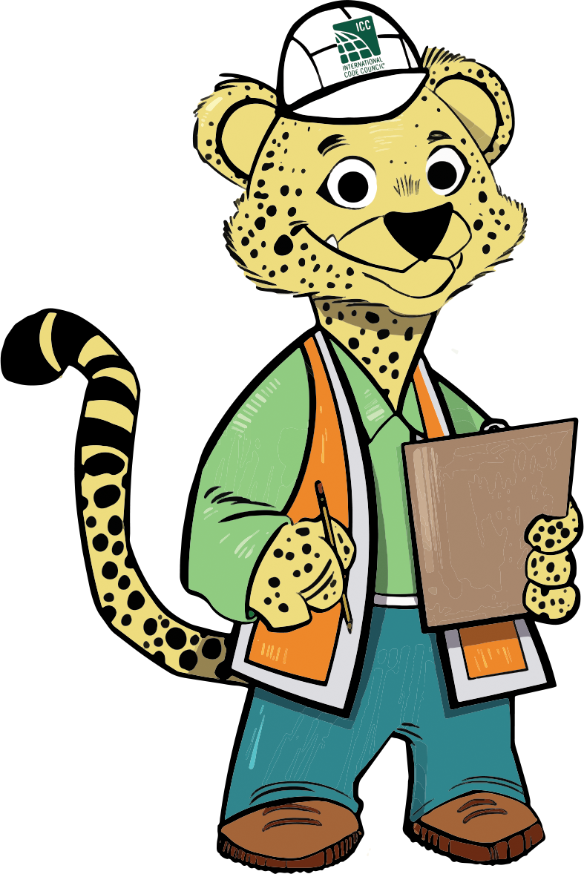
Extension
Activities

Slide 13
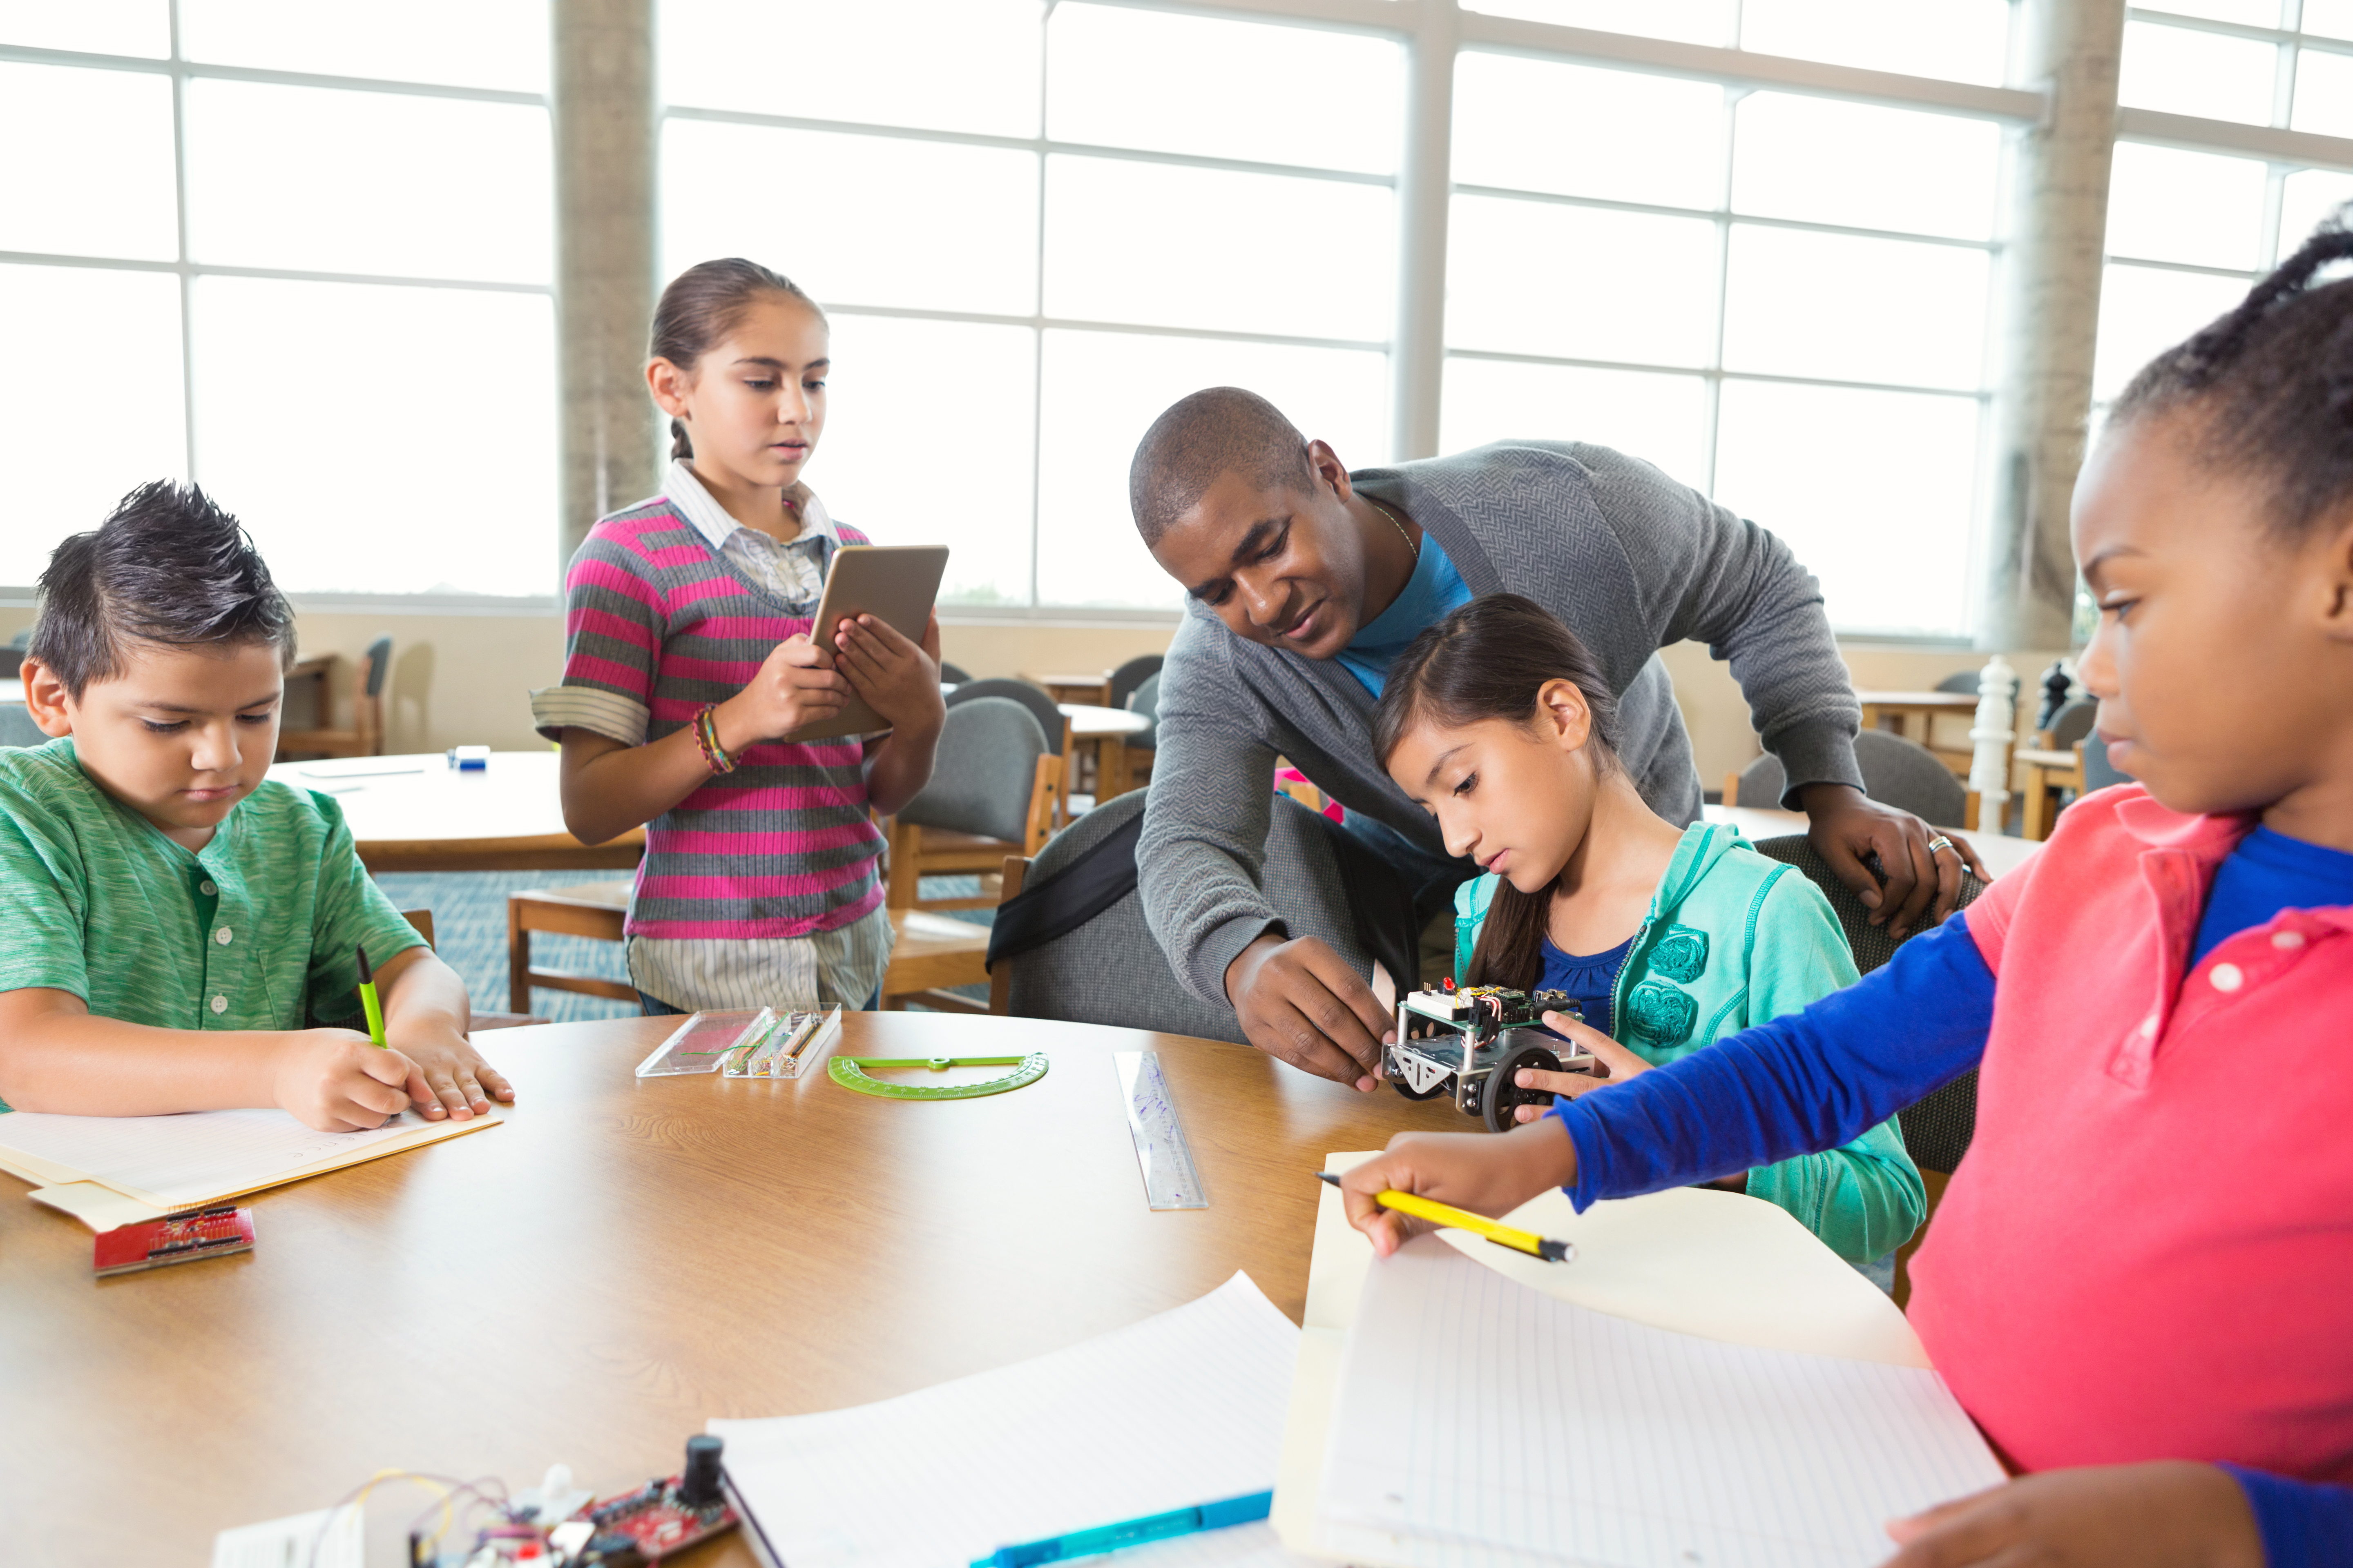


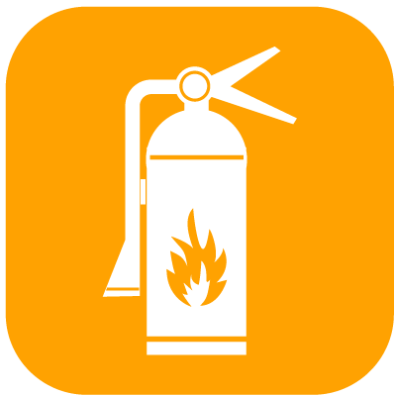
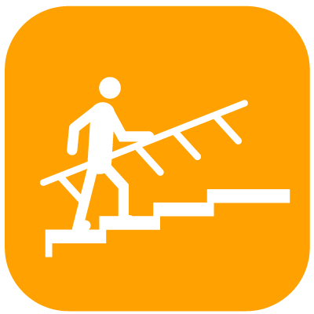
Building Safety Treasure Hunt
Notes:
Building Safety Treasure Hunt – Break students into teams. Have each team go on a walking field trip of the school and find as many safety features in the building as they can, such as the exit signs, sprinklers, railings, energy efficient devices, etc. The students or the teacher can make a list of the items – or draw each of the items they find.
Alternate Treasure Hunt – Use a picture checklist to check off items.
For Virtual Classrooms – Have students turn on their cameras and go on a virtual tour to identify the safety features within their bedrooms or homes.

Slide 14




Building Challenge
Notes:
The concept: To create the tallest, most stable structure possible and determine what trends (aka building codes) yield the best results.
1. Setup (5 minutes): Provide each group of students with 30 marshmallows (stale is better) and 30 dull toothpicks (toothpicks can also be replaced by raw spaghetti). Set ground rules: no additional materials and a time limit for building.
2. Brainstorm & Plan (5 minutes): Ask students to discuss ideas within their groups. Encourage them to think about stability and height before they start building. They can sketch a quick plan if they’d like.
3. Build the Structure (15-20 minutes): Set a timer and let the students bring their ideas to life. Remind them to collaborate and test their structure’s stability as they build.
4. Measure & Evaluate (5 minutes): Once time is up, measure the height of each structure. Test their stability by giving them a gentle nudge. Discuss what made some designs more successful than others.
5. Reflect & Share (5 minutes): Have each group share their building process, challenges, and what they learned, and how this relates to how building codes are developed and implemented. Wrap up by celebrating their creativity and teamwork.

Slide 15
An Ode to Building Safety Month 2026 Coming Soon!

Slide 16

Other Building Safety Activities
Notes:
Posters – Students design their own Building Safety Month posters.
Essay – Students write an essay describing the importance of energy, sustainability and innovation.
Class Book – Students write/illustrate a class book about the importance of energy, sustainability and innovation.

Slide 17
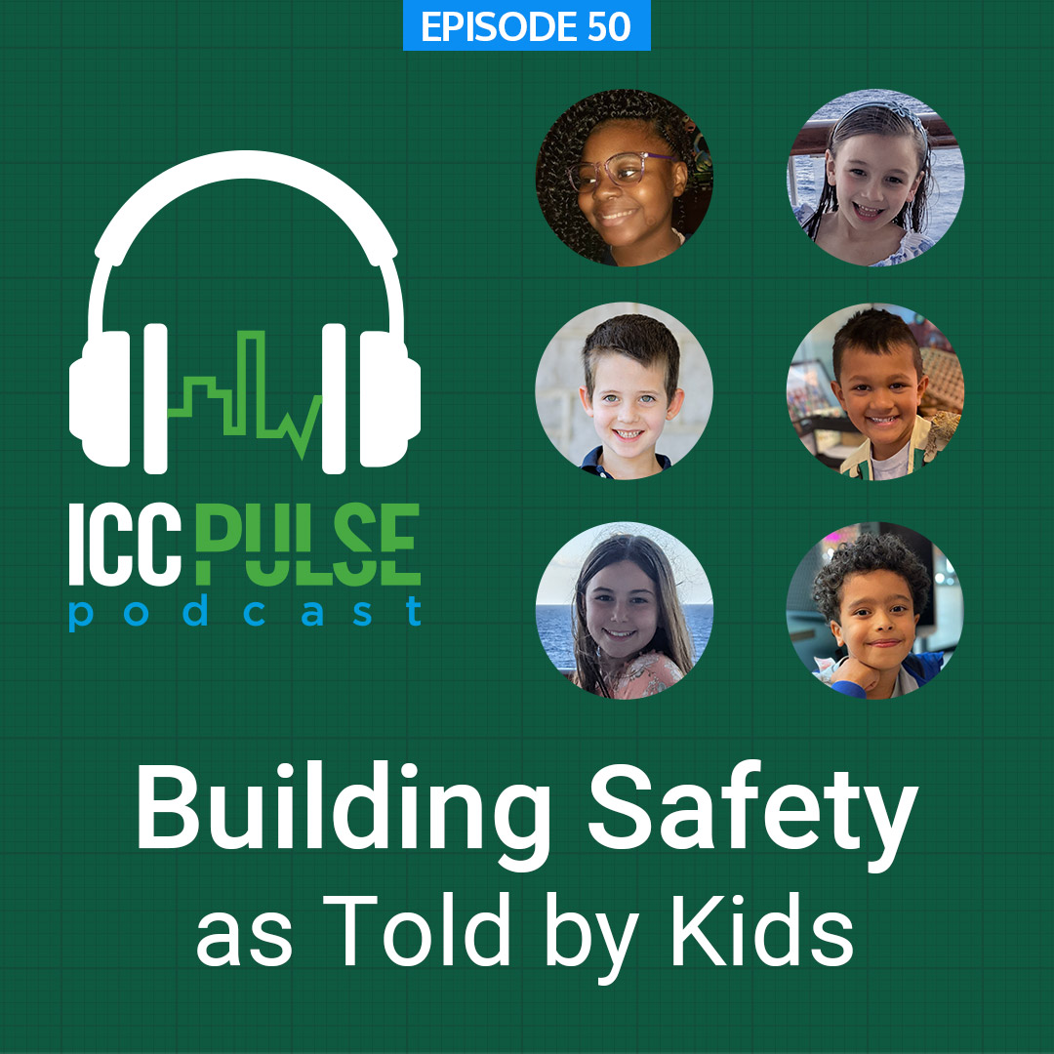
At-Home Activity: Building Safety in Your Home Checklist
Notes:
Send and email to parents recapping the Building Safety Month classroom activity, and include details about this at-home extension activity that they can do with their kids.
Building Safety as Told by Kids, an ICC Pulse Podcast episode, features children of Code Council staff exploring building safety in their homes. The podcast host gave five Code Council families an assignment to go through their homes with a checklist to take inventory of what building safety initiatives are achieved within their homes. She chatted with the kids afterward to see what they learned. Encourage families to listen to the podcast together, then print out the checklist and go on a walk around the house to find their own building safety initiatives. Encourage parents to discuss what they find, what's missing (and work together to fix, if appropriate) and what to do in case of an emergency.
Link to the ICC Pulse Podcast episode, Building Safety as Told by Kids: https://www.iccsafe.org/building-safety-journal/bsj-hits/icc-pulse-podcast-building-safety-as-told-by-kids/
Checklist for printing: https://www.iccsafe.org/wp-content/uploads/23-22360_COMM_22823_Pulse_Podcast_Branding_Doc_FINAL.pdf

